Slide 1
Safe & Appropriate Use of Behavior Supports & De-escalation Strategies
“The manner by which we treat people in our personal and occupational lives reflects or denies the truth of our commitment to human dignity and respect for individual worth.”
~Roger MacNamara

Slide 2
Training Objectives:
Recognize
the importance of building positive healthy relationships.
Understand
challenging behaviors and the importance of observing the individual.
Learn
how to create a safe environment and demonstrate safe staff behaviors.
Understand
only after all nonverbal and verbal measures have been exhausted, can physical intervention for the sake of protection only be used.
Develop
techniques for effective incident minimization including recognizing triggers and signals, de-escalation strategies, disengagement techniques, and maintaining physical safety.
Notes:
READ SLIDE

Slide 3
Building Healthy Relationships
UCP’s philosophy is always “Putting People First.”
Based upon principle that EVERY PERSON deserves to be treated with dignity and respect – cannot be taken away because of someone's disability or subsequent behavior.
Disability affects what people do, NOT who they are.
Dignity + Respect + Honesty = Trust
Notes:
READ SLIDE

Slide 4
Tasks of Development
Need Met
Trust
Feel Relaxed
Security
Have Need
Express Need
Attachment
Need Unmet
Feel Restless
Anxious
Fearful
Notes:
Tasks of Development apply to growing as a child and developing relationships as we age. (Click)
When someone has a need, they will either be able to complete that need on their own or if they can not do so (click) they will need to find a way to express that need. This can be verbal/ non-verbal/behavioral. It is our job to learn how someone expresses their needs.
If we ignore them (click) their need will go unmet. This causes them to (click) have feelings of restlessness, anxiety, and fear.
But if we listen (click) we can help them meet their need. Once that need is met (click) they will feel relaxed. If they know that we will always meet the needs as quickly as possible we build trust. (click) They know that we as a caregiver can and will meet the needs, (Click) feelings of safety and security with the caregiver, and ultimately attachment is formed.

Slide 5
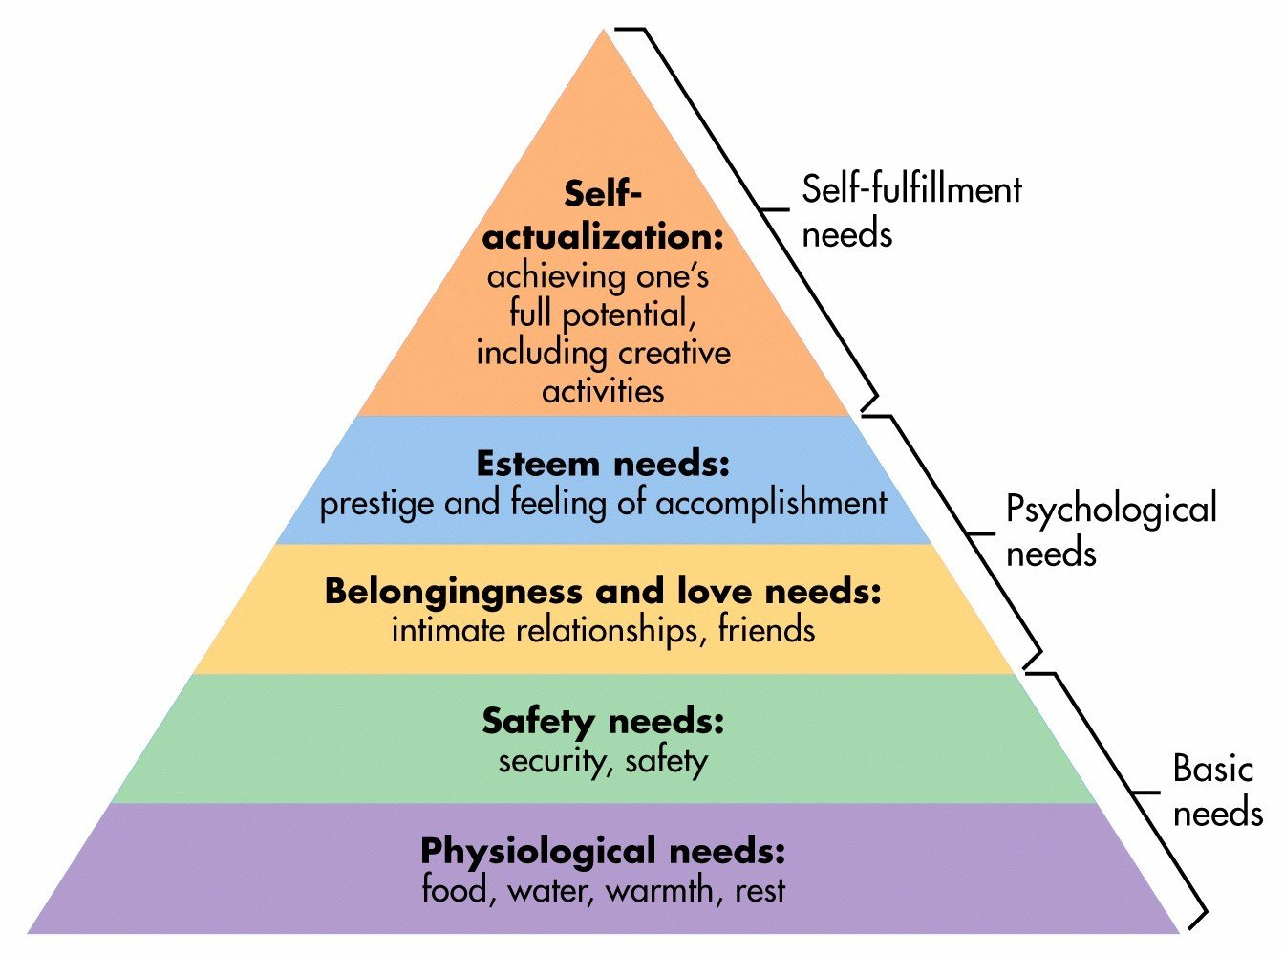
Maslow’s Hierarchy of Needs
www.simplypsychology.org/maslow.html
Notes:
ASK - What happens when basic needs aren’t met?
If you look at physiological needs (food, water, sleep) those are our most basic needs and if those needs are not met, we are not going to move to the next level of needs (feeling safe and secure). Think about what we need in our environment to feel secure. Probably a routine, consistency, not feeling threatened.
ASK - How can we expect someone with a disability who experiences constant change to feel secure?
It especially hard for our individuals to feel secure- we have a lot of staff turnover. Even with the same staff, the same person isn’t on each shift and so they are trying to adapt with the way each staff person works with them.
ASK - What do you think you might do if you always felt insecure and did not feel ‘in control’? Or having to rely on someone else to provide your basic needs?
People can and will NOT move higher on the pyramid until the prior needs are consistently met.

Slide 6
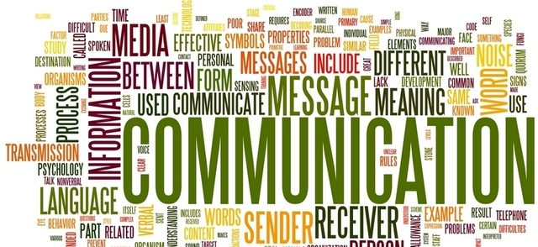
Safety Habits: Managing Staff (YOUR) Behavior
Behavior influences behavior!
NEVER PERSONALIZE! Treat with dignity & respect.
Evaluate importance of what you are trying to accomplish.
Most individuals do NOT want to hurt YOU. In most cases, with 15 seconds of delay through non-physical/evasive skills, the aggressive episode will de-escalate.
Notes:
READ SLIDE
Remember that Dignity + Respect + Honesty = Trust

Slide 7
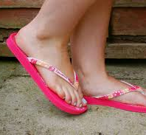
Safety Habits – Create a Safe Environment
DRESS FOR SAFETY:
Appropriate clothing (i.e., not low cut or too short)
Enclosed, comfortable footwear
Avoid loose items (i.e., jewelry, scarves, hair)
Glasses, if not needed
Perfumes
Notes:
READ SLIDE

Slide 8
Safety Habits – Create a Safe Environment
Minimize Clutter and Excessive Stimulation:
Dangerous objects
Objects that interfere with free movement
Cluttered surfaces/unnecessary objects
Loud noises
Overly crowded places
Notes:
READ SLIDE

Slide 9
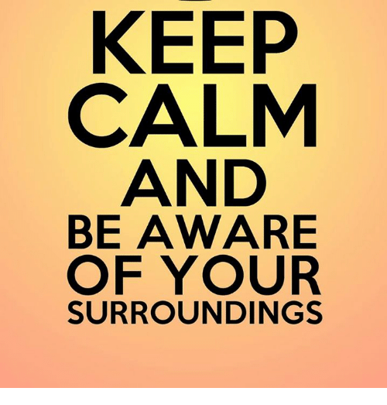
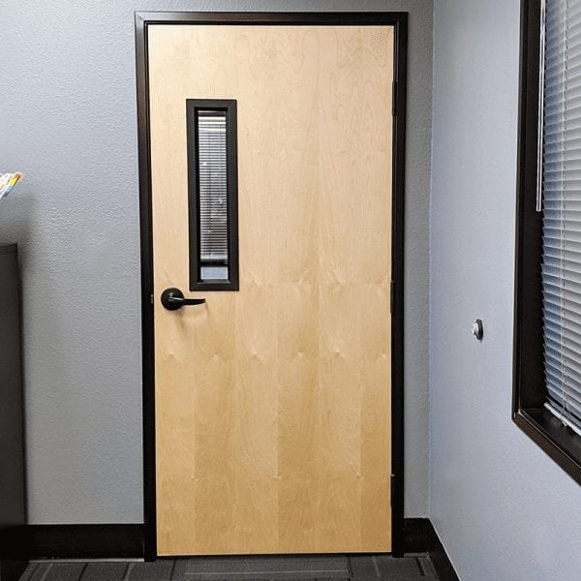
Safety Habits – Create a Safe Environment
KNOW WHERE YOU ARE:
Stop and scan the environment.
Know who is behind you at all times.
Know where the exits are and if the individual becomes anxious, position yourself between both.
Be aware of how and where you position your body (i.e., do not reach across or around individuals).
Notes:
READ SLIDE
Important to be aware of all exits in a building- don’t put yourself in a corner.

Slide 10
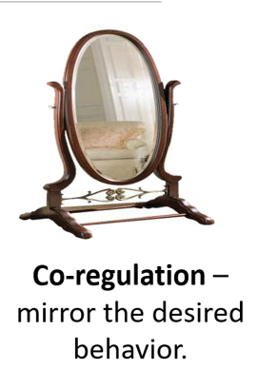
Characteristics: Cyclical
Individual's
Behavior
Staff’s Behavior
Stimulates
Individual’s
Thoughts/Feelings
Staff’s
Thoughts/Feelings
Notes:
The interaction Cycle explains how the individual feels and behaves effects how the Staff feel and behave. (Click)
The individual’s behavior positive or negative effects how the staff’s thoughts and feelings. (Click)
Those feelings and thoughts effects how the staffs acts/behaves (Click)
As Staff our behavior then effects how the Individual’s are feeling and thinking (Click)
How they feel and think effects how they act/behave.
By controlling how we behavior we can model for the individual’s how they themselves should behave. (Click)
For Co-regulation, the goal is to be a positive, professional example of how to cope and interact. When individuals look at us- they should see a model of how to behave.

Slide 11
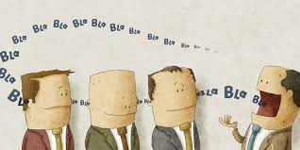
Managing Staff Behavior – Types of Communication
Verbal Communication – What You Say (& When You Say It)
Sometimes say nothing. Respect space.
Positive, concise phrases. Use accurate words.
Address by name.
Use questions whenever possible.
Praise appropriate behavior immediately. Give people attention when doing well.
Try to withhold attention for challenging behaviors. Redirect; do not ignore the person.
Notes:
READ SLIDE
#1 Many of the individuals we work with process things at a different speed. Give them time to understand what you said and come up with their response. Do not rush them or keep repeating yourself.
#3 speak to as Adult. No Hunny, Sweetie, Buddy, etc. If they have a nickname, they prefer you can use that after they tell you to.
#4 - Instead of “don’t you think you should clean that up?” say, “please clean that up” or “would you please clean that up?”
#5- Praise, Praise, Praise when they are doing something you want them to do. Especially if it is a behavior that replaces a negative one. Do not give attention to negative behavior. Many of our individual only get attention when they do something seen as negative and needs correcting. So, they continue to do those negative things. If we only give attention to positive then when they want attention they will do positive not negative. This takes time and commitment from everyone!

Slide 12
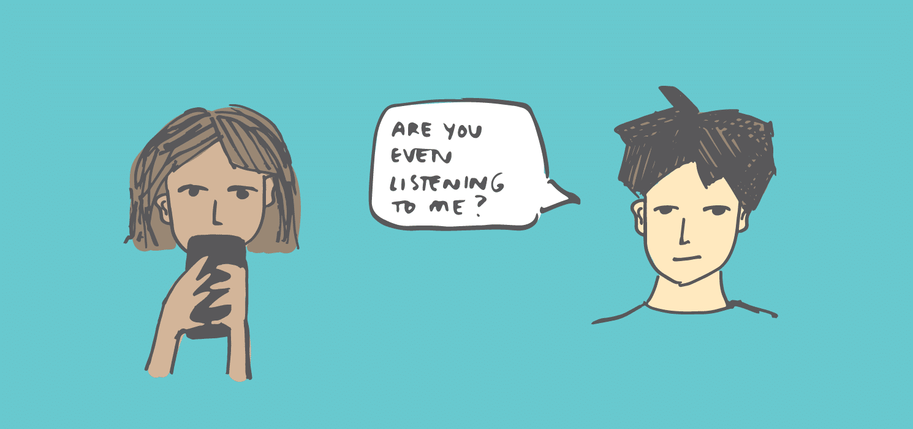
Managing Staff Behavior – Types of Communication
Verbal Communication
Ask for desired behavior (i.e., “handshake please,” not “do not grab at me”).
Avoid saying no, stop, calm down, relax – only cause anger. Avoid you messages.
Active listening – relax, show 100% interest, let person talk, be nonjudgmental, empathize, observe nonverbal communication. Paraphrase.
Use diversion or distraction. Encourage channeling feelings into activity.
Notes:
READ SLIDE
Read Slide
#7 we as humans tend to go negative. Break that habit. Ask for what you want not what they shouldn’t do. Example if you hand them a bowl of soup don’t say “ don’t spill this” instead when they are eating it talk to them about how they like the soup. Thank then for using their spoon.
#8 When you are upset has it ever helped for someone to tell you to relax, calm down, its not that bad? We shouldn’t be doing this to the individuals we work with either.

Slide 13
Managing Staff Behavior – Types of Communication
Verbal Communication
Verbal responses:
Answer ‘information seeking questions’ with a rational response.
Answer ‘challenging questions’ by sticking to the topic (redirecting), ignore the challenge (not the person).
Be careful of violating rights. Try redirection or share a natural consequence.
Use term ‘safe’ – “When you are being safe, then we can…”
Notes:
READ SLIDE
#11 Information seeking EXAMPLE- If individual asks “What time is it?” Don’t respond with “5pm…why?”. Just answer the question…”it is 5pm.” ‘Why’ in a response to answers often annoys people.
#11 Challenging questions EXAMPLE – Try to play down the challenge. Respond, do not react. “Doctor said you need to take your meds to stay healthy.”
#12 EXAMPLE – “When you are calm, we can go in the car.” “When you take your meds, we can go to the park.”
Take a break – try later!
Discuss NATURAL CONSEQUENCES

Slide 14
Effective Communication
--------
----------
---------------
USE “I” “WE” MESSAGES
“I know you can do this.” | vs. | “You better do this”
“I’d like to hear more.” | vs. | “Explain why you did this”
“Help me understand what is going on” | vs. | “What is wrong with you?”
“We can work this out” | vs. | “You need to calm down!”
“Can I help you?” | vs. | “You are doing this all wrong!”
Notes:
When we are talking with our individuals we need to use “I” and “We” messages instead of “You” statements. When we use “I”/”We” messages it conveys support and respect. Think a about which of the following you would respond to better. Which of these statements would make you feel respected and supported? Which makes you feel attacked or persecuted? (read out the statements)

Slide 15
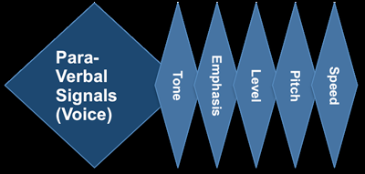
Managing Staff Behavior – Types of Communication (Verbal, Para-verbal, Non-verbal)
Para-verbal Communication - How You Say It
Tone – firm but not condescending, impatient, or aggressive
Volume – clear but not yelling
Cadence – even, calm
“Say what you mean, mean what you say, but don’t be mean when you say it.”
Notes:
READ SLIDE
How you say anything has a significant effect on how others perceive it.
EXAMPLE – Instead of sternly and loudly saying, “Please stop yelling.” Say firmly but softly, “I am right here and am listening to you, please speak softer/quieter.”

Slide 16
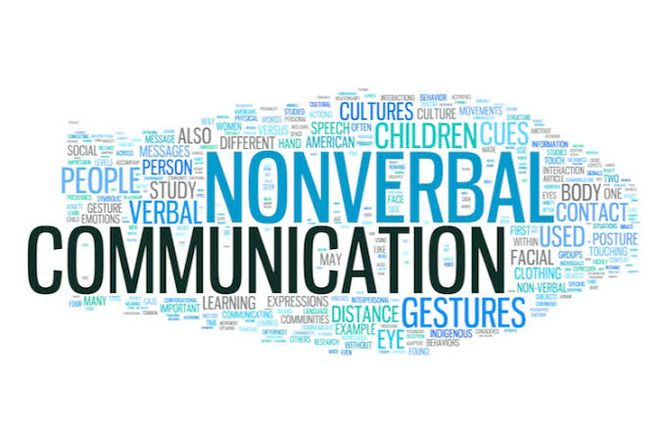
Managing Staff Behavior – Types of Communication
Non-verbal Communication – What Your Body is Saying
Distance: 4-5 ft. in front/behind; 3-4 ft. to the side.
Approach from side, whenever possible.
Avoid invading personal space.
Movement: moderate pace = calm fast pace = threat/panic
Even in a crisis, be mindful of your pace (except for safety).
Touch perception: Can be perceived as threatening. Consider trauma history. Ask permission.
Body language: Be aware of your posture, arms, chin, eye contact, facial expressions.
Notes:
READ SLIDE
Consider the 3P’s – Position, Posture, Proximity
#1. Social Zone is approx. 4-12 ft. away from another person (where ‘casual conversations’ occur). Personal zone is 2-4 ft. Intimate zone is less than 2 ft.
Most people can tolerate someone standing/approaching at a closer distance when you are at their side compared to being directly in front or behind them.
#4. Fidgeting can relay that you are tense.

Slide 17
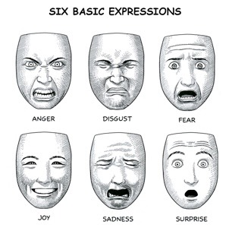
Managing Staff Behavior – Types of Communication (Verbal, Para-verbal, Non-verbal)
Non-verbal Communication
5. Watch your cues!
Calm facial expression – most of the time. Positive.
Poker facial expression – if participant becomes agitated.
https://www.erasmatazz.com/library/design-diaries/design-diary-siboot/september-2014/moods-and-facial-expression.html
Notes:
READ SLIDE

Slide 18
Individual Support Plan (ISP)
Understanding of the ISP is required prior to working with a new individual.
Getting to know people and developing a relationship requires knowing the ISP, especially understanding their history and the know and do sections.
Notes:
READ SLIDE
It is also important to read and understand any Social, Emotional, and Environmental Needs (SEEN) plans and/or behavior plans.

Slide 19
Understanding Challenging Behaviors
Individuals with developmental disabilities sometimes display challenging behavior, such as aggression or self-injury due to medical, psychiatric, or neurological conditions.
As support professionals, we must ask ourselves:
How do I always maintain safety for all?
How do I recognize the early warning signs that a person’s behavior may escalate?
How can I intervene effectively before the person’s behavior becomes dangerous?
If a person does become aggressive, how can I best control the situation?
Notes:
READ SLIDE

Slide 20
Characteristics: Function
The function (i.e., purpose) of behavior is
what an individual is trying to get or avoid.
To Get Something | To Avoid Something
I yell and throw things so others will look at me. | I take bathroom breaks during Math class because I am not good at Math.
I show people my artwork because I like hearing them say good things about it. | I don’t use profanity, so people don’t think less of me.
I repeatedly pinch my skin when I am bored. | I elope when there is a lot of noise in the environment.
I ignore staff asking me to clean up, so I have more time with my toys. | I hit the staff when he comes near because he smells like someone who hurt me in the past.
Notes:
The function of any behavior can be traced to one of 2 reasons or functions. We need to figure out what is the behavior trying to communicate. Is the individual trying to get something or avoid something. Read the examples have the students figure out what the person is getting or avoiding.
I yell and throw things because others look at me.
(get attention)
I show people my artwork because I like hearing them say good things about it. (get praise)
I repeatedly pinch my skin when I am bored.
(get sensory input)
I ignore staff asking me to clean up, so I have more time with my toys. (get tangible)
I take bathroom breaks during Math class because I am not good at Math. (avoid activity)
I don’t use profanity, so people don’t think less of me. (avoid feeling inferior)
I elope when there is a lot of noise in the environment. (avoid sensory)
I hit the staff when he comes near because he smells like someone who hurt me in the past. (avoid person)
Can you think of other examples of someone having a behavior and what they are getting or avoiding?

Slide 21
Defining Behavior-Criteria
Notes:
When we describe and document any behavior (or anything really) we need to use the “MOO” criteria.
It is measurable. There should be some way to measure the behavior (number of times, distance, duration, etc.)
The description is what you observed. When someone who wasn’t there when it happened reads your description it should create a picture in their mind of what occurred.
Objective is factual and free of opinions.

Slide 22
Defining Behavior-Activity
Subjective | Measurable, Observable, Objective
Poor Impulse Control | Yelled 7 Vulgarities in 15 seconds
Angry | Kicked a chair 6 times
Hostile | Threatened to attack anyone who approached
Resentful | Refused 3 activities when didn’t get a chance to choose
Non-compliant | Given 9 prompts in 50 seconds to complete task
Subjective (commonly found in our Program) | Measurable, Observable, Objective
Notes:
Group Activity: Many times, when writing notes, we use subjective or broad terms to describe what happened. When using the “MOO” criteria we need to document differently.
Here are a few examples of what someone had written in notes. (on the Left) beside them is how is could have been written using “MOO”.
Read over examples:
Ask students to come up with examples they have use themselves or have seen written that would be considered Subjective. Then go over how it should have been written.
Take a few minutes and go over suggestions.
We tend to only think of the things we see as negative. “MOO” can be applied to anything.
Example- Tara had a good day today. With MOO you would right Tara was smiling a lot today. She got her coat when prompted and walked to the van. She ate all of her lunch and threw away her trash with out being prompted.

Slide 23
Incident Minimization Detecting Antecedents and Predicting Behavior
Antecedents – whatever happens before a behavior.
Triggers (environmental)
Signals (behavioral)
PAY CLOSE ATTENTION…
early detection = earlier intervention
If you start to wonder if it’s time to call for help…IT IS!
Notes:
READ SLIDE. (Instructor, you need a can of soda ☺)
Soda Can Demonstration:
Tell the class to envision that the soda can is an individual who they support (you can name the can). Shake it. if they think it is safe to open it without it exploding. NO!
Ask: “Why not?” Answer: contents are under pressure now/will explode.
Although there was an obvious Trigger (instructor shaking the can) which started the crisis cycle, sometimes it is much more subtle and although we do not always see it, one is there.
People are much like that can of soda. The two best gifts we can give to the people we serve when are under stress is TIME and GRACE. It takes much less time and effort to back off than it does to clean up an explosion.

Slide 24
Safety Habits – Individual Observation
AWARENESS and reading the person is important!
Carefully OBSERVE the individual while respecting space.
Watch for tension (i.e., facial, muscle).
Changes in behavior (i.e., positioning, pacing).
Always follow the person’s Individual Support Plan (ISP) & any behavior plans!
Notes:
READ SLIDE

Slide 25
The Crisis Cycle
Escalation
Signs: Physiological Changes, Getting Upset
What to do:
-Identify signs of agitation
-Offer Options
-Model coping strategies
-Use humor appropriately
-Set Safety expectations
Crisis
Signs: Kicking, Property
Destruction, Self Harm, Etc.
What to do:
-Focus on safety
-Give space, Stay Calm
-Least amount of interaction necessary for safety.
De-Escalation
Signs: Starting to calm
What to do:
-Focus on calming strategies
-Do Not rehash incident
-Structured cooling off
Stabilization
Signs: Completely calm
What to do:
-Show Respect and support
-Problem Solve
-Active listening
-Empathy
Trigger
Signs: Hungry, tired, Bored, Asked to preform Task, etc.
What to do:
-make task more enjoyable
-Removal of/from stress/stimuli
Baseline-Sign: Calm Behavior
-Provide reinforcement for appropriate behavior
-Practice calming techniques and coping strategies
-Support them in what they are doing
Notes:
The crisis cycle shows us that behaviors are temporary and sequential. Everyday “normal” for an individual is known as the baseline.
Baseline-Signs-Calm behavior- What do we do: *Reinforce appropriate behavior-Praise them when they are doing what we see as positive. *Work with them to practice calming techniques/strategies. Find out what may work for them. Once they are escalated, we can’t teach or show them something new. *Keep supporting them in what they are doing. (Click)
Trigger- When something occurs that causes them to start getting upset this is a trigger/antecedent. We need to keep an eye out for any know triggers. If we can remove these before they start to escalate, we will prevent the crisis. Things that can be triggers can be internal or external. Ex Hungry, tired, asked to do something, overstimulated. What can we do? Make tasks more enjoyable. Remove the stress/Stimuli. What we can look for is things like clenching of the jaw, making fists, pacing increased, etc. If we don’t remove the trigger they may start to Escalate (Click)
Escalation- This is when the individual is getting increasingly upset. Physiological changes start happening. What we can do-Identify signs of agitation. Offer options like other activities, having them go to a quiet room, sensory activities they enjoy. We can suggest and model any coping strategies they have in place. If they are someone who likes to joke, we can use humor appropriately. Not focused on them. Sometimes making fun of yourself can help. Set up safety expectations. These should already be in place. Things like going into sensory room when upset. Remind that we keep our hands to ourselves. Tell them what is expected not what they shouldn’t do. (Click)
Crisis- This is when they are is full blown behavior. They are seeing red. No longer thinking rationally they are in survival mode. Things like Kicking, hitting, property destruction, self harm. What should we do: Focus on safety of the individual, others around them, and ourselves. We should remove the individual in crisis to another room if we are able. If not remove anyone else in the room with them. Give them space. Make sure you stay out of arm and leg reach. Always stay facing them. We are going to use the least amount of interaction needed. The more we talk to them or interact the more upset they may get. (Click)
De-Escalation- This is when they begin to calm. Their breathing starts to slow. Behaviors start to slow or stop. They many times are tired and will need to sit. Some will start crying when all the adrenaline is leaving their system. What we can do: Focus on calming strategies they have in place. Keep them in a quiet calm setting away from others if you can. Do not rehash the incident! Give them time to have structured cooling off. By giving them their space but being near incase they need you or what to talk. (Click)
Stabilization- When they are completely calmed down. Not showing any signs of being upset. What can we do: Show them respect and support them where they are. Use your active listening and empathy. If they want to talk you can work on problem solving what caused the incident. If talking about it starts to make them upset stop! (Click)
When the individual is escalating staff needs to be aware of themselves. It is easy to let ourself escalate with the individual. This will only make things worse. We need to control our own responses verbal and non-verbal. Model the behavior we want from them. Make sure our body language is also non-threatening as well as our words. We can freak out on the inside but do everything possible to not let it show. We need the individual to come down and meet us not go up and meet them.
Think back to that soda can- When I shook it that was the trigger or antecedent.
After I shook it
Ask: “What stage of the Crisis Cycle is the person in?” Answer: Phase 3, Escalation
Ask: “When will it be safe to open it?” Allow answers.
Ask: “So after it has sat for a while? What stage is that in the Crisis Cycle?” Answer: Phase 4, De-escalation
Ask: “When I do open it after it has sat, what will happen?” Answer: it will be almost back to normal/baseline, which is Phase 5, Stabilization

Slide 26
The Crisis Cycle Phases
PHASES: | RESPONSES:
Baseline – personal best | Support them in what they are doing
Stimulation or trigger – transitional behavior | Removal of or from stress/stimuli
Escalation – incident | Offering options, then setting expectations for safety
Crisis – different for everyone | Least amount of interaction necessary for safety
De-escalation – cautious assessment | Structured cooling-off
Stabilization – processing | Active listening, empathy, support
Post-crisis – recovery | Observation and support
http://www.mandtsystem.com/
Notes:
READ BELOW:
Baseline phase – staff supporting in what they are doing. ADL’s.
Stimuli phase – staff remove of/from stimulus. Anxiety- staff offer support and an empathetic non-judgmental approach, listen, and allow time.
Escalation phase – staff offer potential options from baseline phase. (example: offer them activities that they enjoy.)
Crisis phase – staff offer least amount of interaction necessary for safety. (let them blow off steam while continuously observing individual and environment)
De-escalation phase – structured cool down. Decrease in physical and emotional energy (crying, apology)
Stabilization phase – active listening, empathy, support. Re-establish communication (debrief), non-judgmental. Don’t take it personal.
Post-Crisis phase – continue to observe and support.

Slide 27
Incident Minimization De-escalation
De-escalation Goals:
Maintain safety of all.
Avoid making situation worse or individual more agitated.
Decrease the crisis behavior.
If aggressive behavior is towards another person, staff may physically intervene with the least restrictive response as possible to ensure safety.
If the person has a written behavior plan, always follow the plan!
Notes:
READ SLIDE

Slide 28
Goal is to always use the least restrictive strategy possible!
De-escalation Strategies
Least Restrictive | Nonverbal
 | Verbal Encouragement
 | Verbal Discussion
Most Restrictive | Verbal Direction
Notes:
READ SLIDE

Slide 29
Non-Verbal Strategies Most often used for low level behaviors – off task, anxious, distracted, non-participation, etc. Effective use of nonverbal strategies prompts self-correction by the individual while minimizing the audience impact.
Planned ignoring - temporarily ignore inconsequential behavior (all staff must be consistent)
Signals - prompts that are either universally known or specifically taught to the individual in advance
Eye contact - purposeful, so they know staff is present
Facial expressions - smiling, frowning
Body language - use of posture, stance, and limbs to convey a message
Gestures - use of staff’s hands/arms/body to convey a message of approval, displeasure, support, etc.
Notes:
Read slide
Planned ignoring-Staff makes conscientious decision to temporarily ignore inconsequential behavior.
Signals include eye contact, facial expressions, body language, and gestures.

Slide 30
Non-Verbal Strategies Most often used for low level behaviors – off task, anxious, distracted, non-participation, etc. Effective use of nonverbal strategies prompts self-correction by the individual while minimizing the audience impact.
Environmental Prompts - Motion to specific thing in the environment to prompt individual (list of tasks on the wall, a chair, clock, etc.)
Sensory Strategies - Minimize external Stimuli by reducing the sensory stimulation (sights, sounds, etc.) Decompression Strategies (fidget toys)
Proximity Prompts - Moving Closer in a non-threatening manner.
Touch Prompts - Only to be used in a kind, supportive way with an individual with whom staff has a positive relationship.
Notes:
Read slide

Slide 31
Encouragement Strategies Most often used for low level behavior – off task, anxious, non-participation, etc. Volume slightly above normal, motivational tone, average rate.
Indicate Concern
Verbalize staff’s concern and support. “I believe in you.” “I’m concerned about you.”
Clear
Brief, simple prompts, 5 letters and 5 words or less.
“Let’s line up, please.” “Time to put away the books, please.”
Offer Assistance
Convey willingness to help. “Can we work on this together?” “Can I help you get started on the first one?”
Attempt to Divert Focus
Temporarily distract from the stressful task and return to it when appropriate. “Did you see the lightening last night?” Do you know what we are having for lunch today?”
Notes:
Read Slide
Indicate concern- Use those “I’ and “We” statements. No “you” statements.
Clear Language- One step at a time don’t give them a long list. Use language they understand. Give them time to process.
Offer Assistance- Know the individual if they would want help of if it would make them more upset to offer.
Attempt to Divert Focus- Temporary. Sometimes people just need to take a break from what is getting them upset them go back to it.

Slide 32
Encouragement Strategies Most often used for low level behavior – off task, anxious, non-participation, etc. Volume slightly above normal, motivational tone, average rate.
Recommend Replacement Behavior
Remind the individual to use pre-taught behavior which replaces the behavior of concern. Remember to positively reinforce its use (meet the function).
Offer Choices
Provide two choices and prompt the individual to choose one. “I know there are a lot of options, but let’s choose between coloring and reading.”
Appeal for Cooperation & Participation
Use your relationship to gain compliance. “Can you do this for me?”
Notes:
Read slide
Recommend Replacement Activity- can also be something else for a few minutes before returning to activity. Ex “I see you are frustrated with that craft. Why don’t we clean up the things we have already used and come back to it.” You may have to re-evaluate how they are doing an activity to make it something they can do with out getting overly frustrated. If it can’t be modified, then you may need to abandon that project and move on to something else. Don’t force someone to do something they clearly do not want to do.
Offer Choices- How many choices do you make in a day? How many choices do the individuals we work with make in a day?
A lot of the time they don’t get to make the choices we do. Someone tells then when to get up what to wear, what to eat, and where to go. It is our job to give them as many choices as we can. Something as simple as holding up 2 shirts and having them pick which one they want to wear. Asking them if they want to take their shower now or in 30 minutes.
Choices can be overwhelming at times. Like going to a restaurant that has a huge menu. We can help them by breaking it don into smaller choices. With big menu ask do you want breakfast food or lunch/dinner food? Do you want a sandwich or a hot meal? Giving 2 to 3 choices at a time gives them the opportunity to make their own choice without being overwhelmed.

Slide 33
Discussion Strategies Used for complaints, diffusing negative energy, prompting problem-solving, information-seeking. Lower volume, soothing tone, slower rate. Best conducted away from the group/activity.
Open-ended Questions & Phrases - Prompt the conversation to desired topic. “Can you tell me what happened when…”
Paraphrase - Restate what was said in a slightly different way to convey attentiveness and understanding. “So, what I hear you saying is…”
Validate - Express that it is ok to feel the way they felt (not validating the behavior). “I can see why you would feel that way.” “Everyone feels that way sometimes.”’
Minimal Encouragers & Pauses - Use small signals to communicate staff are listening and understanding. Use brief breaks to emphasize certain points.
Notes:
Read slide
Validate-Many of the individuals we work with have been told that they can’t do things. They shouldn’t have these feelings. They aren’t like everyone else. It is our job to validate them and let them know they can have these feelings. Everyone has them. Let them know we understand and can help them work through them.
Pauses-Giving people time to process before answering.

Slide 34
Discussion Strategies Used for complaints, diffusing negative energy, prompting problem-solving, information-seeking. Lower volume, soothing tone, slower rate. Best conducted away from the group/activity.
Perception Checking – 1. Describe behavior “I see your fists are clenched.”
2. Interpret “I think this means you’re angry.” 3. Clarification “Can you help me understand?”
Explore Solutions - Prompt their problem-solving. “What do you think you can do?” “What have you seen someone else successfully do in similar situations?”
Provide Feedback & Summarize - As discussion begins to conclude, fill in gaps and give appreciation for participation in conversation. “I’m glad we talked.” “Let’s review what we’ve discussed.”
Notes:
Read slide
Read
Perception Checking- Using statements to check your understanding of what the individuals' words or behavior means. Doing this makes sure we are understanding correctly what is going on with them. We need to avoid making assumptions.
Explore Solutions- Support the individual in brainstorming ways to handle a situation. We are not going to give them the answers prompt them to make their own decisions.
Provide Feedback and Summarize- Talk to the individual about what you observed. Part of the feedback can include identifying the behavior and its consequences. Only if the individual has started to calm down and wants to talk about it.

Slide 35
Direction Strategies Used for rule violations, threats, disruptive behaviors. Slightly above-average volume, stern tone, slower rate.
Reiterate Safety - Focus on the individual’s safety. “You are safe.” “No one here wants to hurt you.”
Benign Confrontation - Stating the expectation to everyone instead of one person. “I need everyone to sit down.” “I need everyone to line up.”’
Positive Problem-Solving - 5 steps: identify the problem, provide acceptable alternatives, prompt selections, share the plan, provide periodic feedback.
Redirection - Stating the desired expectation directly to the individual. “I need you to return to your seat.”
Notes:
Read slide
Positive Problem Solving Example- At lunch time Ray throws his milk against the wall and starts kicking the trash can. You pull him aside and ask if something happened that made him upset? He says I wanted chocolate milk. You can suggest things he could have done like asked for milk from the teacher. Have him choose one of the options given to him. Go over with him if he gets the wrong milk or anything next time, he is going to raise his hand and ask for what he wants when the teachers calls on him. Next time when he raises his hand and asks for a different milk. Tell him he did great you’re are proud of him for following his plan. ( we are the ones who give the options unlike Explore solutions where they come up with the plan)

Slide 36
Direction Strategies Used for rule violations, threats, disruptive behaviors. Slightly above-average volume, stern tone, slower rate.
Positive Correction - 5 steps: Praise, identify problem, state expectation, have expectation repeated, praise compliance. “You did a great job on yesterday’s assignment. You haven’t started on your worksheet. I need you to complete #’s 1 through 5. What is it I am asking you to do? Great work, thank you!”
Limit Setting - clearly, firmly stating what is expected. “We keep our hands to ourselves here.”
Consequence Reminder - Prompting the individual to think about their choices and what their behavior will choose for them. “You are right, you don’t have to do your assignment right now. What are you choosing to have happen if you do not?”
Notes:
Read Slide
Positive correction Example-You did a great job with the snowman craft the other day. I see you haven’t started the Christmas tree ornament. The first step is to paint the tree green and them pick the decorations. What do you need to do? That’s right. Great work your ornament is looking great!

Slide 37
Notes:
This slide shows where in the Crisis cycle it is most effective to use de-escalation strategies. When they are lower on the curve we use the less restrictive strategies. We can use these at any point in the crisis cycle. The key is not using the more restrictive ones when they are low.

Slide 38
R.A.D.A.R.
Recognize – that something is going on.
Assess – what is happening to everyone.
Decide – what to do after you have recognized and assessed.
Act – take the form of a verbal or physical response.
Review Results – evaluate results of actions.
R.A.D.A.R. is used by everyone every day to assess potential threats. Understanding helps us be aware of how we could appear threatening to others. If we maintain awareness of how everyone assesses potential threat, we can more easily manage our own behavior to be perceived as less threatening to others.
Notes:
Additional points to make while READING the slide -
Recognize - maybe you see something doesn’t look right, “gut” feeling
Assess - how are WE feeling? Asses the behavior of others and what their intentions are. Environment- are you inside or outside? Where are exits? A lot of people or only a few?
Decide - how to appropriately respond to situation based on the assessment you just made
Act- act on our decision in a way that will achieve the safest outcome
Review Results - was the assessment, decision, and action that I took successful for this situation?
Your RADAR should always be on, both in observing individuals and also being aware that individuals’ ‘RADARs’ are always on regarding their evaluation of us/environment, too.

Slide 39
Recognize Stage of R.A.D.A.R.
To recognize that something is going on, you need to…
Use all your senses
Use your knowledge of the person
Known triggers
Signs of agitation
If something doesn’t feel right, follow your ‘gut’
Notes:
READ SLIDE

Slide 40
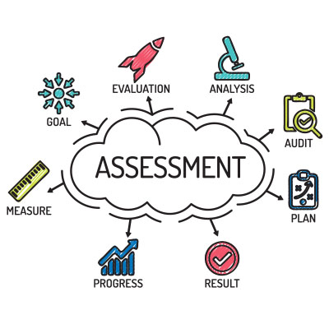
Assessment Stage of R.A.D.A.R.
Assessment is about assessing what is happening to everyone…
first starting with yourself,
then the person,
then the environment.
Notes:
READ SLIDE

Slide 41
Decide Stage of R.A.D.A.R.
Decide what to do after you have Recognized and Assessed…
Take what you noted in your assessment and use that to decide what the best plan of action is.
Don’t blindly leap in!
Notes:
READ SLIDE

Slide 42
Act Stage of R.A.D.A.R.
Actions take the form of a verbal response, a generalized physical response, or a specific physical response.
Safety During incidents
Leadership During incidents
Incident Minimization
Physical Safety
Types of Assistance
Notes:
READ SLIDE

Slide 43
Incident Minimization Safety During Incidents
Safety During Incidents:
Call for help, if needed
Identify leader
Move other participants away
Remove potential weapons
Safety Stance
Stay between individual & exit – use other barriers (i.e., furniture)
Talk quietly, if need to talk at all
Call 911 if situation becomes uncontrollable/dangerous
Notes:
READ SLIDE

Slide 44
Incident Minimization Leadership During Incidents
Teamwork
One lead staff only. Leader’s job is to:
Decide what to do.
Direct the other staff.
Leader is the only person who speaks to individual, unless the leader delegates the role.
Notes:
READ SLIDE

Slide 45
Incident Minimization Physical Safety
Guiding principles for physical intervention:
Least restrictive interaction needed to protect the person, you, or others.
Exhaust all verbal and non-verbal efforts first. Be able to document what you and the individual said/did prior to incident.
Physical interaction should only be used for disengagement and NOT to change behavior in situations where no protective need is present.
All physical interaction should be terminated as soon as the need is over.
Notes:
READ SLIDE

Slide 46
Incident Minimization Managing Staff Behavior
Non-verbal Communication – What Your Body is Saying
Safety Stance (Supportive Stance) – non-challenging posture
Position - where you are in relation to others
Posture - how you hold and move your body
Proximity - distance between individuals
www.qbscompanies.com/Safety-Care
Notes:
READ SLIDE
Supportive stance is important because it communicates respect, is non-threatening, and it maintains safety.

Slide 47
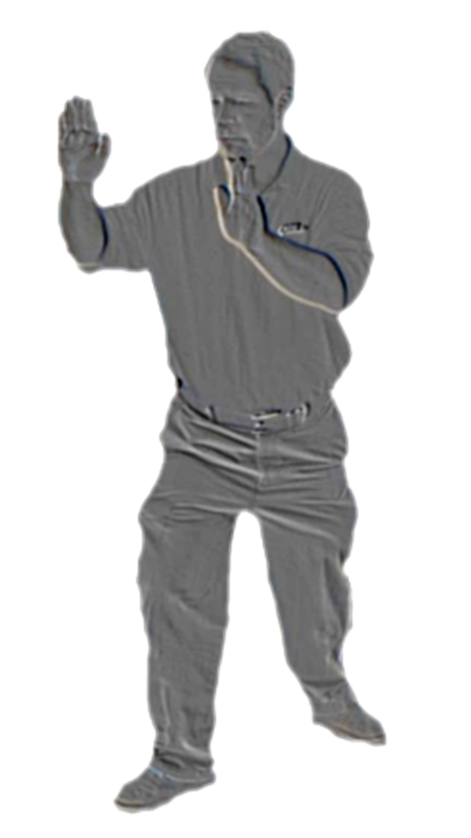
Incident Minimization Physical Safety
PROTECTIVE STANCE
Begin in Safety Stance.
Turn your stance to protect yourself if the person comes towards you.
Hands in front of your face, palms out, fingers together.
Use forearms for blocks.
Hands close to your head.
Do not grab!
Notes:
READ SLIDE
Reminder: Whenever possible, remember to use verbal and nonverbal de-escalation strategies.

Slide 48
Incident Minimization Physical Safety
SAFETY SHUFFLE
Start from Protective Stance.
Call for assistance!
Move your rear foot back first.
Shuffle front foot close to back foot.
Repeat to maintain safe distance.
If necessary, move unpredictably away from participant’s midline.
Never turn your back or get backed into a corner!
Notes:
READ SLIDE
Reminder: Whenever possible, remember to use verbal and nonverbal de-escalation strategies.

Slide 49
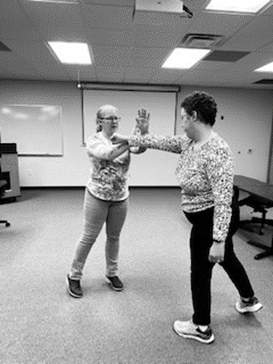
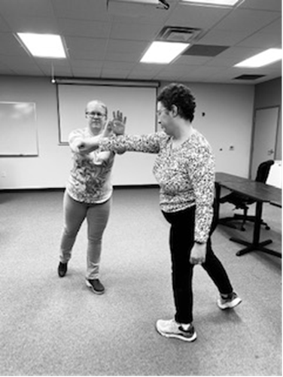
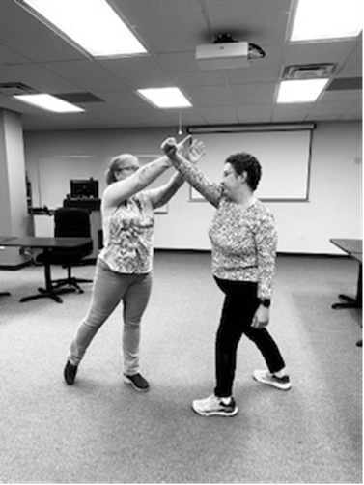
Pivot Parry / Evasion Deflection
Step back 90-degrees with your back foot.
Feet should be shoulder width apart, knees slightly bent.
With your hand open, use your arms to block/deflect.
Use your other arm to shield your face (open palm facing the individual).
Pivot – technique in which you move out of the way, in a defensive manner.
Parry – arm motion that coincides with the pivot to deflect a hit.
Notes:
ACTIVITY: Have learners partner up and gently take turns practicing the technique.
Reminder: Whenever possible, remember to use verbal and nonverbal de-escalation strategies. Call for help.

Slide 50
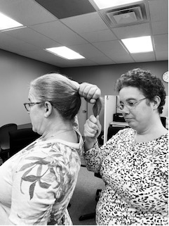
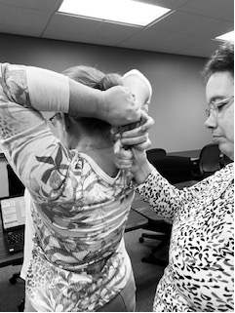
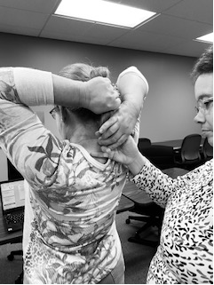
Hair Pull Escape – End of Long Hair
Grasp your own hair inside the person’s grip and pull your hair tightly to your head.
Use your own hand to perform a finger peel.
If a finger peel cannot be performed, remain holding your own hair until help arrives. Do not try to pull away from the individual.
Notes:
ACTIVITY: Have learners partner up and gently take turns practicing the techniques.
Reminder: Whenever possible, remember to use verbal and nonverbal de-escalation strategies. “PLEASE LET ME GO.” Call for help.

Slide 51
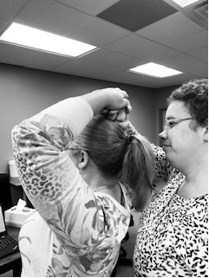
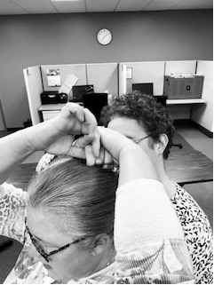
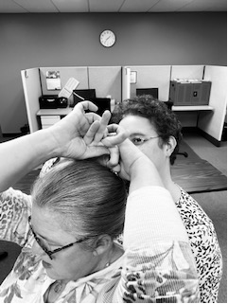
Hair Pull Escape – Close to Scalp
Use both hands to compress the person’s hands to your head (don’t interlock your fingers).
Protect your face with your arms.
Use a finger peel and remove one hand at a time.
Once released, move to safety.
Notes:
ACTIVITY: Have learners partner up and gently take turns practicing the techniques.
Reminder: Whenever possible, remember to use verbal and nonverbal de-escalation strategies. “Please let me go.” Call for help.

Slide 52
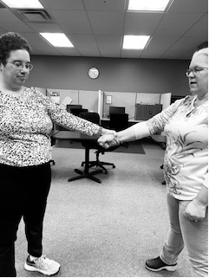
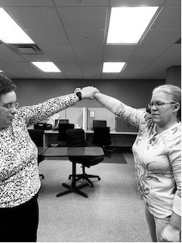
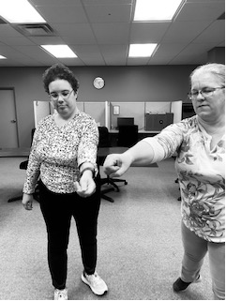
Single Wrist Grab Escape – Make a Circle
Make a large circle with your grasped arm in the direction of the holding thumb until the grab is released.
Step or pivot back to safety.
All wrist grab escapes begin with identifying the location of the individual’s grabbing thumb(s).
Notes:
Consider the intention of the grab. Safety? Getting your attention? Trying to hurt you?
ACTIVITY: Have learners partner up and gently take turns practicing the techniques.
Reminder: Whenever possible, remember to use verbal and nonverbal de-escalation strategies. Tell the person “PLEASE LET ME GO.” Call for help.

Slide 53
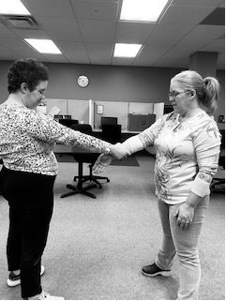
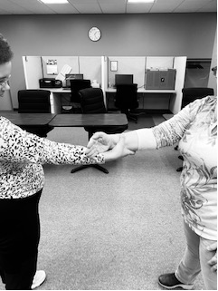
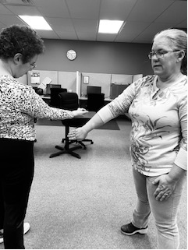
Single Wrist Grab Escape – Finger Roll
Make your grasped hand rigid and turn your wrist so the edge of your little finger can be placed on the person’s arm.
Roll your hand in the direction of the person’s grasping thumb.
Parry the person’s arm to escape and step/pivot forward to safety.
Step or pivot back to safety.
Wrist grab escapes begin with identifying the location of the individual’s grabbing thumb(s).
Notes:
ACTIVITY: Have learners partner up and gently take turns practicing the techniques.
Consider the intention of the grab. Safety? Getting your attention? Trying to hurt you?
Reminder: Whenever possible, remember to use verbal and nonverbal de-escalation strategies. Tell the person “PLEASE LET ME GO.” Call for help.

Slide 54
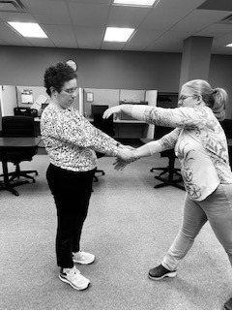
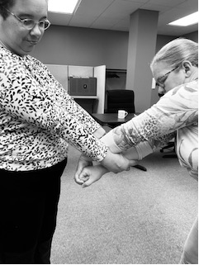
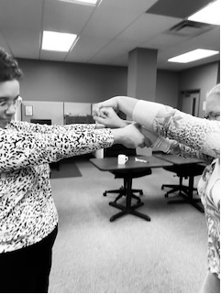
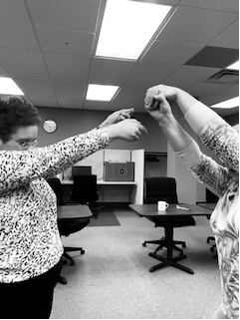
Two-Hand Wrist Grab Escape – Thumbs on Top
Make a fist with your grasped hand.
Use your free hand to reach over and through the person’s arms and secure your own fist.
Make a slight downward motion and pull your fist over your shoulder.
Step/pivot to safety.
Wrist grab escapes begin with identifying the location of the individual’s grabbing thumb(s).
Notes:
ACTIVITY: Have learners partner up and gently take turns practicing the techniques.
Reminder: Whenever possible, remember to use verbal and nonverbal de-escalation strategies. Tell the person “ PLEASE LET ME GO.” Call for help.

Slide 55
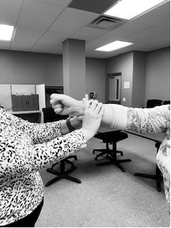
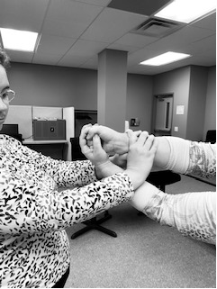
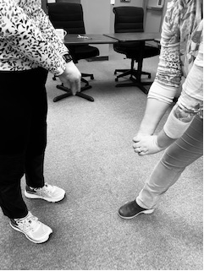
Two-Hand Wrist Grab Escape – Thumbs on Bottom
Make a fist with your grasped hand.
Use your free hand to reach under and through the person’s arms and secure your fist.
Turn your hips towards your back foot and pull your fist down toward your front leg.
Step/pivot to safety.
Wrist grab escapes begins with identifying the location of the individual’s grabbing thumb(s).
Notes:
ACTIVITY: Have learners partner up and gently take turns practicing the techniques.
Reminder: Whenever possible, remember to use verbal and nonverbal de-escalation strategies. Tell the person “ PLEASE LET ME GO.” Call for help.

Slide 56
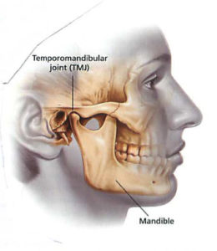
Bite Escape
Push into bite – do not pull away.
Place the index finger knuckle against the individuals jaw hinge.
Rotate your knuckle into the hinge.
As the individual opens their mouth, remove body part and pivot away.
Notes:
ACTIVITY: have learners gently attempt the technique/s on themselves, not with a partner.
#2 - The closer the body part can get to the person’s jaw hinge, the more the bit is neutralized.
Reminder: Whenever possible, remember to use verbal and nonverbal de-escalation strategies. Tell the person “PLEASE LET ME GO.” Call for help.

Slide 57
Review Results Stage of R.A.D.A.R.
Review Results – evaluate the results of actions. Did you achieve the goals of your action/s and if not, what is the next step?
Documentation
Debriefing
ABC Chart
*Remember, your R.A.D.A.R. should always be on, both in observing individuals and being aware that individuals’ R.A.D.A.R.’ is always on regarding their evaluation of us and their environment, too.
Notes:
READ SLIDE

Slide 58
Documentation of Physical Incident
Each incident of physical interaction must be documented after the incident, and an incident report must be filed in the individual’s permanent file.
All uses of non-physical and physical interaction must be documented to demonstrate that physical interaction was a last resort.
Document what happened before, during, and after the incident.
Any injuries sustained during physical interactions must be reported to supervisor.
Be careful of language used when documenting - should be same as what was said. For example, not “Told him to go to his room” but “I asked him to please go to his room to be safe.”
If there is a Behavior Support Plan, document on Antecedent-Behavior-Consequence (ABC) Chart, as well.
Notes:
READ SLIDE

Slide 59
Date Time
Date | Time | Antecedent | Behavior | Consequent
(Date it happened) | (Time it happened) | (What just happened before) | (What intervention) | (What happened after)
Why gather this information?
A-B-C Chart helps us to track and evaluate what occurred.
A – What was happening before the behavior, including where it happened?
B – What was the behavior? Who was involved? Was property or others harmed?
C – What occurred after the behavior was over? Any natural consequences?
Notes:
READ SLIDE
C- Also evaluating if the actions made things better, worse, or not impactful at all.

Slide 60
Debriefing (Processing) After an Incident
After an incident, it is important to debrief/evaluate the incident with team members. What worked? What could have been done differently?
Goal is to communicate to decrease/eliminate future incidents.
Debriefing is to occur after documentation. What could’ve been done differently?
Discuss with staff involved. How are you coping? Feeling?
Consider individual. How are they coping? Feeling?
Notes:
READ SLIDE

Slide 61
UCP Central PA’s Positive Intervention/ Restrictive Procedure Policy
Notes:
HAND OUT copy of UCP Central PA Positive Intervention/Restrictive Procedure Policy and briefly review.

Slide 62
Safe & Appropriate Use of Behavior Supports & De-escalation Strategies
Create a Safe Environment
Remember the importance of observing individuals
Manage YOUR behavior (verbal, para-verbal, non-verbal, cues)
Use nonverbal and verbal de-escalation strategies (least restrictive interaction needed to protect everyone).
Use your R.A.D.A.R. and recall the Crisis Cycle (be alert for antecedents and predict behaviors)
Practice physical safety during incidents
We are Mandated Reporters!
Notes:
READ SLIDE
R.A.D.AR. – Recognize, Assess, Decide, Act, Review Results
Baseline phase – staff supporting in what they are doing. ADL’s.
Stimuli phase – staff remove of/from stimulus. Anxiety- staff offer support and an empathetic non-judgmental approach, listen, and allow time.
Escalation phase – staff offer potential options from baseline phase. (example: offer them activities that they enjoy.)
Crisis phase – staff offer least amount of interaction necessary for safety. (let them blow off steam while continuously observing individual and environment)
De-escalation phase – structured cool down. Decrease in physical and emotional energy (crying, apology)
Stabilization phase – active listening, empathy, support. Re-establish communication (debrief), non-judgmental. Don’t take it personal.
Post-Crisis phase – continue to observe and support.

Slide 63
QUESTIONS? THANK YOU for your participation! ☺
References
Safety Care, Quality Behavioral Solutions to Complex Behavior Problems™. https://www.qbscompanies.com/Safety-Care.
cpi, nonviolent crisis intervention. https://www.crisisprevention.com/.
Mandt System, Inc. http://www.mandtsystem.com/.
Safe Crisis Management, https://safecrisismanagement.com/.
Notes:
1. Have students complete their Student Certification Form
2. Scan roster & forms to T:\Operations\Upcoming Training Rosters\De-Escalation Training\Rosters
3. Make copies of forms for HR. Students may keep their signed form.

