Slide 1
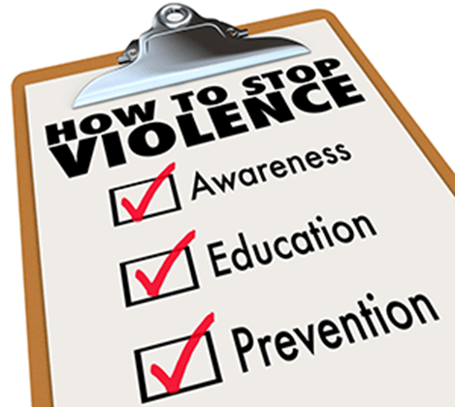
Workplace Violence Prevention & Awareness

Slide 2
Training Objectives:
Review UCP’s Workplace Violence Prevention Policy.
Understand Workplace Violence Prevention Reporting and Action Steps.
Understand Imminent Risk of Violence or Potential Life-threatening Situation Action Steps.
Review UCP’s Weapons Free Workplace Policy.
Recognize how best to respond in an active shooter situation.
Review UCP’s Emergency Response Guide’s protocols for Reporting Emergencies and Active Shooter/Other Assailant.
Notes:
(ASK SOMEONE TO READ the Workplace Violence Prevention & Awareness training objectives)
Although we will spend some time reviewing how to respond in an active shooter/other assailant situation, the goal of this and any workplace violence prevention training & awareness is to stress the importance of proactively recognizing and potentially preventing violence before it happens and to a large degree, that requires being fully present and aware of our surroundings (not staring at our phones!).
However, even with the best training, violence can occur and we need to be prepared.

Slide 3
Workplace Violence Prevention Policy (Employee Handbook, p. 192-196)
Policy Statement:
By helping to identify and prevent threatening or violent behavior affecting the workplace, UCP demonstrates its commitment to maintaining a workplace safe and free of threats or acts of violence for all employees, participants, visitors, vendors, and volunteers.
Notes:
UCP has a Workplace Violence Prevention Policy for employees to follow. You are welcome to review anytime in your Employee Handbook.
VOLUNTEER TO READ the Policy Statement

Slide 4
Workplace Violence Prevention Policy (Employee Handbook, p. 192-196)
Procedures: Conduct that threatens, intimidates, stalks, harasses, or coerces employees, participants, visitors, vendors, or volunteers, will not be tolerated. Any employee who commits an act of workplace violence against a person or property will face immediate suspension and probable termination. Where appropriate, these matters will be referred to legal authorities for prosecution.
Any threats or acts of violence resulting in the conviction of a person, under any criminal code provision relating to threats or acts of violence that adversely affect the legitimate interests of UCP will not be tolerated and may be grounds for termination.
Notes:
VOLUNTEER to read slide

Slide 5
Workplace Violence Prevention Policy (Employee Handbook, p. 192-196)
Procedures (continued):
Employees should promptly inform HR of any protective or restraining order that they have obtained that lists the workplace as a protected area.
UCP encourages employees to bring their workplace disputes to their Supervisor or HR before the situation escalates. UCP will not discipline employees for raising good-faith concerns.
Incidents on the job that cause physical or psychological injury must be reported as a Worker’s Compensation incident in addition to other incident reporting procedures.
Notes:
VOLUNTEER to read slide

Slide 6
Workplace Violence Prevention – Warning Signs, Symptoms & Risk Factors (Employee Handbook, p. 192-196)
Intimidating statements – Ex: “I’ll get even,” “they’ll be sorry.”
Angry stares, loud, profane.
Intense anger, lack of empathy.
Brooding, depressed, strange behavior, “time bomb.”
Disgruntled ex- or current employee.
Keeps records of employees.
Social media threats/violence.
History of personal conflict.
Domestic problems or unstable family.
Volatile or violent personal situations.
Comments about gun knowledge.
Reads materials w/themes of violence, revenge.
Obsession with co-worker.
Notes:
This is a non-exhaustive list of examples of warning signs, symptoms, and risk factors for workplace violence. UCP’s handbook has a more comprehensive list that you can reference on page 192 or 193 (depending upon version) of your handbook. That full list is as follows:
Threatening social media posts.
Possessing reading material with themes of violence, revenge, and harassment.
Making intimidating statements such as: “I’ll get even” or “You haven’t heard the last from me.”
Dropping hints about knowledge of firearms.
Keeping individual records of other employees, the individual believes have violated UCP policy.
Physical signs of hard breathing, reddening of complexion, menacing stares, loudness, fast profane speech.
Disgruntled employee or ex-employee who is excessively bitter.
Being a loner.
Having a romantic obsession with a co-worker who does not share that interest.
History of interpersonal conflict.
Intense anger, lack of empathy.
Domestic problems, unstable/dysfunctional family.
Volatile or violent personal situations such as found in some custody battles.
Brooding, depressed, strange behavior, “time bomb ready to go off.”
Not all of these as stand-alone signs are concerning but sometimes it is a combination that creates more concern.

Slide 7
Workplace Violence Prevention – Reporting & Action Steps (Employee Handbook, p. 192-196)
All employees must immediately verbally report threatening behavior!
Threats of Violence, Action Steps:
Employees must immediately verbally report concerns to the supervisor or other manager (if immediate supervisor is not available).
When reporting concerns, employees should be as specific and detailed as possible.
Supervisor must immediately verbally notify HR.
Ensure safety of staff/participants.
Notes:
All employees must verbally report observed warning signs, symptoms, and risk factors immediately.
It is everyone’s responsibility to be aware of and appropriately respond to these early warning signs. IF YOU SEE SOMETHING SAY SOMETHING
Employees must immediately verbally report concerns to his or her Supervisor; or a management level supervisory employee if the immediate Supervisor is not available.
When reporting concerns, employees should be as specific and detailed as possible.
The Supervisor must then immediately verbally notify the Human Resources Department.
Supervisors especially must be alert to and respond to these behavioral indicators. If an employee exhibits such behavior, the employee may be monitored, and such behavior will be documented according to approved procedures.

Slide 8
Workplace Violence Prevention – Examples of Threatening Behavior (Employee Handbook, p. 192-196)
Verbal or physical harassment or threats.
Assaults or other violence.
Behavior that causes others to feel unsafe.
Throwing objects.
Making a verbal threat to harm someone or property.
Destroying UCP property.
Sending harassing or threatening letters, emails.
Possession of weapons or dangerous devices.
Menacing gestures.
Intense or obsessive romantic interest.
Attempt to intimidate.
Any behavior that causes concern someone might act violently.
Notes:
This is a non-exhaustive list of examples of threatening behavior. Our handbook has a more comprehensive list you can reference.
Verbal or physical harassment.
Verbal or physical threats.
Assaults or other violence (i.e. hitting or shoving another person).
Behavior that causes others to feel unsafe (i.e. bullying, sexual harassment).
Throwing objects.
Making a verbal threat to harm another individual or destroy property.
The intentional destruction of property owned, operated, or controlled by UCP.
Making harassing or threatening telephone calls or sending harassing or threatening letters or other forms of written or electronic communications.
Possession or inappropriate use of firearms, weapons, or any other dangerous devices in violation of the Weapons-Free Workplace policy.
Making menacing gestures.
Displaying an intense or obsessive romantic interest that exceeds the normal bounds of interpersonal interest.
Attempting to intimidate or harass other individuals.
Behavior that, from the perspective of a reasonable person, has generated a concern that someone might act out violently (whether the person intends to or does).

Slide 9
Threats of Violence Action Steps
Ensure the safety of participants and staff
Verbally notify supervisor/management
When reporting a threat of violence, the employee should be as specific and detailed as possible
Do not place self in harms way
Supervisor immediately verbally notify HR
Notes:
If an employee becomes aware of any threat of violence, these action steps should be taken:
Ensure the safety of participants and staff.
The employee must immediately verbally report the incident to the Supervisor or a management level supervisory employee if the immediate Supervisor is not available.
When reporting a threat of violence, the employee should be as specific and detailed as possible.
Employees should not place themselves in peril, nor should they attempt to intercede during an incident.
The Supervisor must then immediately verbally notify the Director of Human Resources or a member of the Human Resources Department.
As a note, if the situation worsens or there appears to be imminent risk of violence, immediately call 911!

Slide 10
Imminent Risk or Actual Occurrence of Violence Action Steps
Avoid danger zone by moving staff/participants away and CALL 911!
If participant creating situation, attempt de-escalation. If not possible, safely isolate participant and CALL 911.
Verbally notify supervisor/management as soon as you have exited immediate danger
Do not place self in harms way
Supervisor immediately verbally notify HR
Notes:
If an employee becomes aware of any act of violence about to happen, or violence is occurring, the employee should take these steps:
Try to avoid danger by moving staff or participants away and immediately contact local law enforcement by dialing 911.
If a participant is creating a threating situation, try to deescalate but if this is not possible, safely isolate the participant and call 911 (let them know it is an individual with a diagnosis).
Immediately after contacting the law enforcement authorities for emergency assistance, the employee must report the incident verbally to his or her Supervisor or a management. The Supervisor must then immediately verbally notify the Director of Human Resources or a member of the Human Resources Department.
When reporting a threat or incident of violence, the employee should be as specific and detailed as possible.
Employees should not place themselves in peril, nor should they attempt to intercede during an incident.
Shortly we will discuss active shooter/other assailant situation.

Slide 11
Weapons Free Workplace Policy (Employee Handbook, p. 191)
Employees are prohibited from carrying a weapon while in the course and scope of performing their job, whether on or not on UCP property, and whether they are licensed to carry or not. Includes: firearms, ammunition, high-powered archery, illegal knives, pepper spray.
Immediately report knowledge of possession of weapons by staff or participant!
Notes:
UCP has a WEAPONS-FREE WORKPLACE policy to ensure that we maintain a workplace safe and free of violence for all employees, participants, visitors, volunteers, and vendors. UCP prohibits the possession or use of dangerous weapons on company property, unless otherwise allowed by law. Employees are prohibited from possessing a weapon on their person while on UCP property, while using company owned or leased vehicles, or during their employment with UCP.
Prohibited weapons include any form of weapon or explosive restricted under local, state, or federal regulation. This includes, but is not limited to, firearms, ammunition, high-powered archery equipment, illegal knives or other weapons covered by the law. Legal, chemical dispensing devices such as pepper sprays that are sold commercially for personal protection are not covered by this policy. Any question about whether an item is covered by this policy shall be resolved by the HR department.
Employees are required to immediately report to their Supervisor or Director any weapons that a staff member, participant or a participant’s friend or family member brings onto UCP property.

Slide 12
UCP’s Emergency Response Guide: Reporting Emergencies
What You Should KNOW:
In emergency situations, you might be the first line of defense. Know that others will take their cues from you. Act accordingly.
What You Should DO:
First and foremost: See something, say something. Trust your gut instinct.
Check the scene around you. If safe to do so, move yourself and others to safety. A safe location has been pre-determined for all UCP locations. Know it.
Notes:
UCP’s Emergency Response Guide details general guidance on what we should do in the event of any emergency –
ASK SOMEONE TO READ
What You Should KNOW:
In emergency situations, you might be the first line of defense. Know that others will take their cues from you. Act accordingly.
What You Should DO:
First and foremost: See something, say something. Trust your gut instinct.
Check the scene around you. If safe to do so, move yourself and others to safety. A safe location has been pre-determined for all UCP locations. Know it.

Slide 13
UCP’s Emergency Response Guide: Reporting Emergencies
Call 911 at the first opportunity.
Be prepared to give your location and the nature of the emergency.
Care for affected individuals as directed.
Follow instructions of 911 dispatch; provide first aid until emergency personnel arrive on the scene.
Notify UCP leadership as soon as the situation allows.
Personal contact with a member of UCP management is essential; leaving a message is not sufficient.
Only UCP Emergency Response Contacts are authorized to speak to the media on behalf of UCP.
Notes:
What You Should DO continued on this slide
ASK SOMEONE TO READ

Slide 14
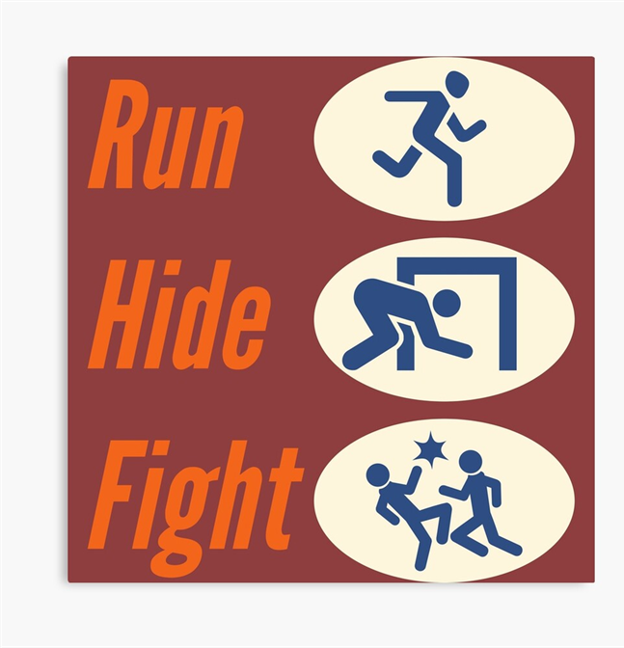
UCP’s Emergency Response Guide: Active Shooter/Other Assailant
What You Should KNOW:
• RUN, HIDE, FIGHT protocol. Know the steps you would use to respond to an active shooter or assailant.
• The primary and secondary exit locations and evacuation procedures for your location.
• Anticipate that individuals may use weapons, makeshift weapons at their disposal, or other violent tactics to ensure harm. Be alert to your surroundings.
Notes:
Before we discuss what we need to know and do in the event of active shooter or other assailant situation, I wanted to share a few facts about active shooter events in the US:
According to the Department of Homeland Security Between 1982 and 2022, the top 7 states for number of mass shootings are:
California – 23
Florida – 12
Texas – 11
Washington & Colorado tied at 4th with 7 each
Wisconsin & Pennsylvania are tied at 5th with 5 each
In March 2018, three people were killed by an armed gunman during a hostage situation at Yountville Veterans Home in Napa County, California.
In February 2018, 17 people including students and teachers were killed and 17 more were wounded when a gunman opened fire inside Marjory Stoneman Douglas High School in Parkland, Florida.
In October 2017, 58 people were killed and 851 were injured when a gunman opened fire from the window of a hotel room on a crowd of concert goers at the Route 91 Harvest Music Festival on the Las Vegas Strip in Nevada.
In June 2016, 49 people were killed and 58 were injured when a gunman opened fire inside Pulse nightclub in Orlando, Florida.
In December 2012, 20 children between six and seven years old as well as six adult staff members were killed when an armed gunman opened fire in Sandy Hook Elementary School in Newtown, Connecticut.
In July 2012, an armed gunman opened fire at a Century movie theater in Aurora, Colorado, killing 12 people and injuring 70 others.
This slide shows what we need to KNOW in the event of an active shooter or other assailant –
• RUN, HIDE, FIGHT protocol. Know the steps you would use to respond to an active shooter or assailant.
• The primary and secondary exit locations and evacuation procedures for your location.
• Anticipate that individuals may use weapons, makeshift weapons at their disposal, or other violent tactics to ensure harm. Be alert to your surroundings.

Slide 15
UCP’s Emergency Response Guide: Active Shooter/ Assailant
What You Should KNOW:
Law enforcement will attempt to stop the threat. Do EXACTLY what they say.
Law enforcement will NOT stop to help wounded individuals or answer questions. Keep out of their way.
Law enforcement considers EVERYONE a suspect until they are able to identify the shooter or assailant.
Notes:
What You Should Know continued:
Law enforcement will attempt to stop the threat. Do EXACTLY what they say.
Law enforcement will NOT stop to help wounded individuals or answer questions. Keep out of their way.
Law enforcement considers EVERYONE a suspect until they are able to identify the shooter or assailant.

Slide 16
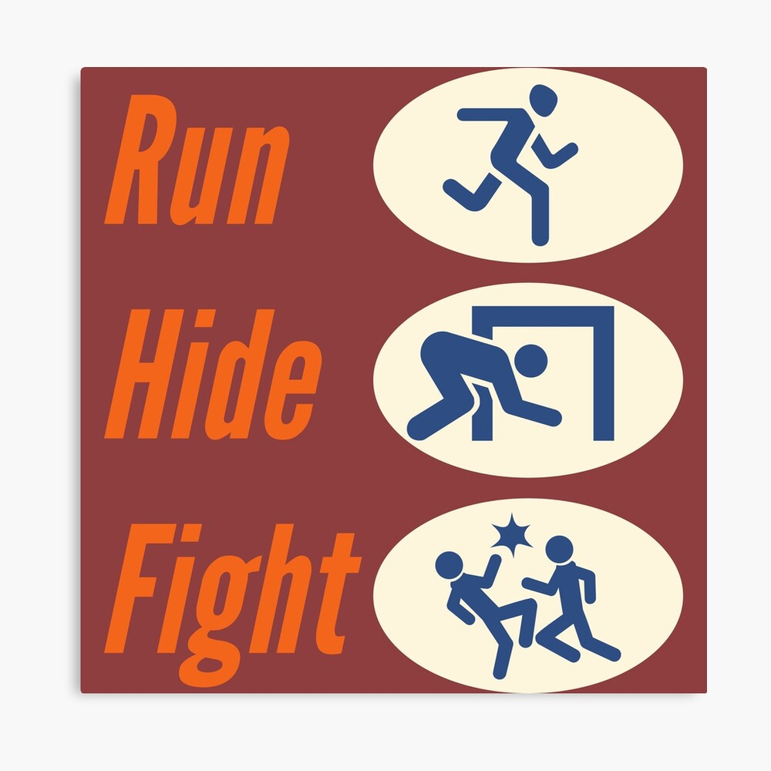
UCP’s Emergency Response Guide: Active Shooter/Other Assailant
What You Should DO:
Follow the RUN/HIDE/FIGHT protocol
RUN: Gather in the pre-determined safe place.
HIDE: Barricade yourselves in.
FIGHT: If the assailant starts shooting, this is your only option. Try to create a diversion: use a fire extinguisher, throw objects, make noise.
Alert law enforcement. If it can be done safely, call 911. Give your location.
Notes:
These next two slides outline What You Should DO in the event of an active shooter/assailant (ASK SOMEONE TO READ)
Follow the RUN/HIDE/FIGHT protocol
RUN: Gather in the pre-determined safe place. When running, try to zig zag/be unpredictable in movement vs. a straight line.
HIDE: Barricade yourselves in.
FIGHT: If the assailant starts shooting, this is your only option. Try to create a diversion: use a fire extinguisher, throw objects, make noise. Be unpredictable.
Alert law enforcement. If it can be done safely, call 911. Give your location.
(HOLD UP UCP’s ER RESPONSE CARD)
Although it is not listed on this slide, notify Janeen, Bridget, Nate, SOMEONE as soon as safely able to do so (only after calling 911).

Slide 17
UCP’s Emergency Response Guide: Active Shooter/Other Assailant
What You Should DO:
Use your words to alert people to the threat. If you have access to an intercom or phone, use it. If not, yell or shout.
When evacuating, quickly remove as many people as possible. NEVER go back inside.
When law enforcement arrives, identify yourself as non-threatening:
1. Keep hands visible at all times.
2. Do not reach for cell phone, purse, badge, etc.
3. Make no sudden movements.
Notes:
What You Should DO in the event of an active shooter/assailant is continued on this slide (ASK SOMEONE TO READ)
If possible, alert other people to the threat. If you have access to an intercom or phone, use it. If not, yell or shout.
When evacuating, quickly remove as many people as possible. NEVER go back inside.
When law enforcement arrives, identify yourself as non-threatening:
1. Keep hands visible at all times.
2. Do not reach for cell phone, purse, badge, etc.
3. Make no sudden movements.

Slide 18
Active Shooter Readiness: Options for Consideration RUN, HIDE, FIGHT (7-minute video)
https://www.youtube.com/watch?v=pY-CSX4NPtg
Notes:
This is a 7-minute video created by the US Department of Homeland Security (DHS) which does a nice job demonstrating use of the RUN, HIDE, FIGHT protocol.
The DHS Active Shooter HANDOUT corresponds with the video (HOLD UP HANDOUT)

Slide 19
What YOU should do in case of an active shooter attack RECAP…
"Run" to the nearest exits, making use of available concealment while moving away from the source of hazard.
If unable to safely evacuate, "hide" in a secure area where access can be blocked or entryways can be locked, and, as appropriate, "fight".
If no rapid escape is possible, seek cover behind any available natural or artificial objects that eliminate direct line of sight from the source of hazard.
Call 9-1-1 and remain alert for potential secondary attacks.
Render first aid when safe to do so.
Maintain situational awareness while providing assistance to others.
When help arrives, follow instructions given by law enforcement.
Source: Homeland Security Active Shooter Attacks Action Guide
Notes:
As a RECAP from the video…
(ASK SOMEONE TO READ SLIDE)
The DHS Active Shooter HANDOUT corresponds with the video (HOLD UP HANDOUT)

Slide 20
Training Recap:
Verbally report warning signs or potentially threatening behavior immediately.
If there is imminent risk of violence, get out and call 911 immediately (then call supervisor).
If you see something, say something!
RUN, HIDE, FIGHT in an active shooter/assailant situation.
Notes:
Violence prevention is always the goal.
ASK: What questions do you have regarding workplace violence prevention and awareness?

