Slide 1
Minimize the Spread of Infectious Disease Policy
Standard Precautions Presentation

Slide 2
UCP Policy Statement & Purpose
Policy Statement: UCP will take all reasonable measures to ensure the safety of employees and participants during global and local infectious disease events. These may include implementing infection control guidelines designed to stop or slow the spread of infectious diseases.
Purpose: The purpose of this policy is to ensure a uniform, consistent process for adhering to a strict standard and contact precautions to minimize the risk of spreading infectious disease, and as a protection for all employees and participants.

Slide 3
Procedures
Standard (Universal) Precautions are used for participant care and are based on a risk assessment and make use of common-sense practices and personal protective equipment (PPE) use that protect healthcare providers from infection and prevent the spread of infection from participant to participant. This includes:
1. Hand Hygiene
2. Use of personal protective equipment (PPE) whenever there is an expectation for possible exposure
3. Follow respiratory hygiene/cough etiquette principles
4. Properly clean and disinfect the environment
5. Handle textiles and laundry carefully

Slide 4
Procedures – Hand Hygiene
Handwashing is one of the best ways to protect yourself/others from getting sick.
Wash hands key times:
Before, during, after preparing food
Before eating food
Before/after caring for anyone who is sick
Before/after wound care
After using the toilet
After changing diapers or cleaning someone who has used the toilet
After blowing your nose, coughing, sneezing
After touching an animal, animal feed/waste
After handling pet food/treats
After touching garbage
Entering home/worksite

Slide 6
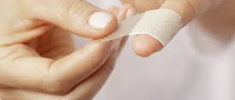
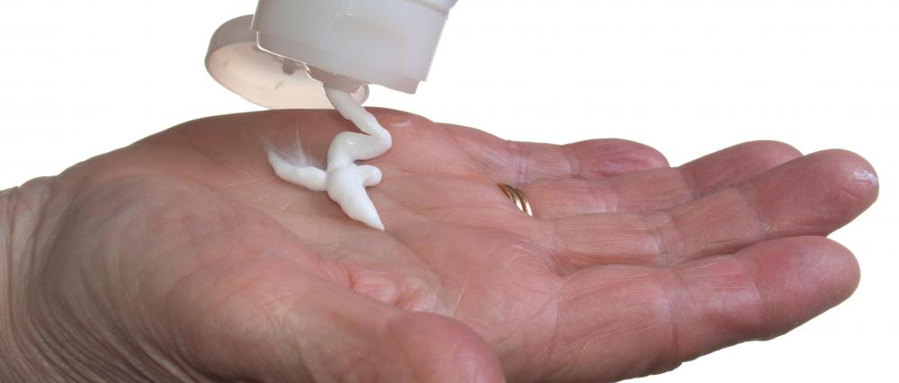
Skin & Nail Care
Lotions can prevent/decrease skin dryness from hand hygiene.
Keep open wounds clean and covered.
Germs live under long nails and under/around rings.

Slide 7
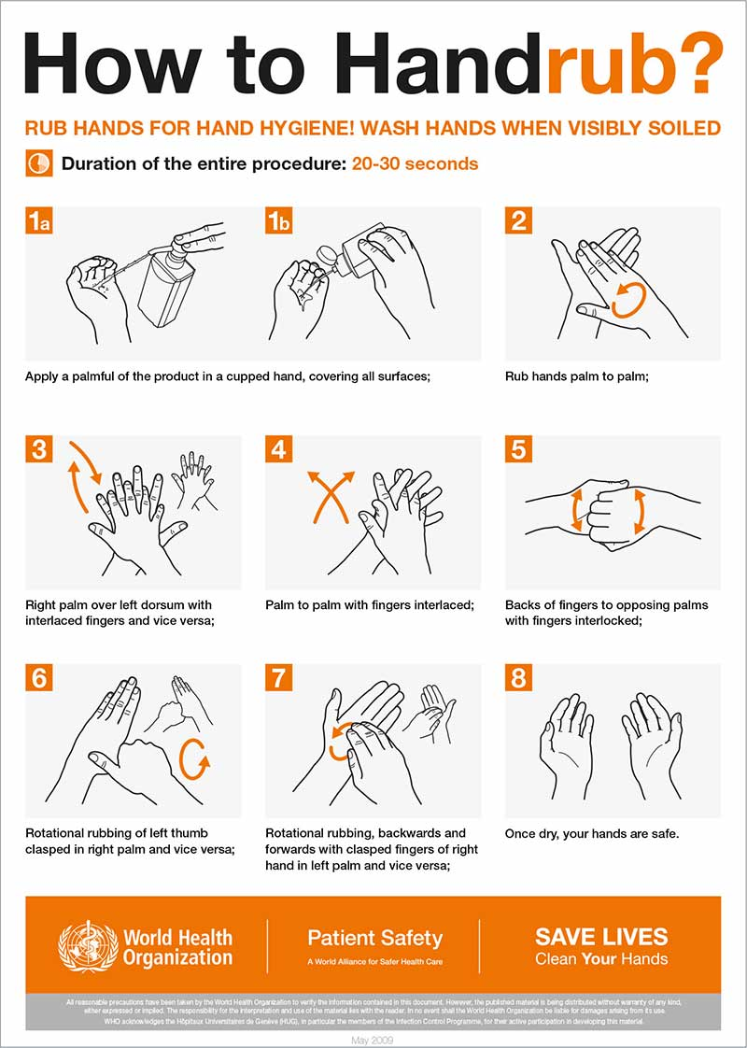
Procedures – Hand Hygiene
Washing hands with soap & water is the best way to get rid of germs. If soap & water are not available, use an alcohol‐based hand sanitizer that contains at least 60% alcohol.
Hand sanitizers can reduce germ counts but do not get rid of all germs, effectively clean visible dirt/grease, or remove harmful chemicals (i.e., pesticides).

Slide 8
PPE - Glove Use
Wear gloves when possibility of contact with blood/bodily fluids or contaminated equipment.
NOT a substitute for hand hygiene (wash before & after gloving).
Do NOT reuse gloves.
Correct removal and disposal.

Slide 9
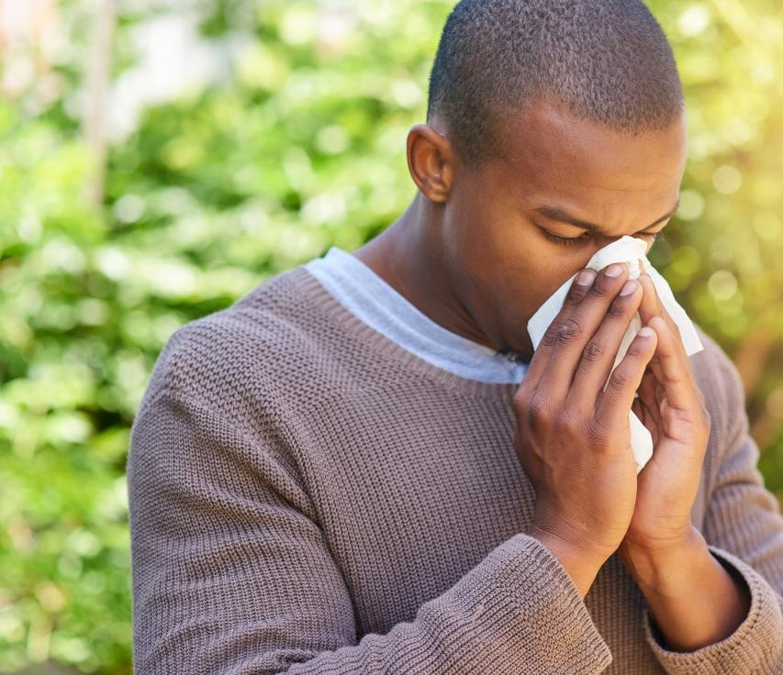
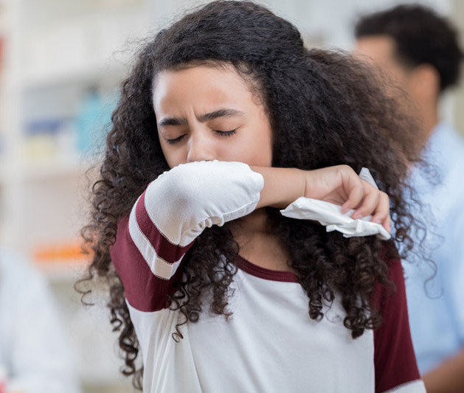
Respiratory hygiene & cough etiquette…
Cover your mouth and nose with a tissue when coughing or sneezing.
Dispose of immediately in waste receptacle.
Turn away/use inside elbow if tissue is not available.
Perform hand hygiene.

Slide 10
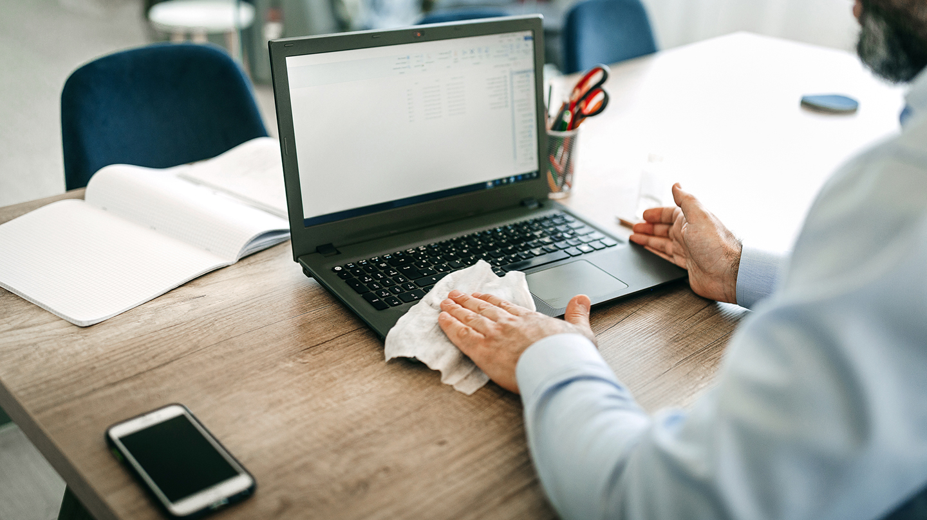
Clean and disinfect the environment…
If visibly dirty, surfaces should be cleaned using detergent or soap/water prior to disinfection.
For disinfection, use diluted bleach solutions, alcohol solutions with at least 70% alcohol, or EPA registered household disinfectants.
Bleach solution: 1/3 c. bleach per gallon of water or 4 tsp. per quart.
Wear gloves when possible!

Slide 11
Clean and disinfect the environment…
Computer keyboards/mice, phones, tablets:
Use disposable, pre-moistened disinfectant cloths (not overly saturated).
Liquid is the enemy of electronics, not disinfectant itself.

Slide 12
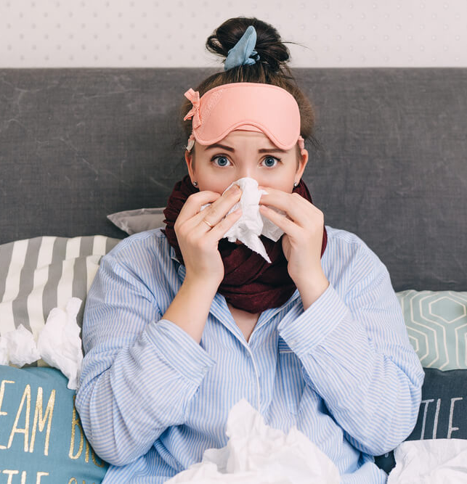
STOP the Spread of Illness…
Stay home when sick!
Cover coughs & sneezes with a tissue.
Wash hands with soap & water or use hand sanitizer frequently.
Flu virus/others are spread via droplets from persons mouth/nose or from touching contaminated surface and touching eyes, nose, mouth.
Consider annual flu vaccine to prevent seasonal flu.

Slide 13
Precautions around person with infectious disease…
Follow healthcare provider’s instructions. Provide support getting groceries, prescriptions, etc.
Monitor symptoms. If worsens, call the healthcare provider and report the patient has an infectious disease.
If patient has an emergency and 911 is called, share the patient has an infectious disease.
Household members should separate from the patient and use a separate bed-/bathroom, if available.
Prohibit nonessential visitors.
Ensure shared spaces have good air flow, such as AC or open window, weather permitting.
Perform hand hygiene frequently.
Avoid touching your face with unwashed hands.

Slide 14
Precautions around person with infectious disease…
Patient should wear a facemask around people and if not able, the caregiver should mask.
Wear a disposable facemask and gloves when in contact with body fluids.
Throw out disposable facemasks/gloves after each use.
When removing PPE, first remove and dispose of gloves, then perform hand hygiene. Next, remove and dispose of facemask, then perform hand hygiene.
Avoid sharing items with the patient. Do not share dishes, drinking glasses, utensils, towels, bedding. After patient use, thoroughly wash.
Clean “high‐touch” surfaces, such as tabletops, doorknobs, bathroom fixtures, phones, keyboards. Immediately clean surfaces that may have body fluids.
Use household cleaning spray or wipe. Labels contain use instructions such as wear gloves and have good ventilation.

Slide 15
Precautions around person with infectious disease…
Immediately remove and wash clothes/bedding that have body fluids on them.
Wear gloves while handling soiled items and keep soiled items away from your body; after removing gloves perform hand hygiene.
Follow directions on labels of laundry items and dry thoroughly using the warmest temperatures recommended.
Place used gloves, masks, other contaminated items in a lined container before disposing of them with other waste, then perform hand hygiene.
Discuss any additional questions with your healthcare provider state or local health department.

Slide 16
PPE Correct Masking

Slide 17
Remember… practice Universal Precautions universally!
Resources:
UCP Central PA Minimize the Risk of Infectious Disease Policy
www.cdc.gov/coronavirus
www.cdc.gov/cdctv/healthyliving/hygiene/fight-germs-wash-hands.html

