Slide 1
Healthy Relationships & Sexuality
Community Integration, Individual Choice and
Supporting Individuals to Develop & Maintain Relationships
Notes:
Before we begin, I want to be clear that you have permission to feel uncomfortable with parts of this training, it’s human nature. Being uncomfortable shows that you have learned boundaries, and understanding boundaries is perhaps the most important safety and self-protection skill we have as human beings, and in turn, that we can teach to others. This presentation is simply an introduction to the topic of Healthy Relationships & Sexuality, based on UCP’s Sexual Health, Personal Relationships, and Sexuality Guidelines.
I will be respectful of your level of participation but ask you to keep an open mind because this training is about supporting and promoting choice in others.
It is important to keep in mind that developmental disabilities and sexuality are both naturally occurring in people – they are two parts of many parts which make up a whole, complex, beautiful human being.

Slide 2
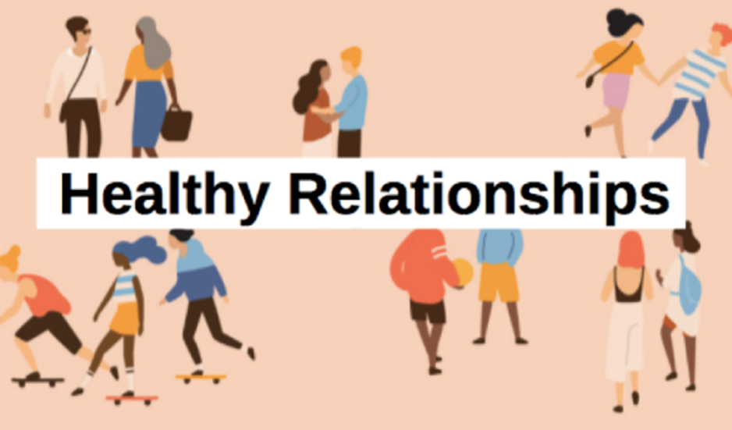
Training Objectives:
Understand your role as a staff relating to a participant's sexual health, personal relationships and their sexuality.
Introduce UCP’s guidelines on sexuality and personal relationships.
Develop and learn strategies to encourage healthy relationships and mitigate risk.
Notes:
READ SLIDE Training Objectives

Slide 3
Background Information: _______ Office of Developmental Programs
Notes:
This ODP bulletin titled Guidelines Concerning Sexual Health, Personal Relationships, and Sexuality was released in April of 2018. Prior to April 2018, the only guiding document released by ODP that referenced sexuality for people we support was in 1996 (22 years priors). Long time coming, eh?
This 2018 bulletin was issued to direct providers to develop guidance for their participants on the topic of Sexual Health and personal relationships. Ultimately, the focus of the bulletin was to emphasize that all people have the right to live, love, work, play and pursue their aspirations in their communities.

Slide 4
UCP Central PA’s Sexual Health, Personal Relationships, and Sexuality Guidelines
Notes:
So, UCP developed Sexual Health, Personal Relationships, and Sexuality Guidelines. As a reminder, the guideline states that it is our philosophy that participants have the right to pursue personal relationships, their sexuality, and experience a life that is no different than that of individuals without disabilities, without being neglected, exploited, or abused.
The purpose is to establish guidelines that support and promote choice in sexual health, personal relationships, and sexuality that embody the concept and principles established in Everyday Lives. We need to provide an environment that supports choice in sexual health, personal relationships, and sexuality; that respects privacy; and where personal choices related to sexuality are treated with dignity and respect.
For these guidelines, sexual health is defined as the experience of the ongoing process of physical, psychological, and social-cultural well-being related to sexuality. Sexual health is evidenced in the free and responsible expressions of sexual capabilities that foster harmonious personal and social wellness, enriching individual and social life. We will provide accessible and appropriate education, information, and resources that address sexual health, personal relationships, and sexuality needs to program participants.
Really, the guidelines focus is on what can be done to support people, not on what cannot be done.

Slide 5
UCP Central PA General Relationship Questionnaire
Assessment used to evaluate understanding of sex-related topics, including:
Anatomy & Physiology
Sexual intercourse
Masturbation
Pregnancy/contraception
STD’s
Sexuality
Results used to develop educational opportunities for participants, based on their knowledge, to protect from misinformation, exploitation or abuse. The results will also be used to promote and assist the participant in establishing their sexual wellness.
Notes:
Under #2 in the guidelines purpose, anyone in our services is asked to undergo an initial knowledge assessment or questionnaire on sexuality related topics. The results are potentially used to develop educational opportunities for participants based on their knowledge, so they aren’t misinformed, exploited, or abused.
This questionnaire is strongly encouraged but is optional and it is conducted by program specialists and other program staff. The questionnaire process includes the assessment to determine if the person is able to understand and give informed consent (safety first). The big take away from the questionnaire is finding out if the person wants to learn more, because part of our role as a provider is to educate.

Slide 6
Everyday Lives Values as They Apply to Sexual Health, Personal Relationships, and Sexuality
Individuals with disabilities have the right…
to privacy when accessing supports and have the right to have information about their personal relationships remain private unless they consent to a disclosure.
to enjoy relationships and to express their sexuality in a safe manner.
to have their sexual health and personal relationships supported by knowledgeable provider agency staff and a knowledgeable Individual Support Plan team.
Notes:
Page 2 and 3 of the guidelines reviews the everyday lives values as they apply to sexual health, personal relationships, and sexuality.
READ SLIDE

Slide 7
Everyday Lives Values as They Apply to Sexual Health, Personal Relationships, and Sexuality
Individuals with disabilities…
are sexual human beings with their own cultural, religious/faith, ethnic, and family values.
have the right to enjoy their personal relationships and sexuality in a safe, consensual, and legal manner, while respecting the rights of others.
have the same basic rights as individuals without disabilities to self-identify their gender, sexual orientation, and sexual preferences.
have the right to accessible and appropriate education, information, and resources that address their individual personal relationships, sexual health, and sexuality needs.
Notes:
READ SLIDE
So UCP is committed to ensuring that all staff who work with their participants are aware of and are committed to ensuring all of these values.

Slide 8
What we do not acknowledge, we cannot change…
People with disabilities have had their sexuality denied, punished, and abused throughout history.
Society is often uncomfortable with the sexuality of people with disabilities.
Feeling uncomfortable may be present within us.
Prejudices are not easy to see when you have them.
Notes:
QUESTION: What are some examples of ways services and systems have oppressed the sexuality of people we support? A: segregation, castration and sterilization, electric shock, policies and practices that forbid sexuality.
People with disabilities have had their sexuality denied, punished, and abused throughout history. Often that is because society can be uncomfortable with the sexuality of people with disabilities. It is important to self-reflect and acknowledge if we maybe have feelings of discomfort, because is we are not aware our prejudices, how we change them?
QUESTION: What are some of the past and present beliefs that shape the belief that individuals with disabilities are not or should not be sexual beings? (there is NO WRONG ANSWER – just beliefs that have been present in society)
-People with disabilities are so accepting -Perpetual Children -Fear of abuse/taking advantage of -Unwanted pregnancy
Shortly, we are going to address fact vs. myth regarding some those ‘beliefs’, but first we are going to watch a 5-minute video on the Sexual Bill of Rights…

Slide 9
Sexual Bill of Rights
https://www.youtube.com/watch?v=zX8z_5kXLGo
Notes:
AFTER VIDEO:
Adults with disabilities have the right to develop and engage in sexual relationships with anyone they chose, so long as the relationship is between two consensual adults and does not violate boundaries.
The World Health Organization defines SEXUALITY as a central aspect of being human throughout life that encompasses sex, gender identities and roles, sexual orientation, eroticism, pleasure, intimacy and reproduction. Sexuality is experienced and expressed in thoughts, fantasies, desires, beliefs, attitudes, values, behaviors, practices, roles and relationships. While sexuality can include all of these dimensions, not all of them are always experienced or expressed.
Sexuality is very broad.

Slide 10
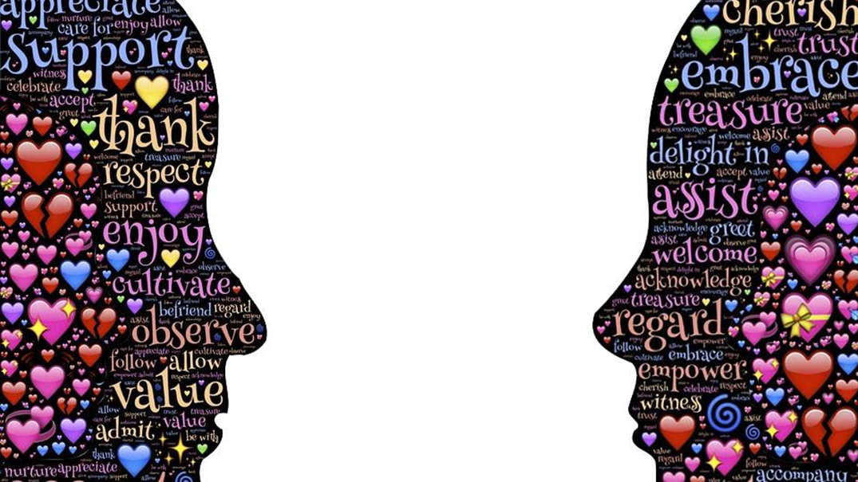
FACT VS. MYTH
1.People with disabilities are sexual and express their sexuality like anyone else.
2. All people need love, intimacy, acceptance, and companionship.
3. People living with disabilities can have real sex.
4. Even if a participant is with someone all the time, there is still risk.
5. Abuse can take place between peers or by staff or others in isolated environments.
6. Most abuse is committed by a person familiar to the victim.
7. Education is key to promoting healthy sexual behavior.
8. Teaching about sexuality does NOT promote promiscuity.
Notes:
ASK FACT or MYTH for each statement. #1 ADD – It is important to recognize that just because a 40-year-old has an 8-year-old intellect, that person in every other aspect of being an adult is a 40 year old, with 40 years of life experiences. That person is no less a sexual being that you are or I.
AFTER #8: Everything we do in life, brings risk. It is important that we weigh the risk vs. just saying ‘someone can’t enjoy their sexuality’ because there is risk.
QUESTION: What skills do people need to have to live a healthy & happy social life? A: likeability, reciprocity, trust, thoughtfulness, approachability, common interests and passions, responsibility, assertion, negotiation, sharing, manners, compassion, listening, boundaries, humor (a.k.a. soft skills) – freedom from abuse/victimization/safety, hygiene/selfcare, self-protection, respect, social skills (general), balance, fulfillment, understanding
QUESTION: Of those skills you listed, how many are skills that people need to possess to have a happy (& safe) sexual life? A: ALL! The foundation of leading a healthy sexual life is first knowing the skills for a healthy social life.
why they hold their belief. At the end explain that each of these statements are all fact.

Slide 11
ACTIVITY BREAK
Question: What skills do people need to possess to have a healthy and happy social life?
Activity: Working with a partner, list as many answers as possible in 3 minutes. Have someone take notes to report out.
Notes:
Instructor:
With a partner, take THREE minutes to discuss and write down as many answers as possible to the following question:
What skills do people need to have to live a healthy & happy social life?
After THREE minutes, ask teams to read off one skill and for others to checkoff that skill if also have it. Continue around the room until everyone has shared every skill listed.
POSSIBLE ANSWERS:
likeability, reciprocity, trust, thoughtfulness, approachability, common interests and passions, responsibility, assertion, negotiation, sharing, manners, compassion, listening, boundaries, humor (a.k.a. soft skills) – freedom from abuse/victimization/safety, hygiene/selfcare, self-protection, respect, social skills (general), balance, fulfillment, understanding
Instructor, ASK follow-up question: Of those skills you listed, how many are skills that people need to possess to have a happy (& safe) sexual life?
--ALL! The foundation of leading a healthy sexual life is first knowing the skills for a healthy social life.

Slide 12
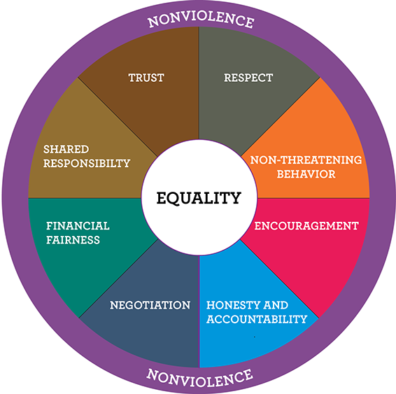
A Healthy Relationship is…
Free from abuse and victimization
One with choice and control
One which allows you to pursue your vision
Balanced – me-/you-/us-time
Allows you to be an individual and be yourself
Having people who care about you and not just for you
Reciprocal Roles
Notes:
A healthy relationship is free from abuse & victimization, and it is important that we teach that not all abuse will necessarily feel bad.
It is one with choice and control. A healthy relationship should bring out the best in us and we should not feel scared or alone or trapped or desperate.
One which allows you to pursue your vision. A healthy relationship should encourage us to follow our dreams and encourage us, provide opportunities, should not be controlling, we should have time for our own interests.
A healthy relationships is balanced – me time/you time/us time. It is important to learn what it takes to be a good friend and/or a good boy/girlfriend
Allows you to be an individual and to be yourself – You shouldn’t be told that you can’t talk to other friends or spend time doing something you enjoy. Or that your opinions are stupid.
A healthy relationship is having people who care about you and not just care for you. There should be emotional connection and support and genuine caring about your day, and your life.
A healthy relationship should be reciprocal in caring about and caring for one another.

Slide 13
Increase opportunities for an Everyday Life & Healthy Relationships by:
Notes:
Important for us, as provider to remember (as we just learned in person-centered planning) that we are paid to foster and enhance non-paid relationships – to help others communicate and connect, safely. Isolation is always bad. People who are known in their communities are safer!
Community presence and participation is key to encourage those valued social roles. Any type of potential sexual relationship certainly must first begin with a healthy social relationship.

Slide 14
Gaining Valued Social Roles & Developing Healthy Relationships takes time (& social skills)!
40 hours with someone = “casual friend”
90 hours = “friend”
200 hours = “close friend”
Acquaintanceships flip over to friendship 3-9 weeks after people first meet each other.
If you haven’t hit friendship status within 3 months after meeting, you likely never will.
Notes:
Gaining important valued social roles and developing healthy relationships, whether it be friendships or more intimate relationships, takes a lot of time and learned social skills.
This slide calls out estimated time it takes to establish a friendship.
This is why it is important to for people to be consistently and routinely actively present and participate in their communities.

Slide 15
Skill Development
Is it safer to teach it?
Model and teach boundaries, social graces, interpersonal skills
Grooming & self-care
Private vs. public
Be clear, concrete, consistent and communicate with dignity and respect
Only intervene when there is cause to intervene
Notes:
General considerations for Skill Development –
Is it safer to teach it?– The answer is it is safer to teach way more often than not. As a provider, we need to remember to follow outcomes developed by the team and in the ISP.
Model and teach boundaries, social graces, interpersonal skills so Our behavior needs to model appropriate boundaries. Modeling is also a great teaching tool. Give affection appropriately and without violating boundaries. Sometimes people with disabilities get treated differently – we use kid voices or pet people.
Grooming & self care is very important for image enhancement. People need to look approachable by being clean and presentable.
Keep private, private…i.e. dress/undress in bed/bathroom, close doors/windows for private activities such as masturbation or bathroom time (if ISP allows. We need to knock on people’s bedroom doors and wait to be accepte din.
Be concrete, clear, consistent, and communicate with dignity and respect, NEVER SHAME or overreact. We inadvertently teach that no really doesn’t mean no (ignoring wishes, wants) – that learned modeling could potentially put the person in a situation where they don’t ‘hear’ no as no from someone OR they are not empowered to say and mean ‘no.’
Only intervene when there is cause to intervene. If there are possible consequences (i.e. refusing to shower) or safety concerns (i.e. inappropriately trying to touch someone) or dangerous behavior (i.e. hurting oneself). It is natural to masturbate, view pornography, engage in intimate activity but sometimes guidance is needed on recognizing appropriate time, place and means. Ask for the desired behavior (not say that is inappropriate). So if walk into someone’s home and someone starts masturbating in a chair, I would ask them to go to their bedroom because that is a private place (not STOP doing that).
We need to allow people to learn from mistakes, whenever possible.

Slide 16
Victimization Awareness
May not understand healthy relationships
May need a friend
Too eager to please
May not recognize situation as a crime
Have limitations in communications
Notes:
People with disabilities are 7x more likely to be victims of sexual abuse for various reasons as noted on this slide BUT we can help mitigate risk by ensuring the people we support have the skills they need to be safe, including the ability to self report.
For anyone we support, we always need to be alert for signs of abuse, neglect or rights violations. Sometimes abuse, especially sexual abuse or exploitation, can have some not so obvious signs. For example, maybe someone will give-away assets or things of importance to them to ‘a friend,’ or there might be banking changes or a strange payee change, perhaps social isolation, or a personality or behavior change – for example, maybe Jimmy doesn’t want to get on a van to go to a job he loves. We can’t just assume he is being non-compliant. All behavior is communication and has meaning.
Remember our role is to REPORT anything that seems off or is concerning to a point person immediately! SEE SOMETHING SAY SOMETHING!

Slide 17
Define ‘friend’
Notes:
ASK: When adults with disabilities were showing a pictures similar to this one and asked the question “tell me about this picture” – what do you think was the most common answer?
A: “the people on the couch are friends.”
Be careful with the word ‘friend’ vs. boy/girlfriend – people with ID and/or autism can be concrete thinkers who interpret things literally. Not everyone is our friend. Define what a friend is and use it appropriately. Use boy/girlfriend specifically and appropriately. For example, DSP’s are NOT friends. We can have friendly relationships, but they are professional roles, and we must have clear boundaries.
Waters can be very muddy and we need to be very clear and concrete with our word choices and what we model. Another example – genitals are only part of body that have ‘cute’ names made up to talk about – we use made up language – it’s already hard for people to self-report.
IT IS VERY IMPORTANT TO USE ACCURATE LANGUAGE IN EVERY SITUATION POSSIBLE!

Slide 18
ACTIVITY BREAK Small Group Discussion
Review the scenario with your group.
You have 10 minutes to discuss possible ways to address the situation.
Assign a note taker to report out.
Notes:
ACTIVITY – plan for 15-20 minutes total.
Assign each small group a scenario to review.
Allow 10 minutes for each group to discuss possible ways to handle the situation.
Ask each group to have an assigned note taker to report the team’s ideas.
Plan for at least 10-15 minutes to discuss the proposed ideas and allow the class to contribute more ideas.

Slide 19
National Alliance for Direct Support Professionals (NADSP) – Relationships
As a DSP, I pledge I will assist the people I support to develop and maintain relationships. Furthermore, as a DSP, I will:
I pledge I will advocate with the people I support when they do not have opportunities to build and maintain relationships.
I pledge I will recognize the importance of maintaining reciprocal relationships and proactively facilitate relationships between the people I support, their family and friends.
I pledge I will assure that people have the opportunity to make informed choices in safely expressing their sexuality.
I pledge I will separate my personal beliefs and expectations regarding relationships (including sexual relationships) from those of the people I support based on their personal preferences. If I am unable to separate my own beliefs and preferences in a given situation, I will remove myself from the situation and seek the assistance of a qualified coworker.
I pledge I will refrain from expressing negative views, harsh judgments, and stereotyping of people close to those I support.
Notes:
The National Alliance of Direct Support Professionals created a code of ethical standards with respect to assisting individuals with ID in developing, cultivating and maintaining relationship.
We ask all UCP staff to pledge to uphold these standards.

Slide 20
Summary & Conclusion
It is the responsibility of all UCP employees to be aware of the sexual health, personal relationships, and sexuality guidelines established.
Key take away #1 – Assess participants knowledge and interest in various areas of sexuality and desire to have meaningful healthy relationships.
Key take away #2 – Educate participants on basic sexuality and promote positive relationship development.
Key take away #3 – Monitor participants for any red flags and remember to:
RECOGNIZE
RESPOND
ELEVATE
When you see, hear or think something doesn’t seem right remember to err on the side of safety and report to your supervisor!

Slide 21
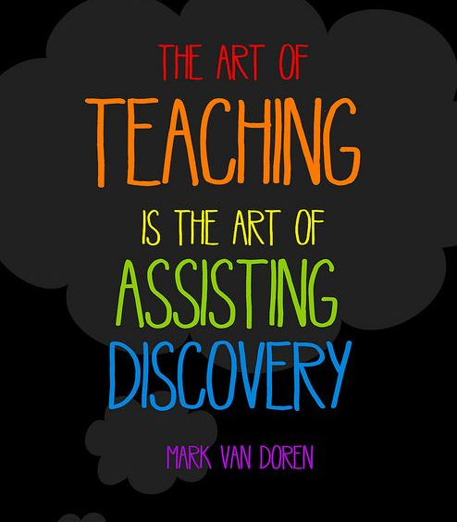
Thank you for your participation!
Resources
ODP Everyday Lives
UCP’s Sexual Health, Personal Relationships, and Sexuality Guideline
UCP’s General Relationship Questionnaire
Open Futures Learning – Sexuality and Relationships module
ODP bulletins - 00-18-01 and 21-020
Sexual Bill of Rights https://www.youtube.com/watch?v=zX8z_5kXLGo

