Slide 1
Transportation & Safe Driving

Slide 2
Transportation & Safe Driving Training Objectives:
Review Required Documents & Safe Driving Record
Understand Operational Standards & Accident Reporting Procedures
Review Mileage & Pre-trip inspections
Understand the importance of following Safe Driving Standards
Define Defensive Driving expectations
Recognize importance of Distracted Driving awareness
Review Assisting Individuals procedures
View Wheelchair Accessible Full-Size Van with Lift & Q Restraints Training Video
View Wheelchair Accessible Mini/Conversion Van with Ramp & Q Restraints Training Video
Understand UCP GPS Vehicle Monitoring – Geotabs use and requirements

Slide 3
Document Requirements:
UCP’s insurance requires the following for employees who (a) transport an individual (in a UCP vehicle, personal, individuals’) (b) drives a UCP vehicle, (c) operate own vehicle for UCP activity:
1. Copy of Valid driver’s license;
2. Copy of vehicle insurance coverage;
3. Motor vehicle driving record checks.
Anyone who transports an individual in personal vehicle, ODP requires #1 & #2 PLUS copy of vehicle registration & inspection.
Employees who transport an individual in the individual’s vehicle, copies of their vehicle registration, insurance, and inspection are required.

Slide 4
Safe Driving Record Requirements:
A motor vehicle report that reveals any of the following will disqualify an employee from engaging in driving activities:
Three or more traffic violations and/or at fault accidents within a one (1) year period, or One or more or the following type of serious traffic convictions within the past one (1) year -
Driving under the influence (DUI).
Driving while intoxicated (DWI).
Refusal to submit to a Blood Alcohol Content test.
Failure to stop and report an accident and leaving the scene of an accident as defined by state law.
Conviction for homicide, manslaughter, or assault arising out of the use of a vehicle.
Conviction for reckless or careless driving.
Racing.
Possession of a controlled substance.
Making a false report.
Conviction for attempting to elude a police officer.
Revocation or administrative restriction of a driver’s license.

Slide 5
Operational Standards for Employees:
Participants in staff’s vehicle is permitted ONLY when agency-provided transportation is NOT available or in an ER. Transportation need must be related to service plan.
By expiration dates, MUST provide supervisor renewed required documents.
Report changes in driving record, license suspension, or insurance coverage to supervisor by next scheduled workday.
If suspended from driving, supervisor will try to reassign driving, or person may be transferred to a position not requiring driving. Termination may result if alternatives cannot be provided.

Slide 6
Operational Standards for Employees:
Staff using own vehicles when engaging in UCP business assume liability for accidents up to their vehicle insurance liability limits.
UCP is not liable for damage costs to staff’s personal vehicle.
Required to carry state minimum single limit coverage for both bodily and property damage.
UCP carries non-owned automobile liability insurance that will provide coverage ONLY in excess of staff’s personal auto insurance limits.

Slide 7
Accident Reporting Procedures:
If an accident occurs while working, follow accident reporting procedure:
Call 911 if the accident involves injuries, vehicle is not drivable, or incident involves a moving violation.
Immediately report to supervisor, who will initiate worker’s comp reporting process, reasonable suspicion testing, insurance paperwork to report.
Complete & submit Accident Report Form to supervisor by next workday.
Email documentation & photos to vehicles@ucpcentralpa.org

Slide 8
Mileage & Pre-trip Inspection
Monthly Mileage Reimbursement Forms for non-UCP vehicles.
Submit to Supervisor
UCP Agency Van Use Log for UCP vehicles.
Pre-inspection of vehicle for damage and pre-trip safety check – report concerns immediately.
Gas Cards in each UCP vehicle only – use last 4 digits of your social security # as your PIN.
Gas ONLY!
Gas tanks need to be ½ full.

Slide 9
Safe Driving Standards:
When driving for work, employees are expected to follow safe & defensive driving standards including, but not limited to:
Never text or talk on a cell phone while driving.
Radio volume at a low level.
Obey all traffic laws & wear seat belts.
No tobacco use in any UCP vehicle and not in personal vehicles when transporting.
Adhere to all requirements as identified in UCP’s Driver Safety and Transportation policy.
Do not take full size vans through drive-thru due to height restrictions.

Slide 10
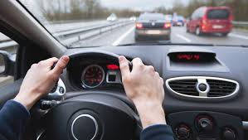
What is Defensive Driving?
Definition: Driving to save lives, time, and money, in spite of the conditions around you and the actions of others.

Slide 11
Important Considerations
Driver condition
Are you physically and emotionally prepared to drive?
Do you engage in Distracted Driving?
Vehicle condition
Is it in safe operating condition for you and other drivers?
Weather conditions
Can change quickly and require different driving habits.
Road conditions
Prepared for the unexpected: potholes, curves, hills, blind spots, road construction, pedestrians.

Slide 12
Good Defensive Driving Practices
Obey traffic rules & seat belts use
Be far sighted & keep eyes moving
Backing up
Following & stopping distance
Preventing rear end collisions
Leave yourself an out
Remove distractions

Slide 13
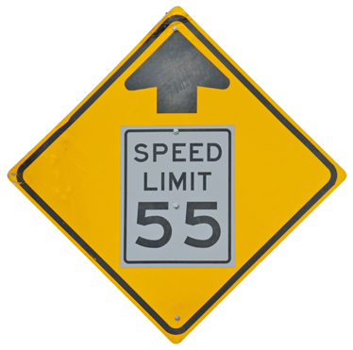
Obey Traffic Rules & Use Common Sense
Follow speed limits
Obey traffic signs and signals
Follow the 4-second rule
Signal your intentions: tap brakes; early turn signal
Pass with care and only where allowed

Slide 14
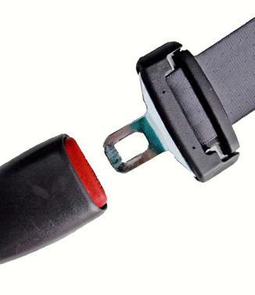
Seat Belts
Prevent contact with the steering wheel, dash or windshield.
Keep you inside vehicle (25x more likely being killed if thrown from vehicle).
Protect body organs.
Improve chance of remaining conscious if involved in an accident.
Keep driver behind the wheel if have to swerve or brake suddenly.
REQUIRED ON EVERY PASSENGER BY LAW.
Page 14

Slide 15
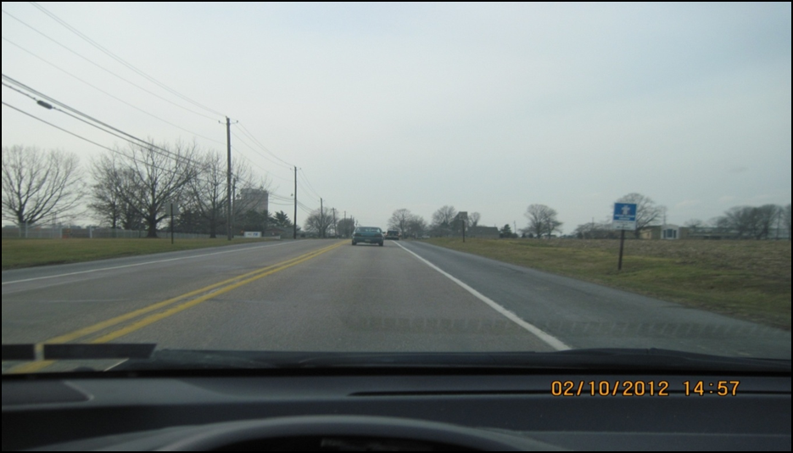
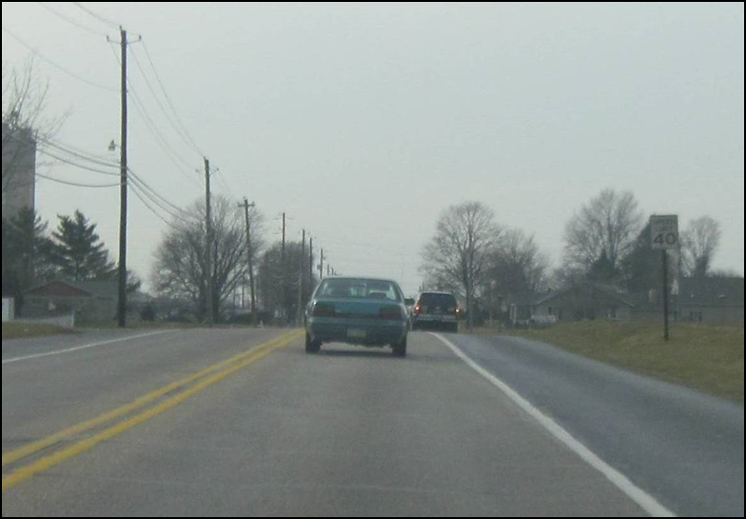
Be Far-Sighted – Look Ahead
Know what is ahead and what you are driving into. Don’t focus on the road just in front of you.
Allow yourself the time to adjust and react to the changing conditions and situations.
Look 12 seconds ahead.

Slide 16
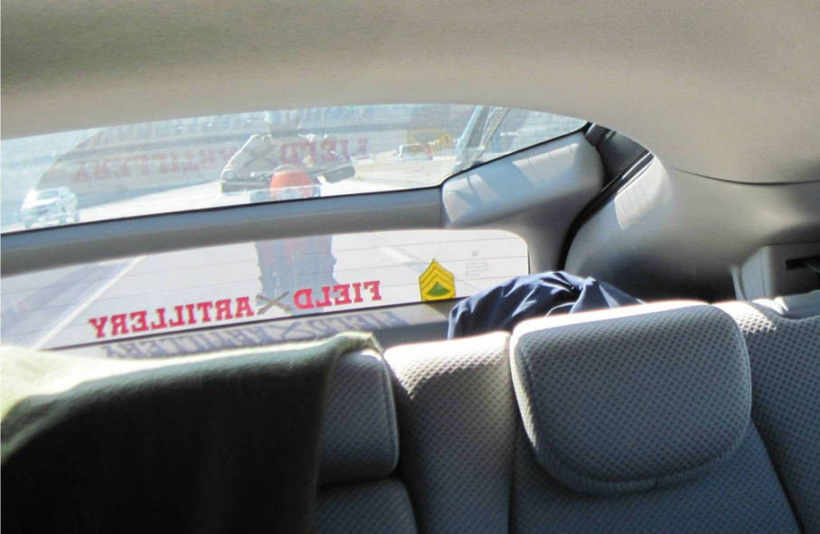
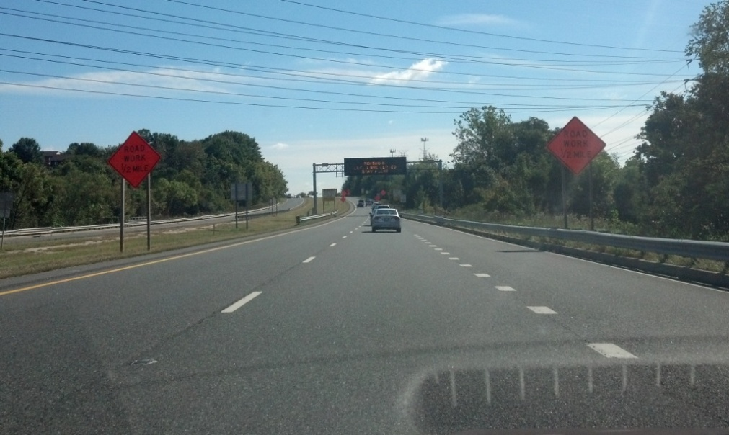
Keep Eyes Moving
Keep eyes scanning to gain peripheral awareness.
Check mirrors every 5-8 seconds- rear and side view.
2 seconds max per object.
Be aware of other vehicles movements - speed, lane changes, proximity.
Notes:
Continuously scanning the area in front, to the sides, and behind maintains your awareness of the road environment. This will allow you to anticipate potentially hazardous situations and give you time to react.
Scan the scene and road ahead, sides, and behind
Constantly checking mirrors and looking around will keep you aware of vehicles and their changing position
Be cautious of blind spots: Assume another vehicle is where you want to be- always check first
Keep tabs on other vehicles movement, you don’t want them creeping into a blind spot.
Peripheral vision is your early warning system.
No more than 2-sec per object.

Slide 17
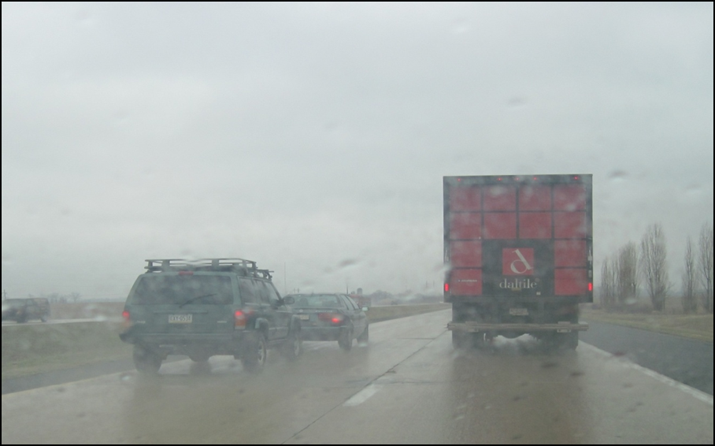
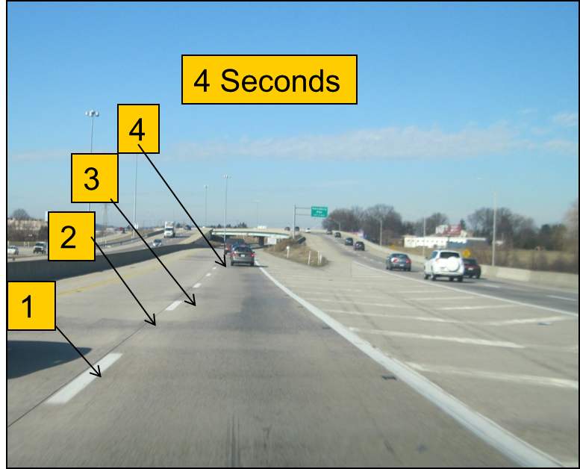
Maintain an Adequate Following Distance
Allows you time to react.
4 seconds minimum.
Add 1-2 seconds for speeds above 40 mph.
Count the time between you and the vehicle ahead passing the same fixed point.

Slide 18
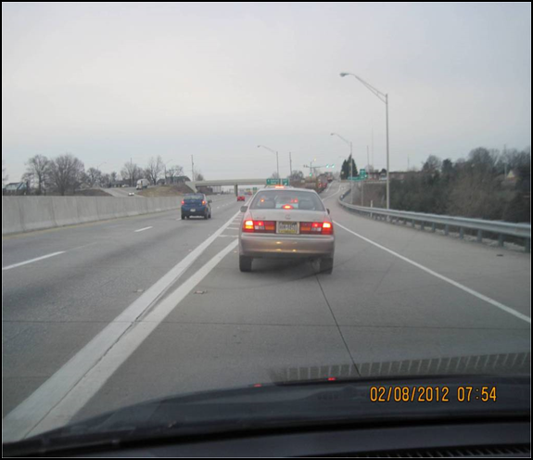
Stopping Distance
Perception & Reaction Time
+ Braking Distance
= Total Stopping Distance
Perception & Reaction Time:
Time to recognize and react
Average 1.5 seconds
At 60mph, 1.5 sec =132 ft traveled (88fps)
Braking Distance:
Distance it takes to stop a vehicle from a given speed
Average vehicle at 60mph = 185 ft
Ex: Stopping distance from 60mph
60mph = 132ft+185ft = 317 total

Slide 19
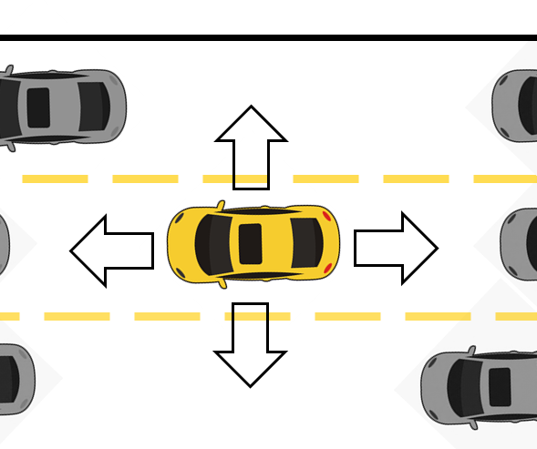
Leave Yourself an Out
Plan ahead and be aware of possible hazards.
1-2 car length space from vehicle stopped in front – should be able to see where tires of vehicle ahead touch the road.
Maintain a space cushion around your vehicle.
Don’t let other drivers dictate how you drive.
Maintain a speed where you are comfortable, even if under limit.
Notes:
Always have an escape route

Slide 20
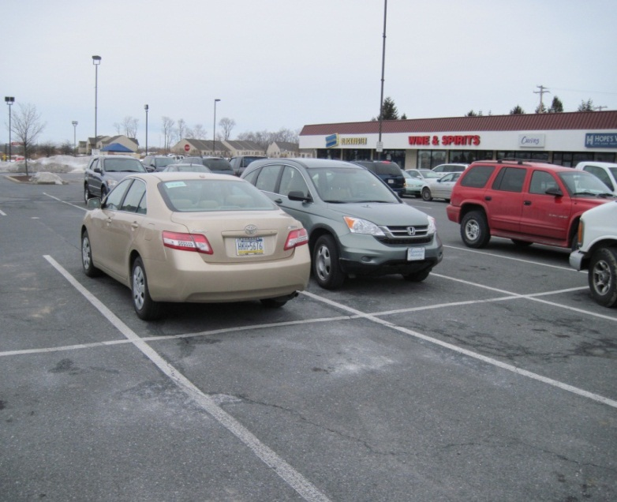
Backing Up
Avoid backing up when possible!
Pull through parking spots or try to back into the parking space (not into traffic).
Use mirrors or spotter when view is obstructed.
Never back up on a roadway if turn is missed!
Notes:
Backing up is a leading cause of vehicle accidents and should be avoided when ever possible.
Whenever possible, position you vehicle so you can pull out of a spot instead of having to back out.
When backing:
Be aware of you surroundings and know what’s behind you.
Check mirrors and look in the direction of travel.
Move slowly and inch out of the space until you have a clear view.
keep your eyes moving and scanning in all directions.

Slide 21
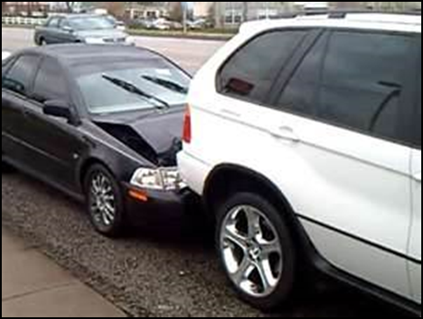
Prevent Being Rear-Ended
Look ahead, anticipate braking situations, avoid panic braking.
Check mirrors to be sure traffic is slowing behind you.
As you slow and come to a stop, visualize your actions should the vehicle behind not show signs of slowing.
Identify an escape route and leave yourself an out.
Communicate your actions to the vehicles following behind (i.e. turn signals).
Leave 1-2 car lengths between you and vehicle ahead.

Slide 22
Distracted Driving Definition
According to Distraction.gov distracted driving is any non-driving activity a person engages in that has the potential to distract from the primary task of driving and increase the risk of crashing.
Driving is a skill that requires your full attention to safely control your vehicle and respond to events happening around you. Distractions are anything that takes your attention off the primary task of driving.

Slide 23
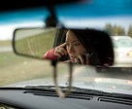
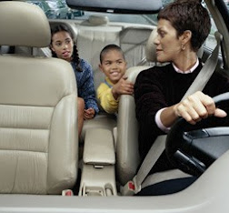
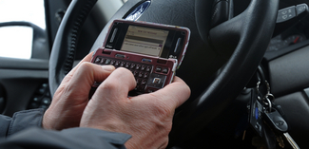
Three Main Types of Distraction
Visual — taking your eyes off the road
Manual — taking your hands off the wheel
Cognitive — taking your mind off what you’re doing
Notes:
• Events inside and outside the vehicle can distract a driver. Adverse roadway and weather conditions require a driver’s full attention.
• While taking one's eyes off the road presents obvious risks, activities that take a driver's mind away from driving are just as risky.
• A driver's ability to manage distractions varies widely and can change from day to day depending on stress level and fatigue.
• Distracted drivers may fail to recognize potential hazards in the road and react more slowly to traffic conditions, decreasing their “margin of safety.”
• Research suggests that distracted driving increases the risk of rear-end and single-vehicle crashes.

Slide 24
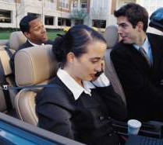
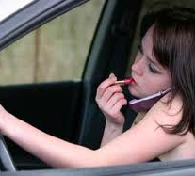
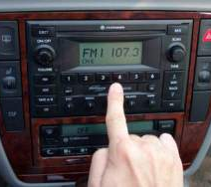
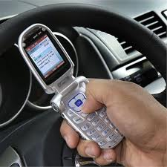
Distracted Driving
Using a cell phone
Talking /texting
Checking emails
Eating and drinking
Talking to passengers
Grooming
Rubber necking
Reading
Using a navigation system
Changing radio
Notes:
IF an app such as mapquest, googlemaps, waze must be used, please try to have another staff navigate OR is driver must use, use it in hands-free/listen mode. Try to review the routes PRIOR to driving.

Slide 25
Distracted Driving Video (3 minutes)
https://www.youtube.com/watch?v=7eFH3y_SIO0

Slide 26
Safety First – Assisting Individuals
When assisting individuals in/out of cars and on/off vans:
Ensure the vehicle is turned off and keys are removed (unless needed for operating lift).
Assist people who are most mobile first.
Before driving, ensure seat belts are on (remind passengers the law requires seatbelts before you can operate the vehicle).
If using a wheelchair accessible van, make sure to lock wheels on mechanical lifts and that the wheelchair is properly secured in van (view videos on next two slides).

Slide 27
Wheelchair Accessible Full-Size Van with Lift & Q Restraints Training Video (8 minutes)
https://youtu.be/-FBBKee9BK8

Slide 28
Wheelchair Accessible Mini/Conversion Van with Ramp & Q Restraints Training Video (12 minutes)
https://youtu.be/hPaGGGT82Rg

Slide 29
UCP GPS Vehicle Monitoring (Geotabs)
GPS (geotabs) is a satellite tracking system that is attached to UCP vehicles, that monitors during operation:
Speed of travel as compared to the speed limits
Time of travel
Length of stop
Time vehicle is idling
Location of the vehicle at every stop
Vehicle mileage
Acceleration, deceleration and hard braking
Impacts to the vehicle

Slide 30
UCP GPS Vehicle Monitoring (Geotabs)
Scan geotab fob after starting UCP vehicle.
Warning beep if idling for too long, exceeding speed limit, engaging in quick turns, or hard breaking.
Do NOT share fob with another driver.
UCP will use tracking data – report cards of high, medium, low risk.
Safe driving will be recognized.
Poor driving and violations will be subject to progressive discipline.

Slide 31
UCP GPS Vehicle Monitoring (Geotabs)
GPS-related activities are monitored and will be addressed following UCP’s Progressive Discipline policy:
Demonstrated patterns of unsafe driving (speeding, harsh braking, acceleration, etc.)
Vehicles that travel consistently over speed limit.
Vehicles left idling at any service location for an extended time.
Stops that deviate from the assigned route of service or other unscheduled stops.
Unauthorized use of company vehicle outside of work hours.
Tampering with the GPS unit.
Failure to swipe fob and/or sharing fob with another driver.

Slide 32
UCP GPS Vehicle Monitoring (Geotabs)
Extenuating circumstances that could prompt an appeal to any GPS-related disciplinary actions:
A medical emergency.
When specifically requested by law enforcement officer or some similar governmental official to engage in the behavior which violates the policy.
Where supervisor has amended the assigned route of service for business-related purposes.
Technical malfunction.

Slide 33
Driver Score Card Example:

Slide 34
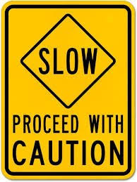
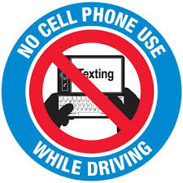
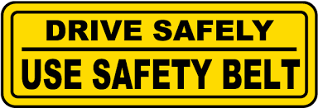
Please drive responsibly!
Thank you!

