Slide 1
Person-Centered Practices & Relationship Building
Community Integration

Slide 2
Training Objectives:
Define Person-Centered Planning
Discover various Person-Centered Thinking tools and approaches
Understand the value of community presence and participation for community integration
Recognize the significance of promoting choice and self-determination
Recognize the importance of encouraging development of valued social roles and relationship building
Understand the need to enhance skill development and to support contribution
Notes:
READ SLIDE

Slide 3
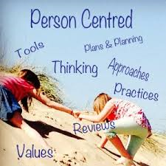
Person-Centered Practices DEFINED:
An ongoing problem-solving process using various approaches and tools to help people with disabilities plan for their future, to achieve goals and desires.
Person-Centered Planning is used to understand what each person wants and needs to live their own, personally defined ‘everyday life.’
Notes:
READ SLIDE

Slide 4
The foundation of Everyday Lives: Values In Action
1. We value what is important to people with disabilities and their families, who are striving for an everyday life.
2. People with disabilities have a right to an everyday life.
Notes:
Providers are to use the recommendations of Everyday Lives to support individuals and their families towards the possibility of achieving an everyday life.

Slide 5
What people want…
Control over all areas of their life. Emphasis on making decisions.
Choice and decisions on everything from food to how time is spent.
Freedom and the same rights as other members of the community.
Connected through meaningful contribution and developing relationships.
Notes:
Out of curiosity, did anybody read any of the Value Statements and think “I’d be glad not to have that value in my own life.”
Anyone willing to give up Control over your life? Stability? How about your Health? Ability to Communicate?
My point is that we often take for granted what we have but so often others are longing for just a small part of what we for take for granted every day, including the right and privilege to define and lead our own everyday life.

Slide 6
Person-Centered vs. System-Centered – Beth Mount
https://www.youtube.com/watch?v=y77y7XW8GtE (2 min)
Notes:
This is a 2-minute video that beautifully defines person-centered planning.

Slide 7
Person-Centered Thinking Tools
Notes:
Every Individual we support has an Individual Support Plan that can serve as a great resource for information for person-centered planning and practices, but that ISP is far from the only resource. Daily conversations and the sharing of ideas, soliciting feedback from all stakeholders – most importantly the Individual themselves– but also their supporters such as Families, Support Professionals, clinical staff, Support Coordinators, etc. is very important.
Additionally, there are tools ODP has developed as part of their CPS Certification training (4 hours on myodp.org site) that can be used to assist with planning, and some of the information can be found on the Individual’s ISP:
Like & Admire are positive characteristics of the person.
Important TO & FOR are things that provide meaning and enjoyment TO each person and things that are needed FOR health, safety and to be a valued member of the community.
Know & Do to Support provides specific tips to promote positive experiences and ensure health and safety.
What Does/Doesn’t Make Sense address what needs to be present or absent from multiple perspectives.
4+1 Questions is a tool that can be used to reflect on past experiences to guide future efforts.

Slide 8
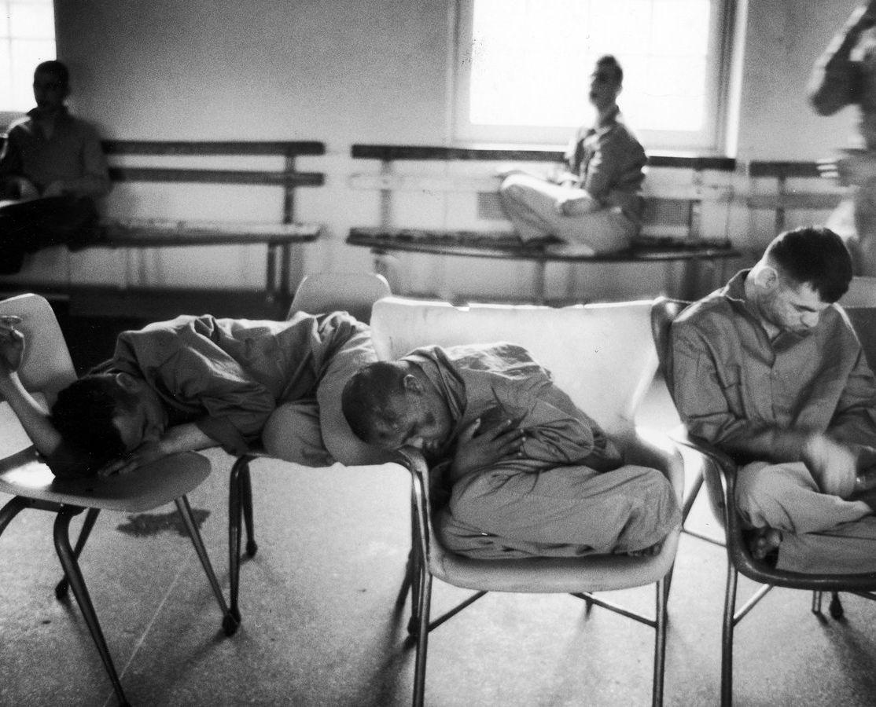
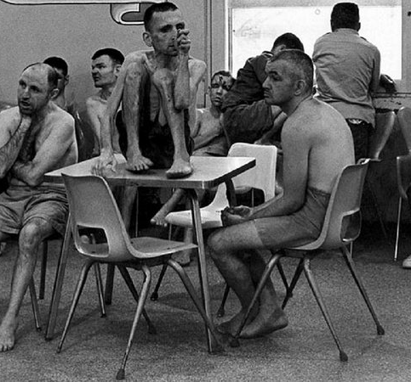
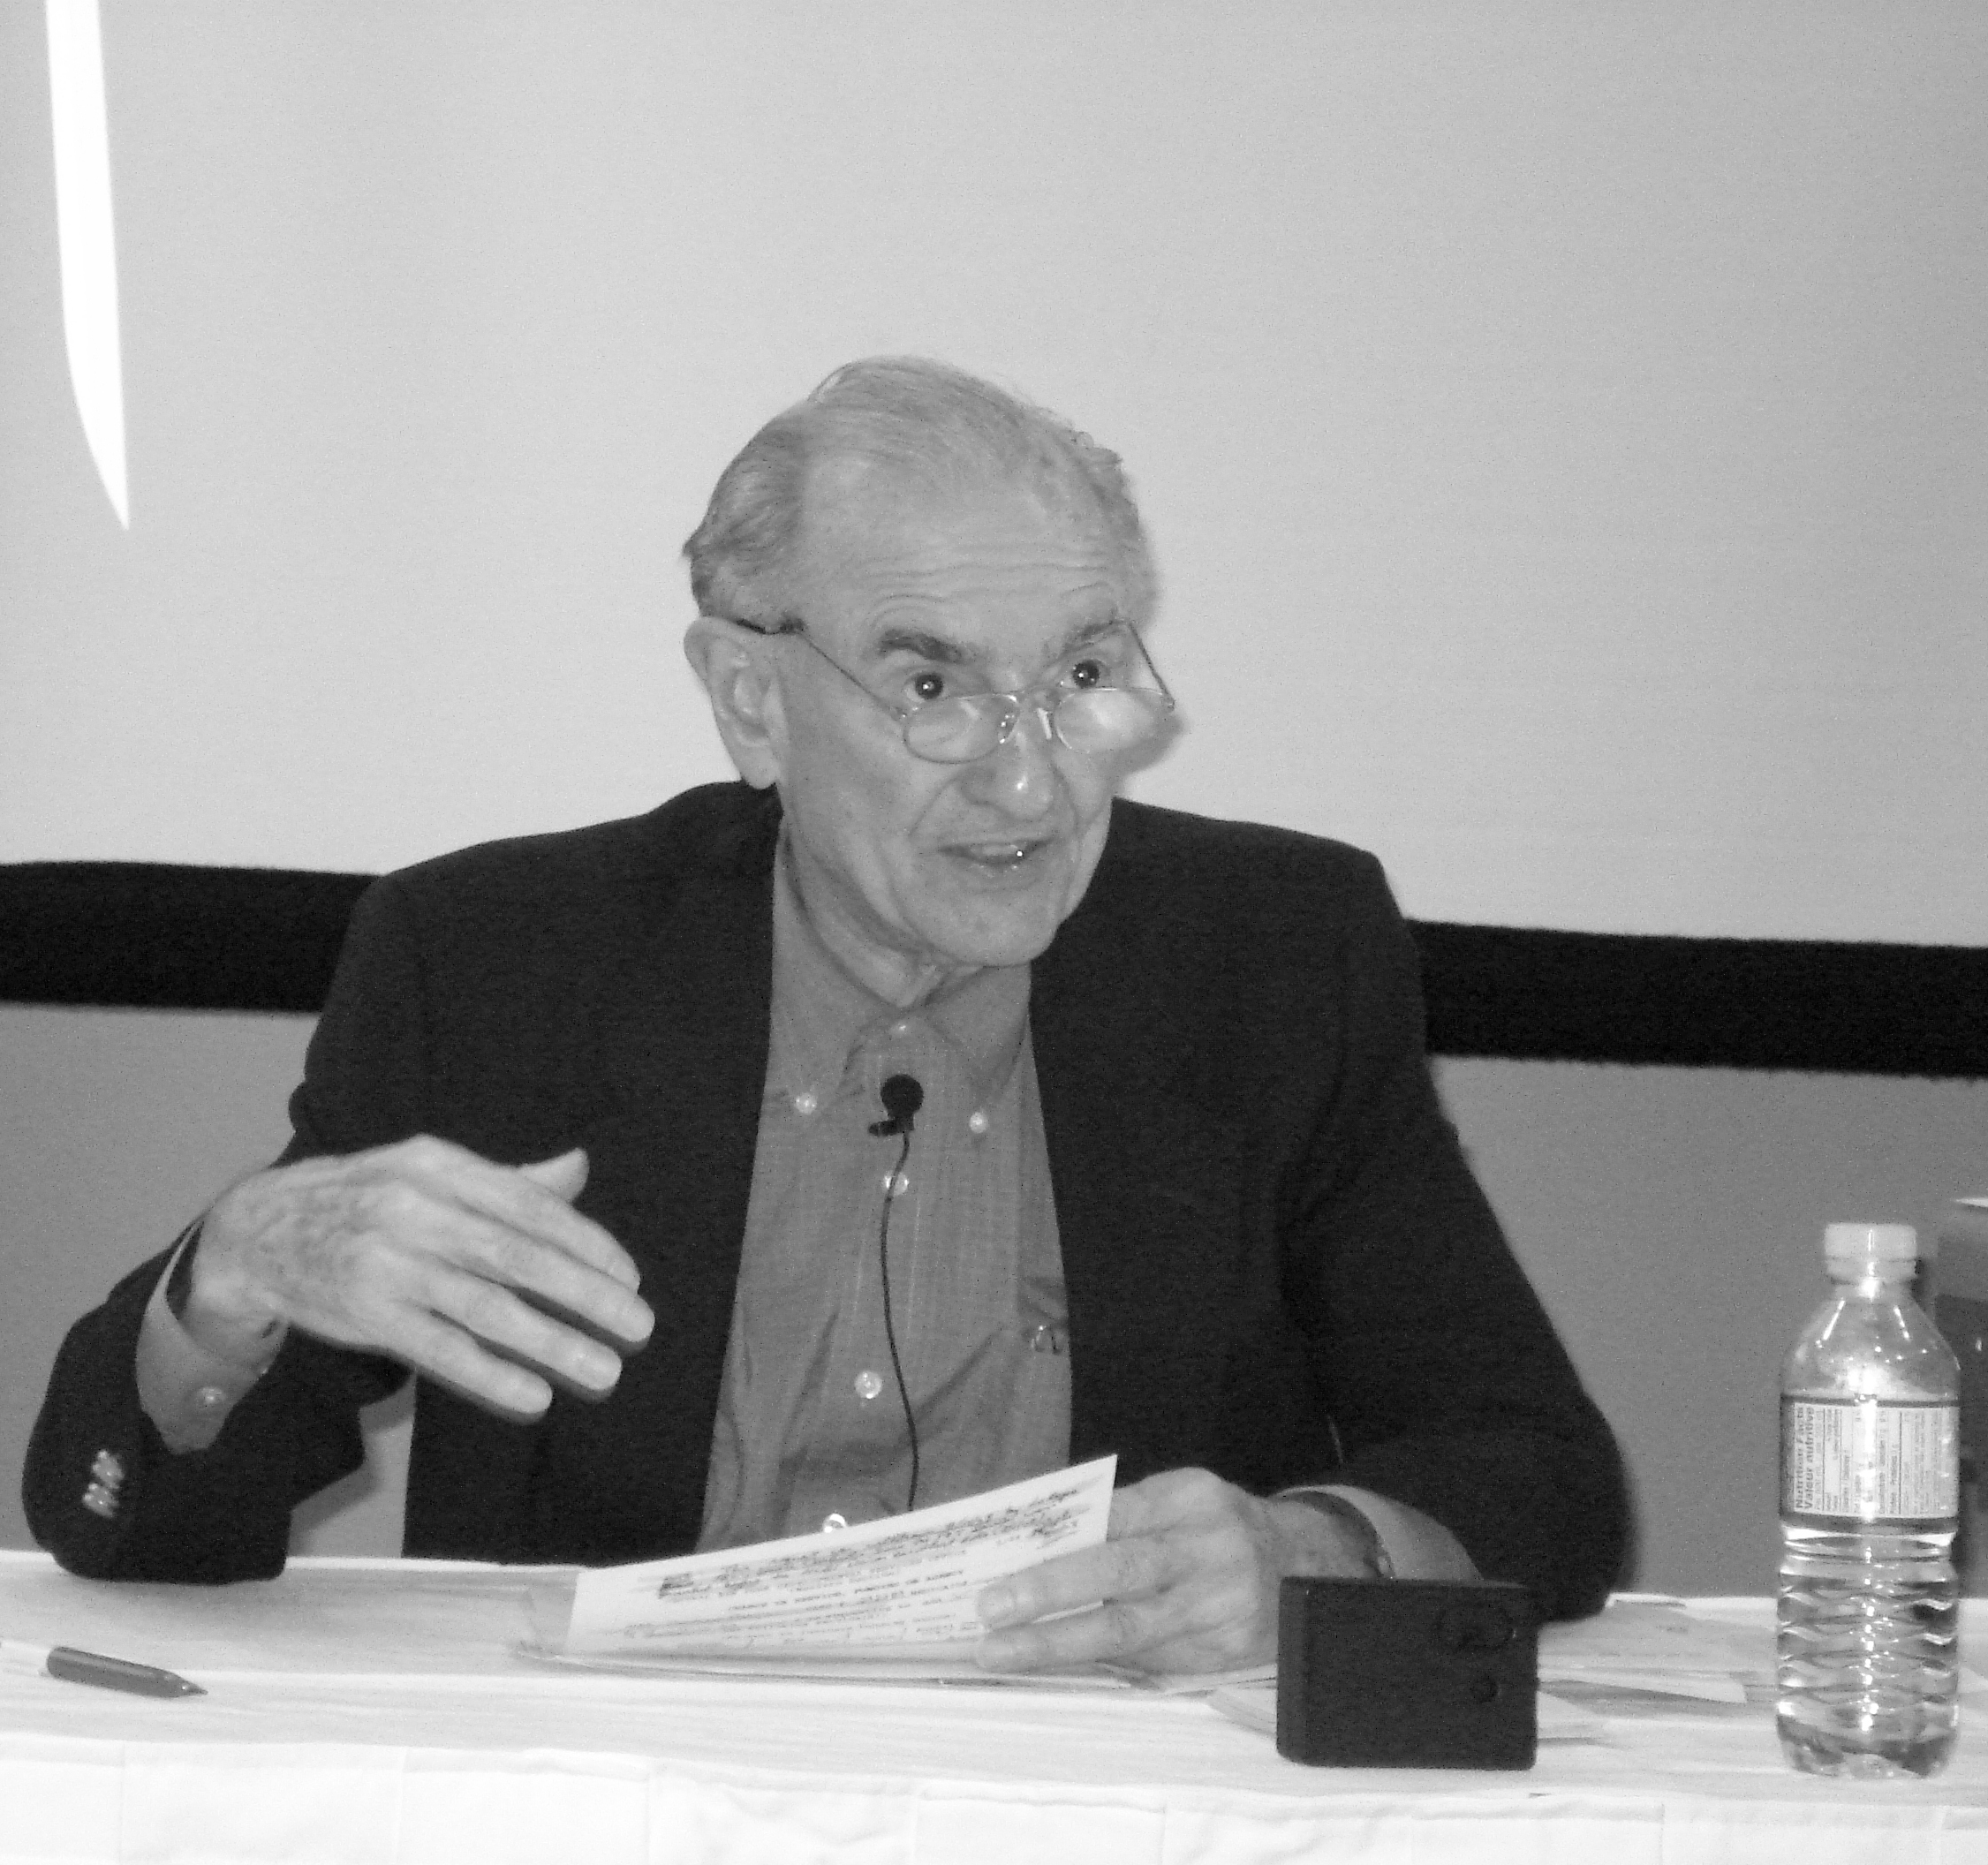
Social Role Valorization Dr. Wolfensberger
Wolfensberger defined SRV as:
"The application of empirical knowledge to the shaping of the current or potential social roles of a party (i.e., person, group, or class)--primarily by means of enhancement of the party's competencies and image--so that these are, as much as possible, positively valued in the eyes of the perceivers."
Notes:
The Theory of Social Role Valorization was developed by Dr. Wolf Wolfensberger. Dr. Wolfensberger was born in 1934 in Germany and emigrated to the US in 1950. He earned a PhD in Psychology, specializing in mental retardation (ID) and special education and became a Professor of Special Education and Director of the Training Institute for Human Service Planning, Leadership, and Change at Syracuse University.
He made an impressive number of significant contributions to the board sphere of human services, most particularly in regard to serving people who are socially devalued (‘less than’) or highly vulnerable people.
In 1972 his work ‘The Principle of Normalization in Human Services’ and a service quality evaluation tool called the ‘Program Analysis of Service Systems’ (aka PASS) contributed to an international wave of service change, moving away from segregating people from typical society (i.e. large institutions with horrible living conditions) towards supporting their integration into community settings and activities.
In the 80’s he moved away from the ‘normalization’ terminology because it was often misinterpreted, and he formulated an approach called the Social Role Valorization (SRV) to address the reality of social devaluation. The basic premise of SRV is that people are much more likely to experience the ‘good things life’ if they hold valued socials roles than if they do not.
PICS: Willowbrook State School in New York City from 1947-1987 (designed for 4k by 965 had 6k – gross understaffing, deplorable living conditions, unregulated abuse/neglect)

Slide 9
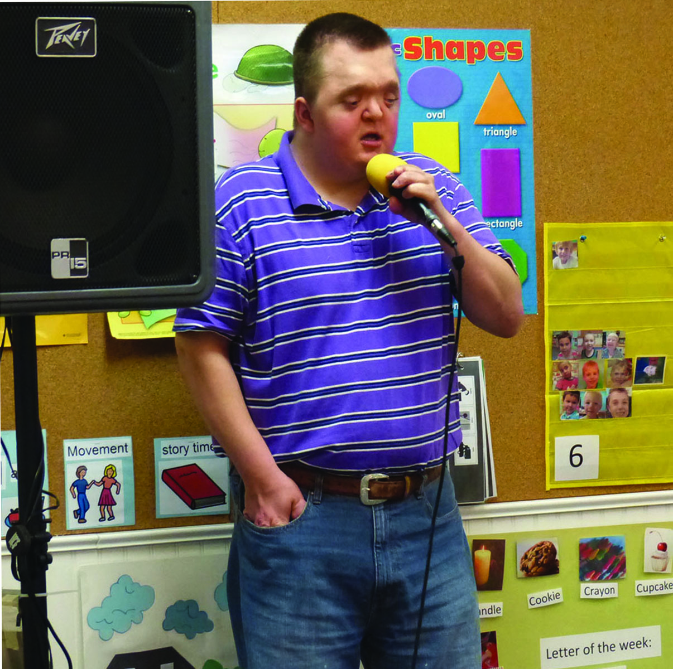
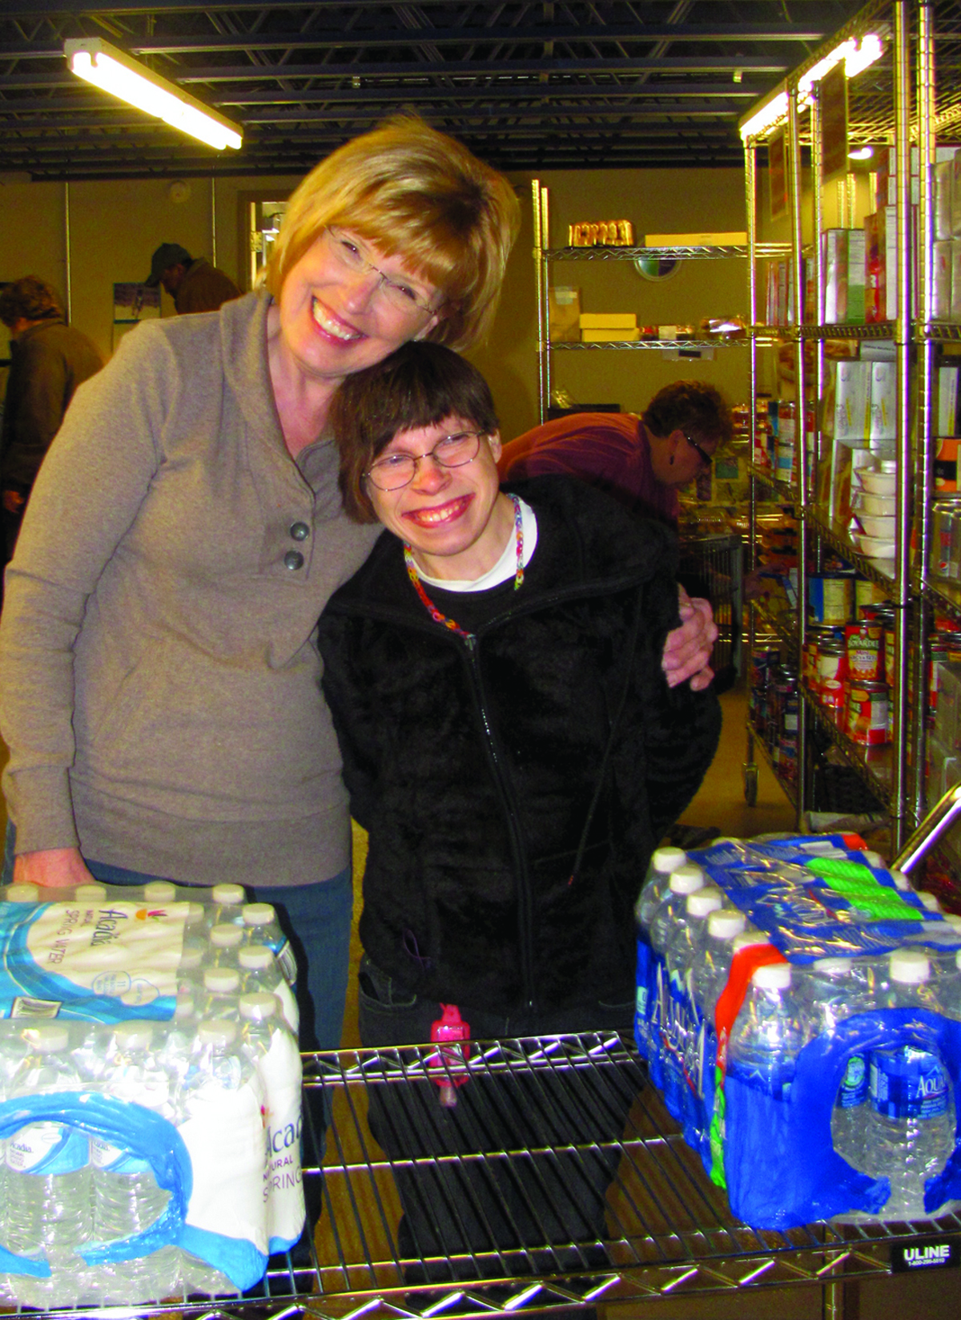
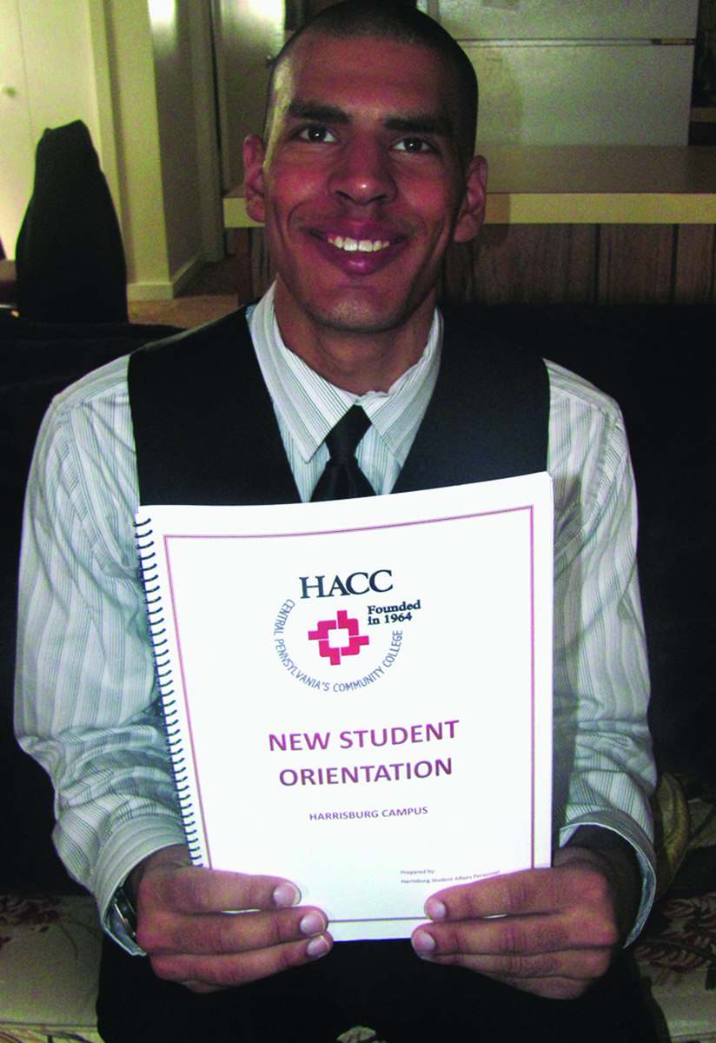
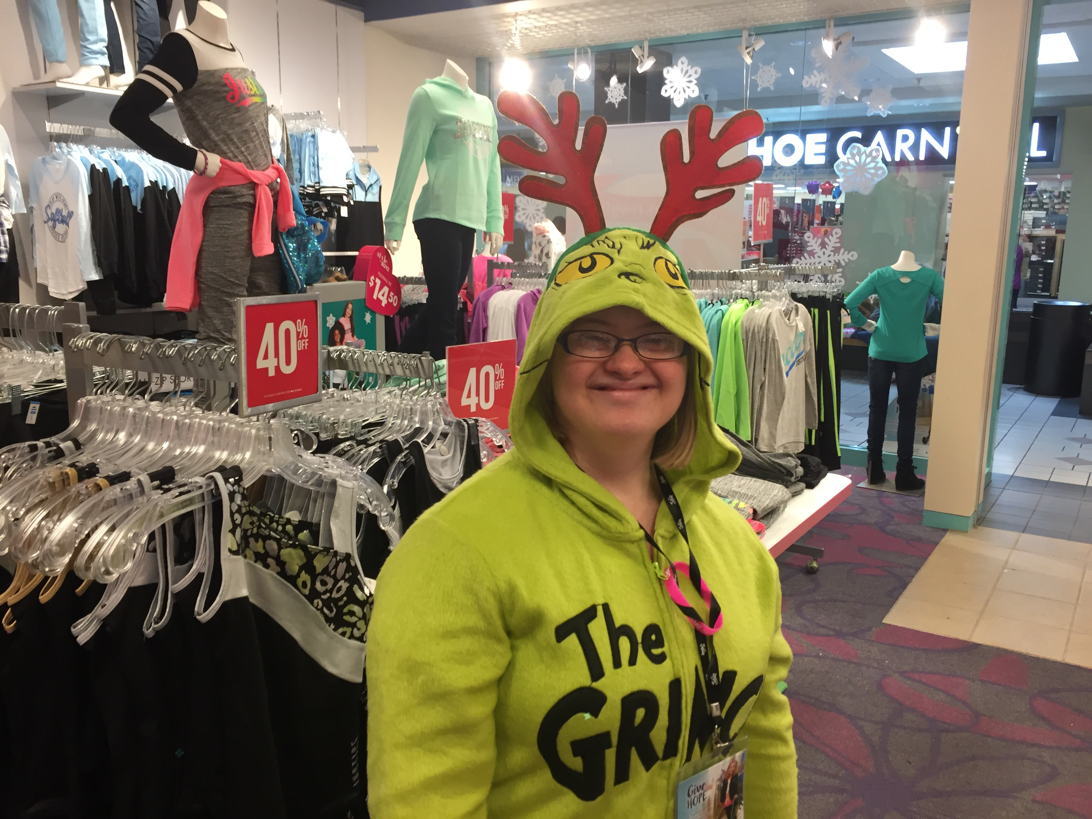
Examples of Valued Social Roles
Employee
Volunteer
Colleague
Neighbor
Customer
Friend
Voter
Citizen
Student/Graduate
Church/Gym/Club Member
Artist/Performer
Pet owner
Homeowner
Home renter
Brother/Sister
Father/Mother
Son/Daughter
Notes:
This is a list of examples of valued social roles that are important to people. People with disabilities often do not have many of these valued roles.
When we think about people we support – the title/roles we often consciously or unconsciously think of are words such as ‘individual, participant, resident, consumer, customer, client, patient’ – these are NOT valued social roles.
Our mission is to empower people of diverse abilities to live a meaningful life through innovative support and services. In other words, our work is help people gain valued social roles, as they desire.

Slide 10
Beautiful Justice - Beth Mount
TEDx Beth Mount Beautiful Justice – YouTube (20 min)
Notes:
Carefully watch this 12-minute video and make note of the 1. valued social roles that Kenny gains because of person-centered planning practices and 2. think about ways his life is impacted and what that means both to him and to his family.
QUESTION: List one valued social role Kenny gains.
QUESTION: How does gaining the valued social role you listed positively impact Kenny’s life?

Slide 11
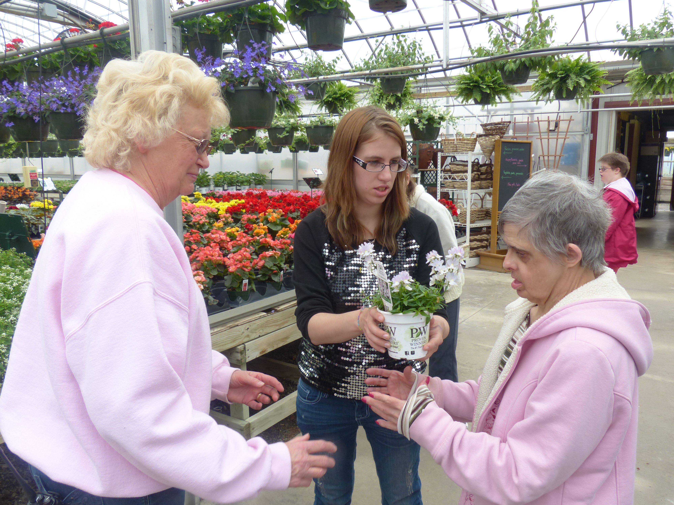
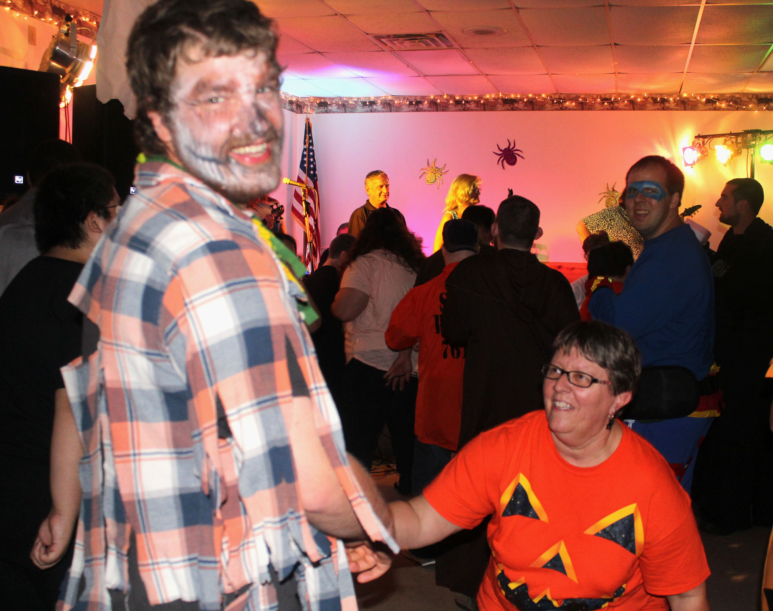
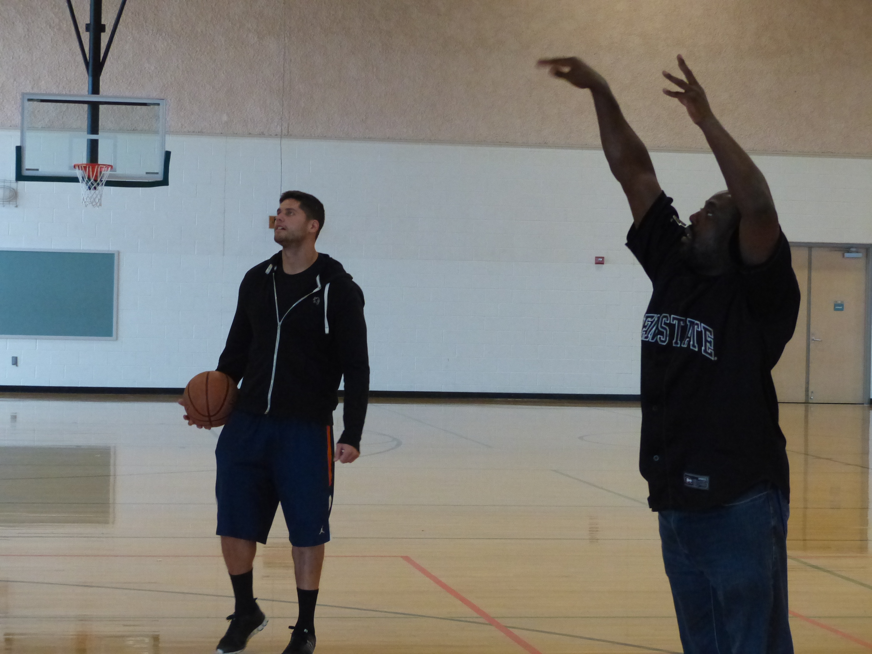
Valued roles give a person a “place” in society and powerfully impact:
Opportunities to contribute
Material gain and self-support
Status and reputation
Positive self-image and boosts confidence
Acceptance and belonging
Associations and relationship
Autonomy and freedom
Personal growth and development
Notes:
YES! Valued roles give a person a “place” in society and powerfully impact people’s lives –
READ SLIDE
Dr. Wolfensberger was referring to these as “the good things in life.”

Slide 12
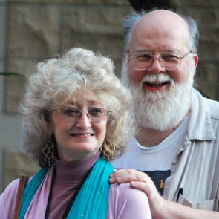
Increase opportunities for an Everyday Life & Community Integration:
Notes:
John O'Brien is a leading thinker who has written widely in the field of disability. He and his wife are lifelong advocates of Person-Centered Planning and they developed framework that can serve as a guide for supporting people with developmental disabilities. They built their work in the early 90’s on the theories of Dr. Wolfersberger’s.
John says that Person-Centered Planning serves as a container for shaping collective intention around what a particular person finds meaningful and valuable in composing a life that they, and the people who love them, find worth living. The O’Brien’s person-centered framework is called the Five Valued Experiences. The Five Valued Experiences are Belonging, Respect, Sharing Spaces, Contribution, Choice, and each one are needed for us to enjoy a happy and meaningful life. Unfortunately, people with disabilities have WAY more access barriers to those valued experiences.
By incorporating the Five Accomplishments, on this screen, as part of the framework for person-centered planning, people with disabilities have a greater chance of gaining those Five Valued Experiences. The accomplishments are 1. Community Presence – how can we increase the presence of a person in local community life? , 2. Community Participation – how can we expand and deepen people’s relationships?, 3. Encouraging Valued Social Roles – how can we enhance the reputation people have and increase the # of valued ways people can contribute?, 4. Promoting Choice- how can we help people have more control and choice in life?, and 5. Supporting Contribution – how can we assist people to develop more competencies?
Really, the goal is community integration through integrative relationships.

Slide 13
Developing Relationships: YOUR ROLE is to help foster and enhance (non-paid) relationships
Community Presence & Participation is KEY
People must be active in their communities - go to typical places that other non-disabled persons go - banks, churches, gyms, restaurants, grocery stores, libraries…
YOUR Role to ensure the person is actively involved in transactions, events, community functions (based upon individuals' preferences)
Notes:
Our role and mission is to help foster and enhance integrative relationships that are freely given (unpaid) with valued typical people.
In order to do that, people must be present and active in their communities; they need to go to typical places that other non-disabled persons go. Banks, churches, gyms, restaurants, grocery stores, library's, events, etc.
People need to be fully integrated into their communities and when they are, opportunities to connect and build relationships will increase, as will the opportunity to contribute! But it’s important to recognize that takes intention and time. Kenny’s everyday life was achieved over years, not weeks or months.

Slide 14
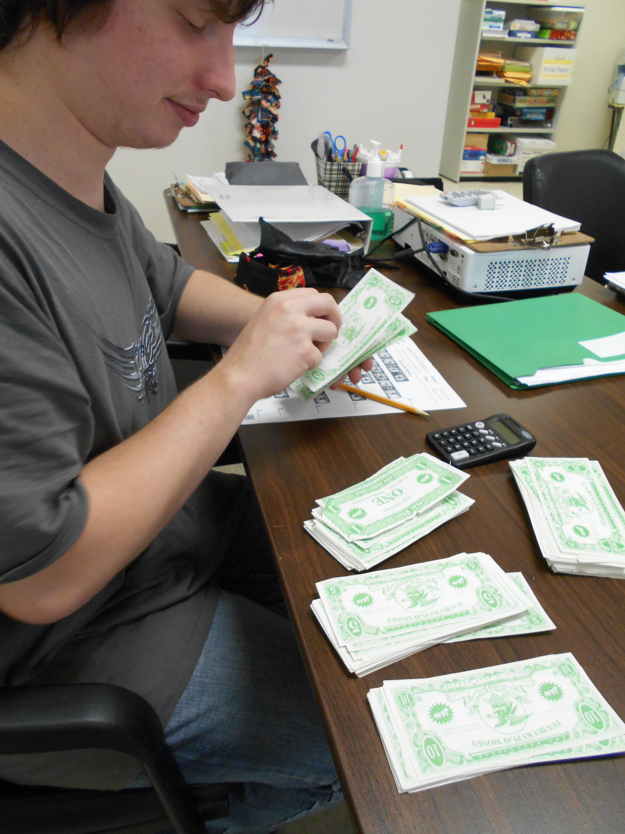
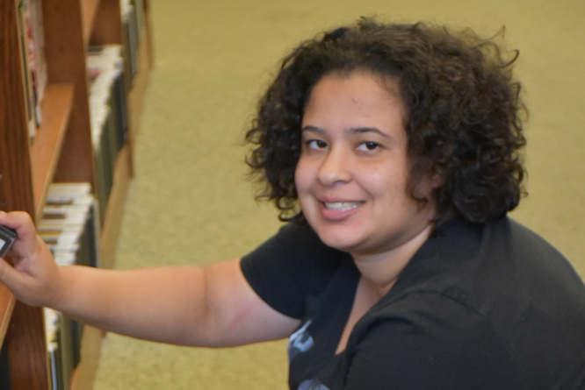
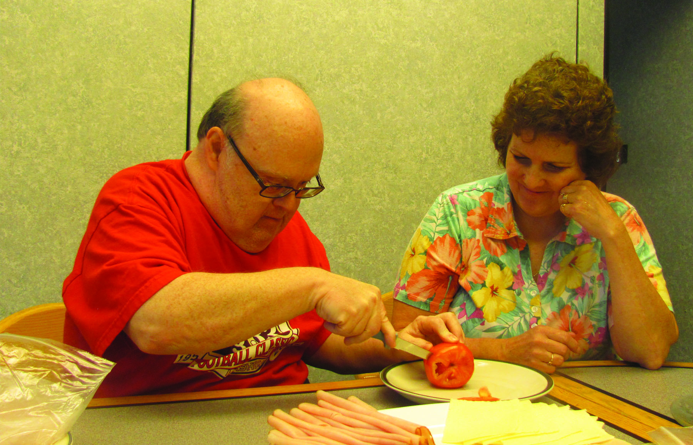
Skill Development/ Gaining Competencies
Teach/expand skills to support contribution
Important to encourage others to do for themselves
Follow outcomes developed by the team and in the ISP
Encourage new experiences
Notes:
An important part of our work is to encourage people we support to develop skills and gain competencies through things like –
Teaching and expanding on skills to support the ability to contribute.
Encouraging people to try to do for themselves and to promote independence.
Encouraging new life experiences, while being mindful to follow the outcomes that are developed for each person, so we are all working towards the same goal and vision.

Slide 15
Community Integration
When individuals increase the number of relationships they have with non-disabled, non-paid persons they will be more confident, connected, independent and will have a more meaningful and valued life, in their home and communities.
Notes:
Ultimately, when individuals increase the number of relationships they have with non-disabled, non-paid persons they will be more confident, connected, independent and will have a more meaningful and valued life, in both their home and communities.

Slide 16
Person-Centered Practices & Relationship Building RECAP
YOUR ROLE is to help people plan and achieve their personal goals and desires through:
COMMUNITY PRESENCE & PARTICIPATION,
ENCOURAGE VALUED SOCIAL ROLES,
PROMOTE INDIVIDUAL CHOICE,
SUPPORT CONTRIBUTION
…to ensure everyone experiences their EVERYDAY LIFE!
Notes:
Regardless of our title, our mission is the same – to empower people of diverse abilities to live a meaningful life through innovative support and services – and by doing so, we are helping people to work towards their vision of an Everyday Life.

