Slide 1
Incident Management Training Understanding Your Role as a Mandated Reporter
Notes:
Upon hire to UCP, you become a mandated reporter. Being a mandated reporter means you are required, by law, to report any witnessed or suspected abuse or neglect. Additionally, as part of your employment at UCP, you are required to report many other types of witnessed or suspected events. Today’s training will help you understand your obligations as a mandated reporter.

Slide 2
Objectives:
Review Incident Management and its history
Review the current Incident Management Bulletin including Incident Primary and Secondary Categories
Outline the roles and responsibilities of incident management
Notes:
This training is designed to help you:
-Understand how the incident management system came to be and why it exists in our field.
-Understand what is considered reportable according to the most recent Incident Management Bulletin 00-21-02.
-Explain what it means to be a mandated reporter and what you are expected to do if you see something or become aware of something which is reportable under the Incident Management Bulletin.

Slide 3
Purpose of an Incident Management System
The Incident Management system for ODP was developed in order to have a centralized way to report events that could have a negative impact on the participants we support.
2001: The original Incident Management Bulletin was released.
2004: A revised Incident Management Bulletin was released.
2021: A revised Incident Management Bulletin (#00-21-02) was released and went into effect on July 1, 2021.
Notes:
-Incidents of abuse or neglect have always been reportable to some extent. However, there was no standard way of reporting or consistency is what people reported. Therefore, the Office of Developmental Programs (also known as ODP) developed an Incident Management system which provided a centralized place for all providers to report incidents. When incidents occur that are reportable, they are entered in an electronic web application called (EIM) Enterprise incident Management. All Providers are required to report incidents electronically if the participants receives any public dollars.
The purpose of ODP’s management system is to ensure that when an incident occurs or is suspected to occur the response is adequate to protect and promote the health, safety and rights of the individual.
-In order for those providers to know what was considered reportable and the responsibilities of providers if such incidents occurred, the first Incident Management Bulletin was released in 2001. A revised Incident Management Bulletin was released in 2004 which helped clarify some information.
-From 2004 until 2021, the same Incident Management Bulletin remained in place. However, a new Incident Management Bulletin was released with an effective date of July 1, 2021. This new bulletin included many changes.

Slide 4
New Incident Management Bulletin
The 2004 IM Bulletin was in place for 16 years. A great deal changed in those years including practices and big changes to program regulations and licensing regulations.
The most recent bulletin is intended to encourage greater reporting and provide greater protections for the participants we support.
Notes:
The bulletin with an effective date of July 1, 2021, is intended to account for the changes in practices, regulations and licensing which have occurred since 2004 when the last bulletin was released.
The hope is that by having the revisions and additional details on the types of reportable incident that could potentially cause harm to participants, we can implement greater protections for all participants receiving services.

Slide 5
What Events Prompted the New IM Bulletin?
Data shows:
Participants with ID/A experience trauma at a higher rate.
It is likely that participants you support have experienced physical, sexual or emotional trauma at some point in their lives.
While you may not know what happened in the past to a participant you support, you need to think about incident management as the way to prevent ongoing or future trauma.
Notes:
So why did ODP release a new Incident Management Bulletin?
First, there’s data behind it. Data shows that people with intellectual disabilities and/or autism experience trauma at a higher rate. With that being known, it is important that you understand that it is likely that the participants you support have experienced some type of physical, sexual and/or emotional trauma at some point in their lives. At times, this trauma is repetitive, and for some, that trauma begins early in life and exists until their death.
As someone who will interact with participants on a regular basis, you need to be prepared to detect and identify reportable incidents. You may not always know what happened to someone in the past, but you need to be prepared to be alert and ready to report in order to try to prevent ongoing or future trauma from occurring.
The other event that prompted a new bulletin is a result of an audit completed by the OIG (office of inspector general) in 2015-2016. The report filed indicated that Pennsylvania did not fully comply with Federal Medicaid waiver and State requirements for reporting and monitoring 24-hour reportable incidents involving Medicaid beneficiaries with developmental disabilities who resided in community-based settings. Specifically, Pennsylvania did not (1) ensure that community-based providers reported thousands of 24-hour reportable incidents within required timeframes, (2) ensure that community-based providers and county and regional investigators analyzed and investigated all beneficiary deaths, and (3) ensure that community-based providers referred all suspicious deaths to law enforcement.
Pennsylvania did not have adequate controls to detect unreported 24-hour reportable incidents and did not have controls in place to ensure that all beneficiary deaths were investigated and that all suspicious deaths were referred to law enforcement. Therefore, Pennsylvania did not fulfill participant safeguard assurances it gave to CMS to ensure the health, welfare, and safety of the 18,770 Medicaid beneficiaries with developmental disabilities covered by the Medicaid waiver. As a result of the OIG’s report ODP developed and released the new bulletin with is designed to monitor situations that could jeopardize the health, safety and rights of the participants receiving the services.

Slide 6
New/Adjusted Incident Categories
The 2021 IM Bulletin includes new primary and secondary incident categories as well as changes to previous categories. These changes were made in order to:
Consistently report incidents by category
Increased focus on corrective action in order to promote better outcomes for participants.
Better data analysis to identify the need for targeted training, technical assistance and statewide action.
Notes:
While there are many changes in the new Incident Management Bulletin, one of the biggest changes surrounds the categories of incidents. In this revised bulletin, there are a series of primary incident categories which serve as the “buckets” under which incidents will be reported. Each of these categories has a specific definition outlined in the bulletin. By having these definitions, ODP is attempting to have consistent reporting.
Under each primary category are secondary categories which help focus the reporting even more to help drive better, more detailed data analysis to focus training, technical assistance or even statewide policy changes if needed.
In addition to the changes in the bulletin, the way incidents are entered into an electronic system shows that ODP has an increased focus on creating corrective action plans following incidents which will help prevent similar incidents from happening again in the future.

Slide 7
Incident Categories
Notes:
Now we are going to review each of the types of incidents which are reportable under the current Incident Management Bulletin and the categories they fall under.

Slide 8
Understanding Incident Categories
Each incident which occurs must be classified under a primary category.
Within each primary categories are secondary categories which serve as sub-categories.
Notes:
As we discuss the types of incidents, we will focus on the primary categories and then the secondary or sub-categories within each of those primary categories.

Slide 9
Category: Abuse
A deliberate or careless act by a person, including another participant receiving services, which may result in mental or physical harm.
Secondary Categories:
Misapplication/Unauthorized Use of Restraint (injury)
Misapplication/Unauthorized Use of Restraint (no injury)
Physical
Psychological (which now encompasses the old category of Verbal)
Seclusion
Notes:
Most people understand that abuse is something which must be reported. However, abuse goes beyond just hitting or striking someone. ODP defines abuse as a deliberate or careless act by a person, including another participant receiving services, which may result in mental or physical harm.
This definition highlights that abuse can occur in many different ways. We will now discuss the secondary categories and examples of each of them.
-Misapplication/Unauthorized Use of Restraint (injury) is defined as the use of a restraint that does not follow ODP’s regulatory requirements, the misapplication of an approved restraint technique, or the use of a restraint that results in an injury requiring treatment beyond first aid. An example of this secondary category is the use of any restraint if it is not approved prior to the restraint occurring where the participant suffers an injury such as a broken arm.
-Misapplication/Unauthorized Use of Restraint (no injury) is defined as use of a restraint that does not follow ODP’s regulatory requirements or the misapplication of an approved restraint technique. An example of this secondary category is the use of any restraint if it is not approved prior to the restraint occurring even if no injury occurs.
-Physical abuse is defined as an act which causes or may cause physical injury to a participant, such as striking or hitting. Physical injuries may or may not be present with physical abuse. Allegations of physical acts without obvious signs of injury must be reported. An example of this secondary category is a patterned bruise that is in the shape of an identifiable object.
-Psychological abuse is defined as an act which causes or may cause mental or emotional anguish by threat, intimidation, humiliation, isolation, or other verbal or nonverbal conduct to diminish another. An example of this secondary category is mimicking or mocking a participant’s speech.
Please understand that under the previous incident bulletin, there were separate psychological and verbal secondary categories but now both of these types of abuse are reported under psychological abuse.
-Seclusion is defined as involuntary confinement of a participant in an area from which the participant is prevented from leaving. This includes verbal instruction or any explicit or implicit intimidation that indicates to a participant that they may not leave a room, regardless of whether the participant has the ability to physically remove himself or herself from the situation. An example of this secondary category is placing a participant in a locked room. In addition, asking an individual to go to a room and not leave until permission is granted is considered seclusion as well as taking someone to their room who is unable to leave on their own. Previously it was thought seclusion was only when someone was placed in a locked room or area. This is definitely a change, and we must be cautious not to allow any form of seclusion to occur.
Some additional notes about abuse:
-Individual to Individual abuse which is abuse between two participants receiving services was previously categorized under its own primary category. However, now such incidents are captured under the primary category of Abuse.
-Sexual Abuse was previously a secondary category of Abuse. However, Sexual Abuse is now captured under its own primary category and not under the Abuse category.

Slide 10
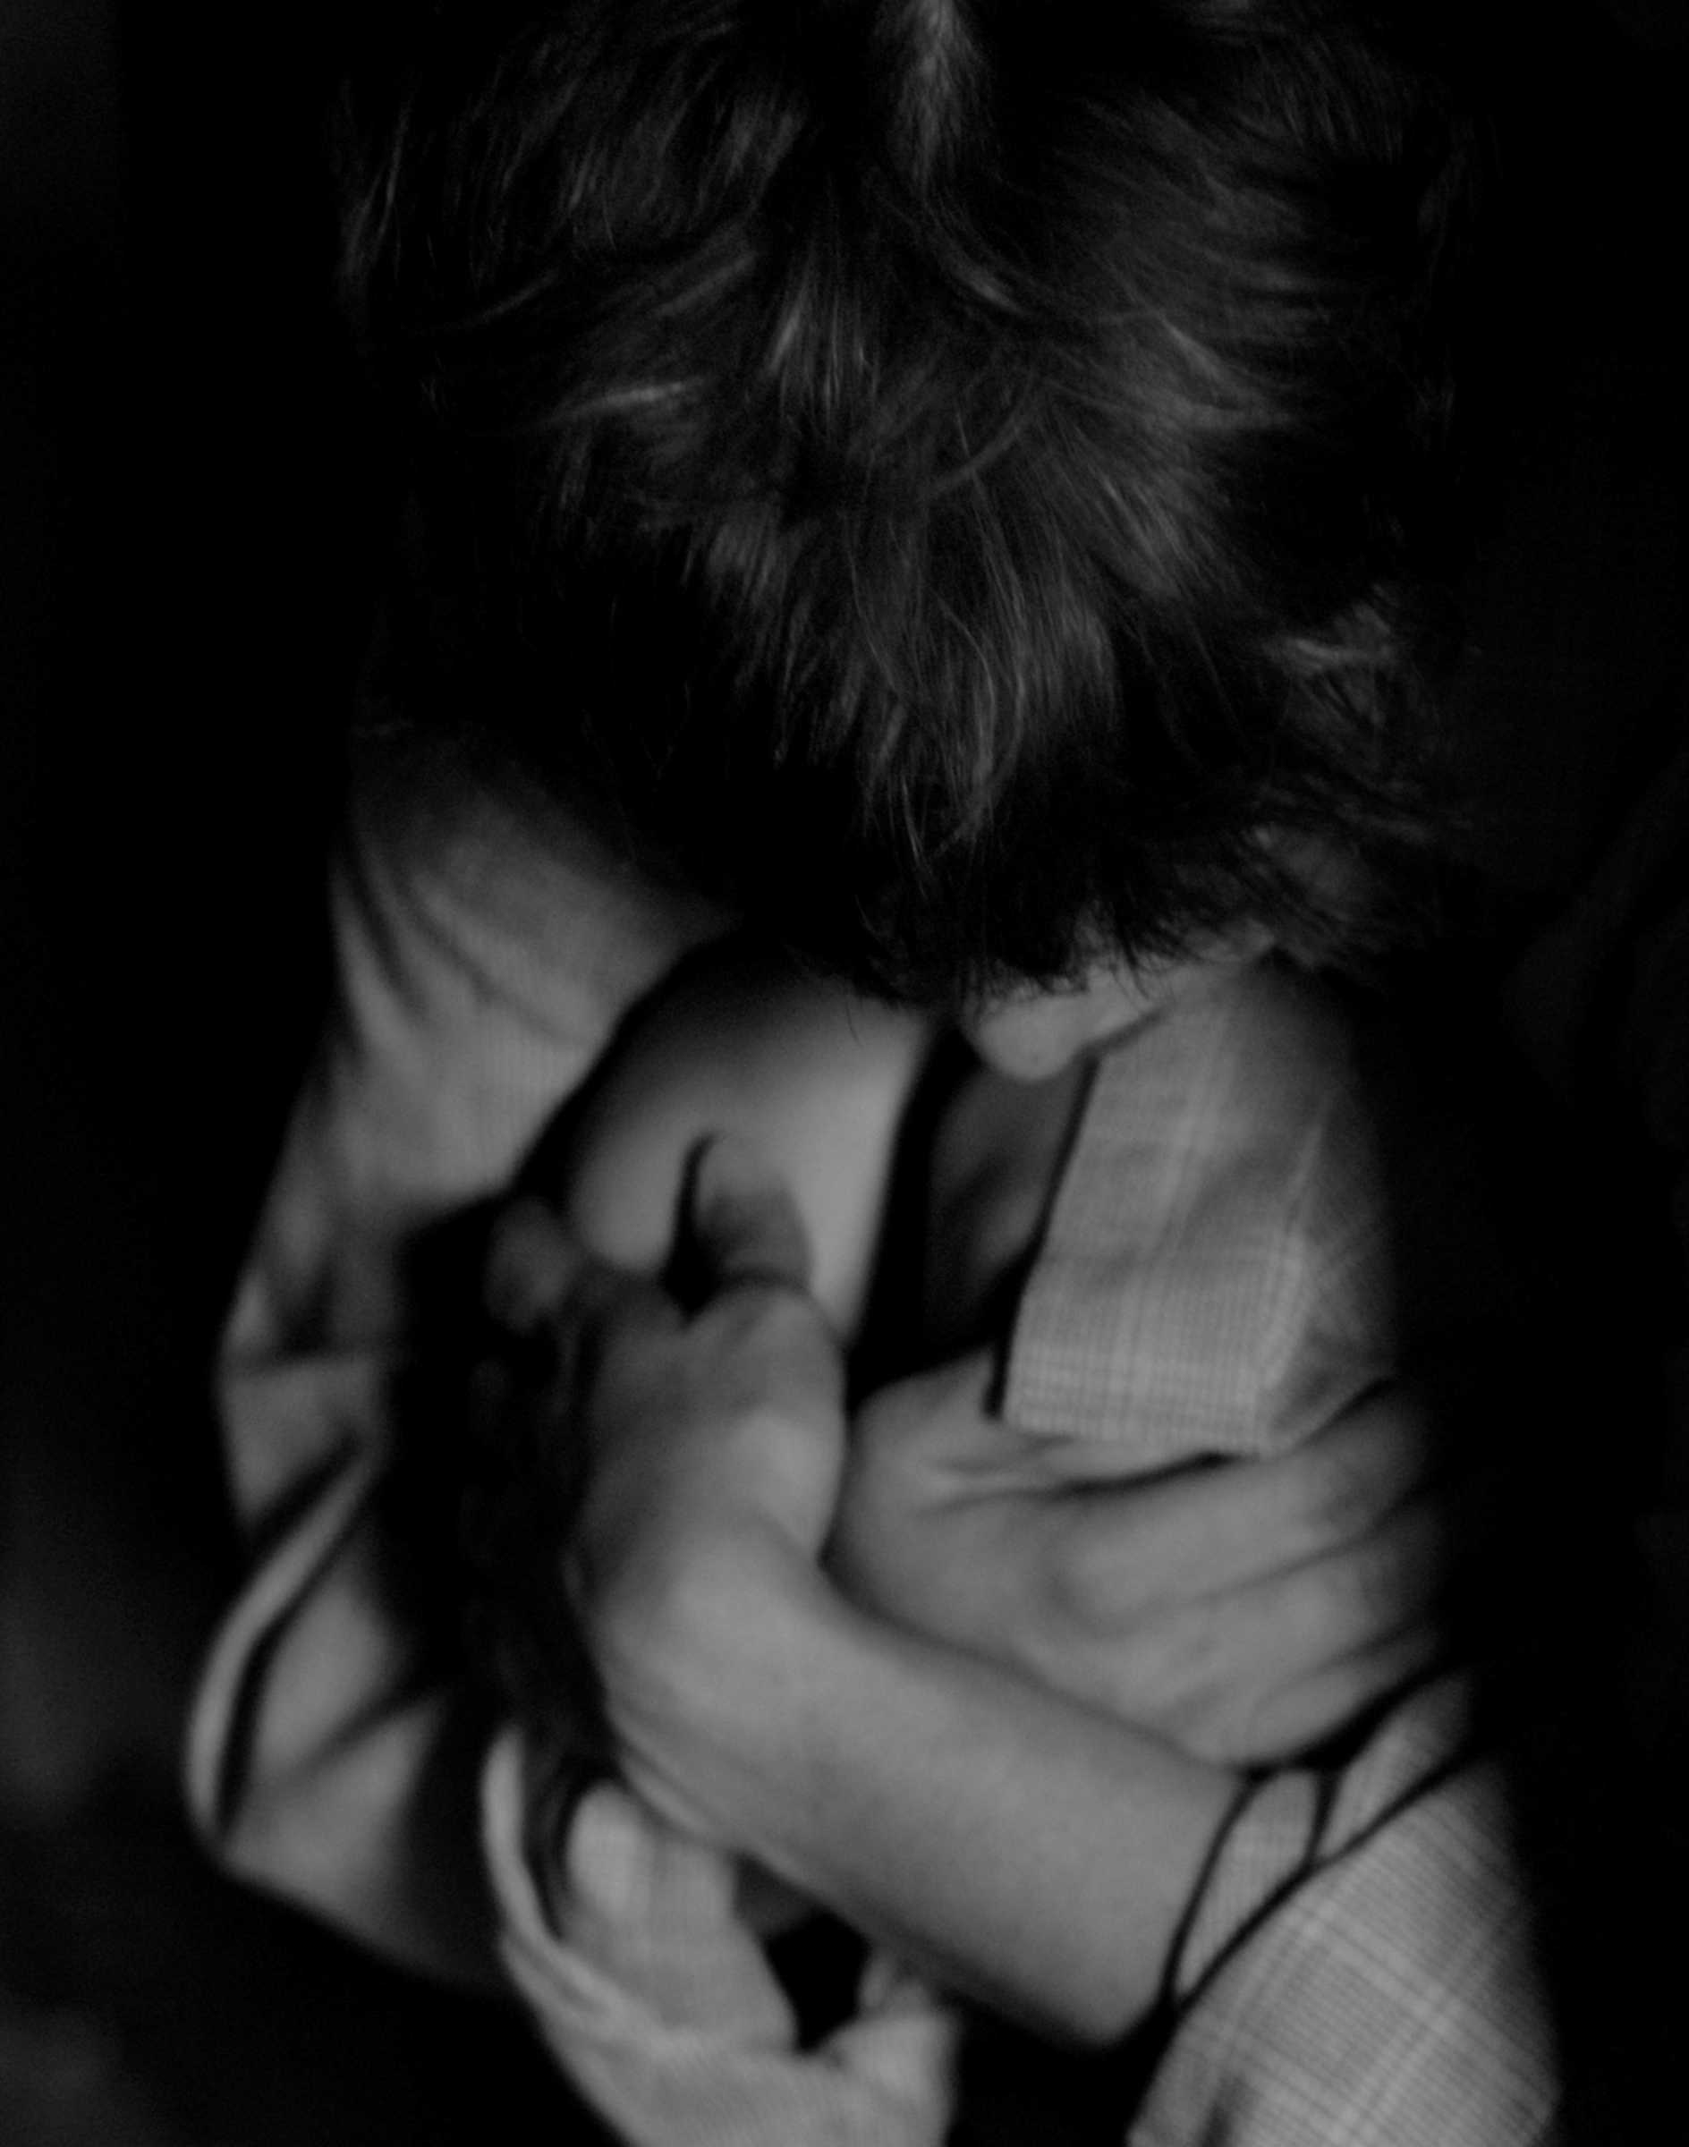
Category: Sexual Abuse
Any attempted or completed nonconsensual sexual act. The act may be physical or non-physical and achieved by force, threats, bribes, manipulation, pressure, tricks, violence or against a participant who is unable to consent or refuse.
Sexual abuse includes any act or attempted act that is sexual in nature between a paid service provider staff and a participant regardless of consent on the part of the participant.
Secondary Categories:
Rape
Sexual Harassment
Unwanted Sexual Contact
Other
Notes:
ODP recognizes that people receiving services are more likely to be a victim of Sexual Abuse. By creating a new primary category of Sexual Abuse, ODP is placing greater focus on this type of incident and prevention strategies.
The Incident Management Bulletin defines Sexual Abuse as any attempted or completed nonconsensual sexual act. The act may be physical or non-physical and achieved by force, threats, bribes, manipulation, pressure, tricks, violence or against a participant who is unable to consent or refuse. Sexual abuse includes any act or attempted act that is sexual in nature between a paid service provider staff and a participant regardless of consent on the part of the participant.
The secondary categories which fall under this primary category are rape, sexual harassment, unwanted sexual contact or other which captures any type of sexual abuse of an unknown type at the time of the report or sexual abuse that does not conform to the other secondary category options.

Slide 11
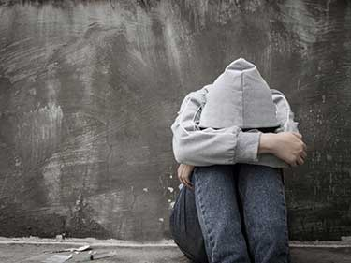
Category: Neglect
The failure to obtain or provide the needed services and supports defined as necessary or otherwise required by law, regulation, policy, or plan (Individual Support Plan, Behavior Support Plan, safety plan, etc.). Secondary Categories:
Failure to Provide Medication Management
Failure to Provide Needed Care
Failure to Provide Needed Supervision
Failure to Provide Protection from Hazards
Moving Violation
Notes:
According to the Incident Management Bulletin, neglect is defined as the failure to obtain or provide the needed services and supports defined as necessary or otherwise required by law, regulation, policy, or plan (ISP, Behavior Support Plan, safety plan, etc.). This includes acts that are intentional or unintentional regardless of the obvious occurrence of harm.
While this category has previously been part of the Incident Management bulletins, there are additional secondary categories and more definition of the previous secondary categories. The secondary categories of neglect are:
-Failure to Provide Medication Management which is defined as an event that may cause harm or lead to inappropriate medication use while the medication is in the control of the person(s) charged with administration. An example of this type of incident is a medication error which occurs over more than one consecutive administration or when a participant receives medication intended for another participant.
-Failure to Provide Needed Care which is defined as the failure to obtain or provide the needed services and supports. An example of an incident which would fall under this secondary category would be not toileting a participant for a four-hour time frame when the participant’s plan says they must be toileted every two hours.
-Failure to Provide Needed Supervision is defined as the failure to provide attention and supervision, including leaving participants unattended. This is usually based upon the supervision care needs as listed in the participant Service Plan (ISP). An example of an incident which would fall under this secondary category would be leaving a participant in the car while going in to pay for gas when the participant’s ISP says they require arm’s length supervision at all times.
-Failure to Provide Protection from Hazards is defined as the failure to protect a participant from health and safety hazards as part of routine care, service provision or as outlined in the ISP. An example of an incident which would fall under this secondary category would be leaving a participant ingesting a cleaning product which was left unsecured when the participant’s ISP says poisons must be locked in their home.
-Moving Violation is defined as any staff or volunteer receiving a moving violation citation during the provision of services to a participant regardless if operating an entity’s vehicle or personal vehicle. An example of an incident which would fall under this secondary category would be receiving a speeding ticket while driving home from taking a participant to the grocery store.

Slide 12
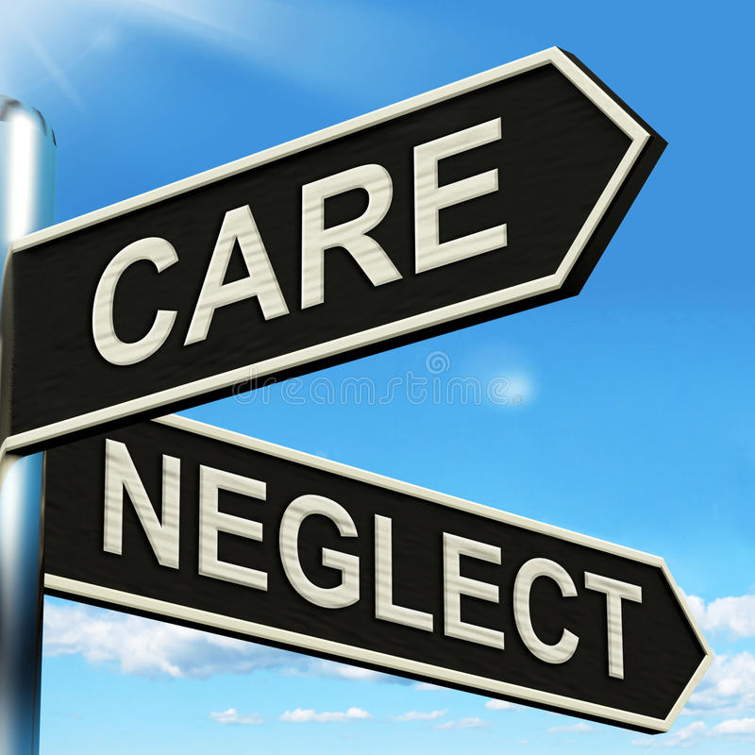
Category: Passive Neglect
The inability to provide supports due to environmental factors which are beyond the control of an unpaid caregiver because of lack of experience, information, resources, or ability. Passive neglect is reportable if there are no current risk mitigation strategies in the ISP that specifically address the area of passive neglect.
Category: Self Neglect
An action or lack of action by a participant that results in the participant denying himself or herself proper care, supports, and services. Self-neglect is reportable if there are no current risk mitigation strategies in the ISP that specifically address the area of self-neglect.
Passive Neglect and Self Neglect are reported by a participant’s SCO.
Notes:
Passive Neglect is a new primary category in the Incident Management Bulletin. It is defined as the inability to provide supports due to environmental factors which are beyond the control of an unpaid caregiver because of lack of experience, information, resources, or ability. Passive neglect is reportable if there are no current risk mitigation strategies in the ISP that specifically address the area of passive neglect.
Self Neglect is a new primary category in the Incident Management Bulletin. It is defined as an action or lack of action by a participant that results in the participant denying himself or herself proper care, supports, and services. Self-neglect is reportable if there are no current risk mitigation strategies in the ISP that specifically address the area of self-neglect. Self-neglect is reported by a participant’s SCO.
As was the case with passive neglect, self neglect incidents are reported by SCOs, not UCP.

Slide 13
Category: Exploitation
An act or course of conduct by a person against a participant or a participant’s resources without informed consent or with consent obtained through misrepresentation, coercion, or threats of force, which results in monetary, personal, or other benefit, gain, or profit for the target, or monetary or personal loss to the participant.
Secondary Categories:
Failure to Obtain Informed Consent
Material Resources
Medical Responsibilities/Resources
Missing/Theft of Medications
Misuse/Theft of Funds
Room and Board
Unpaid Labor
Notes:
Exploitation is a new primary category in the most recent Incident Management Bulletin. Exploitation is defined as an act or course of conduct by a person against a participant or a participant’s resources without informed consent or with consent obtained through misrepresentation, coercion, or threats of force, which results in monetary, personal, or other benefit, gain, or profit for the target, or monetary or personal loss to the participant. Exploitation should be reported regardless of the actual or perceived value of the loss.
The secondary categories of exploitation include:
Failure to Obtain Informed Consent which is defined as an intentional act or course of conduct by a person which results in the misuse of a participant’s consent or failure to obtain consent.
An example that would fall under this secondary category is posting pictures of a participant on UCP’s website without obtaining their consent prior to doing so.
Material Resources is defined as the illegal or improper act or process of a person using the material resources or possessions of a participant for his or her own personal benefit or gain. An example that would fall under this secondary category is borrowing a staff member using a participant’s car to run personal errands without the participant.
Medical Responsibilities/Resources is defined as an act or course of conduct of a person that results in a participant paying for medical care or items that are normally covered by insurance or other means. An example that would fall under this secondary category is having a participant purchase adult briefs for themself each month when their insurance would pay for a subscription service to deliver them for free.
Missing/Theft of Medications is defined as missing medications without explanation or theft of medications. An example that would fall under this secondary category is a package of medications is discovered to be missing when the staff member attempts to administer the morning medications.
Misuse/Theft of Funds is defined as the illegal or improper act or process of a person using the funds of a participant for his or her own personal benefit or gain. This includes misuse or mismanagement by a representative payee or other responsible party, theft of money, Supplemental Nutrition Assistance Program (SNAP) benefits, or soliciting monetary gifts from a participant. An example that would fall under this secondary category is a staff member purchasing items for themself using a participant’s SNAP benefit card.
Room and Board is defined as requiring a participant to pay for items that are covered as part of room and board charges, charging more than allowable rates for room and board, or charging for a service or support that is included in a rate for which a provider is or will be reimbursed. This includes any situation in which the participant is required to pay for the same item/service twice. An example that would fall under this secondary category is requiring a participant in a residential home to pay an electric bill when this is included as part of their room and board contract.
Unpaid Labor is defined as the illegal or improper act or process of a person who is using a participant to perform unpaid labor that would otherwise be compensated in a manner consistent with labor laws. An example that would fall under this secondary category is a staff member using a participant to wash the staff member’s car.

Slide 14
Category: Behavioral Health Crisis
An event or situation that exceeds the participant’s current resources and coping mechanisms that causes the participant to experience extreme disorganization of thought, hopelessness, sadness, confusion, panic, or other emotional distress. The event includes action(s) by a participant that pose a danger to themselves or others and are unable to be mitigated without the assistance of law enforcement, mental health, or medical services.
Secondary Categories:
Community-Based Crisis Response
Facility-Based Crisis Response
Immediate Arrest and Incarceration Crisis Response
Psychiatric Hospitalization (involuntary)
Psychiatric Hospitalization (voluntary)
Notes:
While behavioral health crisis events were previously reportable, this is a new primary category in the most recent Incident Management Bulletin and demonstrates ODP’s greater focus on mental health.
Behavioral Health Crisis is defined as an event or situation that exceeds the participant’s current resources and coping mechanisms that causes the participant to experience extreme disorganization of thought, hopelessness, sadness, confusion, panic, or other emotional distress. The event includes action(s) by a participant that pose a danger to themselves or others and are unable to be mitigated without the assistance of law enforcement, mental health, or medical services.
The secondary categories are:
Community-Based Crisis Response which is an event in which law enforcement or emergency services respond to and resolve without transport to another location for intake, assessment or treatment. An example of this type of incident would be a participant who becomes escalated and per his behavioral support plan requires the police to be called; they arrive and are able to speak with the participant and the participant’s behavior returns to baseline.
Facility-Based Crisis Response is an event in which law enforcement or emergency services respond to and an individual is transported to a psychiatric facility, including crisis facility, or the psychiatric department of an acute care hospital for evaluation or treatment that does not result in an admission. An example of this type of incident would be a participant becoming escalated and law enforcement responds and despite speaking with the participant he continues to escalate at which time it is decided the individual should be transported to a crisis facility.
Immediate Arrest and Incarceration Crisis Response is an event in which law enforcement responds to a behavioral health crisis event and arrests, charges and incarcerates an individual without first obtaining a mental health evaluation/admission at a facility designated to provide such services. An example of this type of incident is a participant strikes a staff causing significant injury, law enforcement is contacted, and the participant is arrested by police.
Psychiatric Hospitalization (involuntary) is an involuntary inpatient admission to a psychiatric facility, including crisis facility, or the psychiatric department of an acute care hospital for evaluation or treatment. An example of this type of incident would be a participant is hearing voices in their head, is taken for evaluation and is involuntarily committed to a facility for treatment.
Psychiatric Hospitalization (voluntary) is a voluntary inpatient admission to a psychiatric facility, including crisis facility, or the psychiatric department of an acute care hospital for evaluation and treatment. An example of this would be a participant meets with their psychiatrist about recent changes in their mental health they have been experiencing and with the guidance of their psychiatrist make the decision to voluntarily commit to a treatment facility.

Slide 15
Category: Death
UCP is responsible for reporting deaths which occur while a participant is receiving UCP services.
Supports Coordinators are responsible for reporting deaths which occur if a participant is not receiving UCP services.
Secondary categories:
Natural Causes-Services Provided
Unexpected-Services Provided
Notes:
If a participant is receiving UCP services at the time he or she passes away, it is a reportable incident even if it was expected. The secondary categories of death are natural causes and unexpected.
If a participant is not receiving UCP services at the time of death, the supports coordinator must report the death.
It’s important to note that deaths attributed to or suspected to have been the result of abuse or neglect require additional reporting in the appropriate corresponding category.

Slide 16
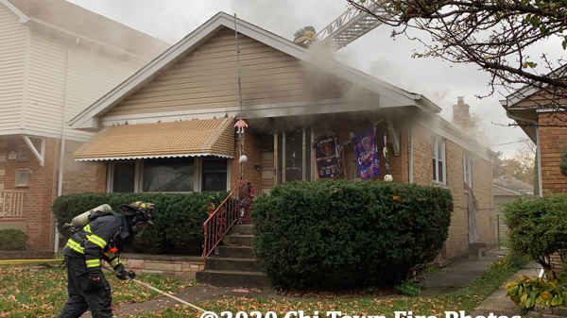
Category: Fire
A situation that requires fire personnel or other safety personnel to extinguish a fire, clear smoke from the premises, etc.
Secondary Categories:
Fire with Property Damage
Fire without Property Damage
Notes:
The primary category of fire is defined as a situation that requires fire personnel or other safety personnel to extinguish a fire, clear smoke from the premises, etc.
The secondary categories include a fire with property damage and a fire without property damage.
Incidents which fall under this category include fire personnel responding to a building’s fire alarm activating as a result of cooking even if there is not an actual fire.

Slide 17
Category: Law Enforcement Activity
Law enforcement activity that occurs during the provision of service or for which a participant is the subject of a law enforcement investigation that may lead to criminal charges against the participant. This includes law enforcement responding to a possible crime when a participant is in the community or in a vehicle.
Secondary Categories:
Participant Charged with a Crime/Under Police Investigation
Licensed Service Location Crime
Notes:
Law Enforcement Activity is defined as law enforcement activity that occurs during the provision of service or for which an individual is the subject of a law enforcement investigation that may lead to criminal charges against the individual. This includes law enforcement responding to a possible crime when an individual is in the community or in a vehicle.
The secondary categories are:
Individual Charged with a Crime/Under Police Investigation is defined as when an individual is formally charged with a crime by the police or when an individual is informed, he or she is suspected of committing a crime, and charges may be forthcoming. An example would be a participant is caught shoplifting and is charged with the crime.
Licensed Service Location Crime is defined as a crime such as vandalism, break-ins, threats, or actual occurrences of acts that may result in harm, etc. that occur at the provider’s service location. An example would be a residential home is broken into while the staff and individuals are out grocery shopping.

Slide 18
Category: Missing Individual
A participant is considered missing when they are out of contact for more than 24 hours without prior arrangement or the participant is in immediate jeopardy when missing for any period. Based on a participant’s history, safety skills, and familiarity with the area, a participant may be considered in jeopardy before 24 hours elapse.
In addition, when police are contacted about a missing participant or the police independently find and return a participant, this is a reportable incident regardless of the amount of time a participant has been missing.
Notes:
Missing Individual occurs when a participant is considered missing when they are out of contact for more than 24 hours without prior arrangement or the individual is in immediate jeopardy when missing for any period. Based on an individual’s history, safety skills, and familiarity with the area, an individual may be considered in jeopardy before 24 hours elapse.
An example would be you take a participant to a baseball game and become separated from him. The individual must be within eyesight at all times. While you are trying to locate the participant, a police office walks up to you with the participant. Another example: leave the building or premises and supervision levels are not met eg direct supervision in the home and building and the individuals walks out and no one is following them.

Slide 19
Category: Rights Violation
An unauthorized act which improperly restricts or denies the human or civil rights of a participant, including those rights which are specifically mandated under applicable law, regulation, policy, or plan. This includes acts that are intentional or unintentional regardless of the obvious occurrence of harm.
Secondary Categories:
Civil/Legal
Communication
Health
Privacy
Services
Unauthorized Restrictive Procedure
Notes:
A rights violation is defined as an unauthorized act which improperly restricts or denies the human or civil rights of a participant, including those rights which are specifically mandated under applicable law, regulation, policy, or plan. This includes acts that are intentional or unintentional regardless of the obvious occurrence of harm.
While Rights Violation was a primary category in the previous Incident Management Bulletin, the secondary categories are new. Those categories are:
-Civil/Legal which is defined as any violation of civil or legal rights afforded by law. This includes the right to vote, speak freely, practice religious choice, access law enforcement and legal services, as well as participate in local, state or national government activities. An example of this violation would be not taking a participant to vote on election day after they expressed interest prior to the election.
-Communication is defined as the failure to support an individual to communicate at all times. This includes a failure to obtain needed communication evaluations, assistive devices or services; provide communication support; or maintain communication devices in working order. An example of this type of incident is a participant’s iPad that they use for communication breaks and there is no attempt to get it repaired/replaced for more than a month. Hearing aides that are not working properly or are sitting at the repair shop for an extended amount of time. Impacts the individual's ability to communicate. We will need to make alternative arrangements to get the hearing aides fixed.
-Health is defined as the failure to support choice and opportunity related to health care. This includes failure to inform and educate an individual about physical or behavioral health evaluations and assessments, changes in health status, diagnosis information, test results, medications, treatment options, etc. This also includes the denial of the right of an individual to make informed health care decisions. An example of this type of incident would be a participant requests to visit a new in-network primary care provider but they are told they must keep going to the original provider as they have always gone there.
-Privacy is defined as any violation of an individual’s safely exercised choice to be free from being observed or disturbed by others. An example would be UCP putting a participant’s photo on their website without the participant’s permission or without them signing a release form.
-Services is defined as any violation of an individual’s right to control services received. An example would be not ensuring a participant is able to attend their own Individual Service Plan (ISP) meeting.
-Unauthorized Restrictive Procedure is defined as any restrictive procedure (other than a physical, chemical, or mechanical restraint) that does not follow ODP’s guidelines related to restrictive procedures or is prohibited by ODP. An example would be a participant is asked to make their bed, they say no so the staff member takes an iPad from the participant and says they cannot get it back until they make their bed.

Slide 20
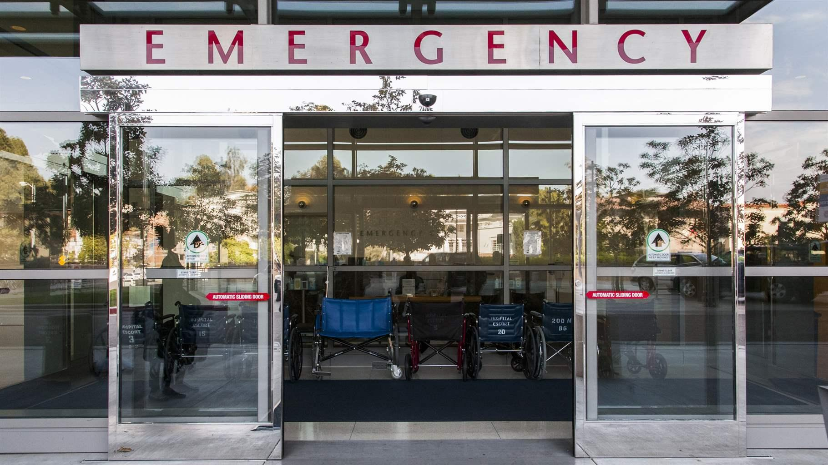
Category: Serious Illness
A physical illness, disease, or period of sickness that requires hospitalization. This includes an elective surgery that requires a hospitalization.
Secondary Categories:
Chronic/Recurring
New
Notes:
In previous Incident Management bulletins, there were several primary categories related to medical care such as ER visits, hospitalizations and treatment beyond first aid. Now, there are two new primary categories that medical incidents fall under.
The first category is serious illness and it is defined as a physical illness, disease, or period of sickness that requires hospitalization. This includes an elective surgery that requires a hospitalization.
The secondary categories for serious illness are:
Chronic/Recurring which is defined as an illness, condition or disease that is persistent or otherwise long-lasting in its effects for which an individual has had previous treatment or diagnosis. An example would be a participant who was previously diagnosed with diabetes has a diabetic emergency and is hospitalized overnight.
New which his defined as an acute illness, condition or disease for which an individual has not previously received treatment. This includes acute illnesses, conditions or diseases that may become chronic in the future. An example would be a participant who is diagnosed with pneumonia for the first time and is hospitalized for observation.

Slide 21
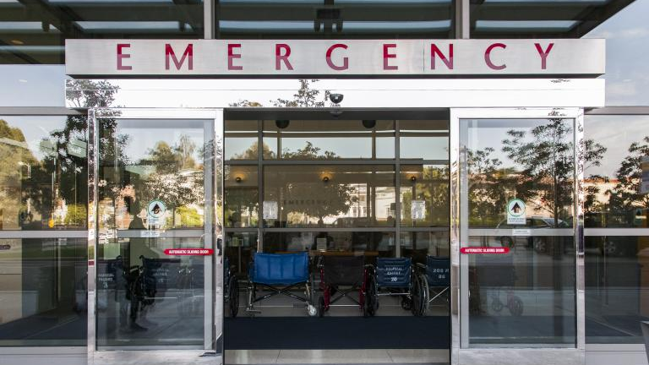
Category: Serious Injury
Any injury that requires treatment beyond first aid. This includes injuries that receive an assessment or treatment at an emergency room, urgent care center, primary care physician office, etc., or that require hospitalization.
Secondary Categories:
Choking
Injury Accidental
Injury Self-Inflicted
Injury Unexplained
Medical Equipment Failure/Malfunction
Pressure Injury (decubiti, pressure ulcer, pressure sore, bedsore)
Notes:
The second medical category is serious injury. Serious injury is defined as any injury that requires treatment beyond first aid.
This includes things such as assessment or treatment at an emergency room, urgent care center, or primary care physician office which do not require hospitalization.
The secondary categories of serious injury include:
Choking which is defined as when food or other items become lodged in the back of the throat and the cause is not attributed to neglect. An example would be a participant begins to choke on food, 911 is called, the staff member delivers back blows and dislodges the piece of food and the participant is transported to the ER for evaluation.
Injury Accidental is defined as any injury (other than self-inflicted) with a known cause at the time of the report. An example would be a participant out for a walk stumbles, falls and breaks their arm and is treated at the ER.
Injury Self-Inflicted is defined as any injury with a known cause at the time of the report that can be attributed to an intentional action of an individual to cause harm upon himself or herself. An example would be a participant becoming upset and banging their head into a wall repeatedly. 911 is called and they are transported to the ER for evaluation.
Injury Unexplained is defined as an injury with no known cause at the time of the report. An example would be a participant wakes up and complains of pain in their foot. The foot is bruised so they are taken the urgent care center where the foot is x-rayed and a fracture is noted.
Medical Equipment Failure/Malfunction is defined as any medical equipment failure or malfunction that requires intervention by a medical professional. An example would be someone has an insulin pump and it suddenly stops working. The participant is taken to their endocrinologist who then fixes the pump.
Pressure Injury is defined as injuries to skin and underlying tissue resulting from prolonged pressure on the skin, regardless of stage and including an injury that is unstageable. An example would while showering a participant, staff notices an unusual mark on their skin. The participant is taken to their PCP where they are diagnosed with a pressure sore.

Slide 22
Category: Site Closure
The emergency closure of a licensed or provider operated service location for one or more days.
Secondary Categories:
Infestation
Loss of utilities
Natural disaster/weather related
Structural
Other
Notes:
Site Closure is defined as the emergency closure of a licensed or provider operated service location for one or more days.
Secondary categories include infestation, loss of utilities, natural disaster/weather related, structural or other reason for closing.

Slide 23
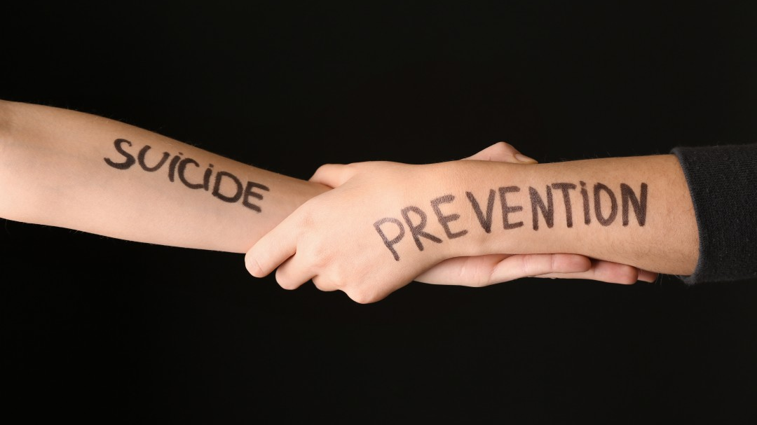
Category: Suicide Attempt
The intentional and voluntary attempt to take one’s own life.
Secondary Categories:
Injury/Illness that Requires Medical Intervention
No Injury/Illness that Requires Medical Intervention
Notes:
As with the previous primary category of Behavioral Health Crisis, the addition of a new primary category of Suicide Attempt shows ODP’s focus on the mental health of the participants we support.
Per the Incident Management Bulletin, Suicide Attempt is defined as the intentional and voluntary attempt to take one’s own life. This does not include suicidal threats or ideations. However, if a participant you are supporting expresses suicidal thoughts or ideations, you should still report these to your supervisor immediately.
It’s important to note that even if medical treatment was sought after a suicide attempt, it should be reported under suicide attempt as a primary category and not as serious injury or illness.
The secondary categories for Suicide Attempt are Injury/Illness that Requires Medical Intervention or No Injury/Illness that Requires Medical Intervention.

Slide 24
Category: Medication Errors
Any practice with the “Rights of Medication Administration” as described in the ODP Medication Administration Training Course.
Secondary Categories:
Wrong dose
Wrong time
Wrong route
Wrong form
Wrong position
Wrong technique/method
Omission
Wrong person
Notes:
A medication error is defined as any practice with the “Rights of Medication Administration” as described in the ODP Medication Administration Training Course.
It’s important to understand that a medication error occurring during a time when an unpaid caregiver is responsible for the administration of medication is not reportable. For example if a participant goes home for the weekend with their mom and she forgets to give a medication, it is not reportable. Also, a participant’s refusal to take medication is not reportable as a medication error, although refusals should still be documented and discussed accordingly.
The secondary categories for medication errors include:
Wrong dose which is giving more or less of a medication than the participant is prescribed. For example, if the participant is to receive 5mL of a liquid medication and they are administered 10mL.
Wrong time is giving the medication anytime out of the prescribed timeframe. For example, if a participant is given their 8PM medications at 8AM.
Wrong route is giving medications in the incorrect location. For example, ear drops are administered in the eyes.
Wrong form is giving a medication in a method it is not intended for. For example, a medication is to be dissolved in water prior to administering and it is given to the participant whole, to swallow.
Wrong position is giving a medication when a participant is not in the right position. For example, a medication to be given while a participant is sitting upright is administered while they are laying down.
Wrong technique/method is administering a medication not per the precise instructions. For example, if a participant is to be administered 10mL of medication via their G-tube by giving 5mL then 10mL of water then 5mL of medication and instead the staff administers all 10mL of medication at once.
Omission is failing to give a medication altogether. For example, a participant is not given their 8AM medications.
Wrong person is giving one participant's meds to another participant. For example, a staff member prepares John’s meds but then hands them to Joe and he takes them.

Slide 25
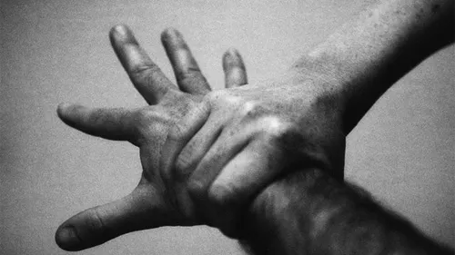
Category: Physical Restraint
A physical hands-on method that restricts, immobilizes, or reduces a participant’s ability to move his or her arms, legs, head, or other body parts freely.
Secondary Categories:
Human Rights Team Approved Restrictive Intervention
Provider Emergency Protocol
Notes:
Physical restraint is defined as a physical hands-on method that restricts, immobilizes, or reduces a participant’s ability to move his or her arms, legs, head, or other body parts freely.
A physical restraint may only be used in the case of an emergency to prevent a participant from immediate physical harm to herself or himself or others.
The secondary categories of physical restraint are:
Human Rights Team Approved Restrictive Intervention which is defined as any physical restraint that is applied in an emergency situation that is part of an approved ISP that contains a restrictive procedure. An example is someone has a pre-reviewed and approved plan that allows for a restraint under certain situations and the staff utilize an approved restraint technique.
Provider Emergency Protocol is defined as any physical restraint that is applied in an emergency situation that is part of a provider emergency restraint protocol. In general, this is not something UCP utilizes.
Please note that only specific types of restraints are permitted and those are outlined by ODP policies and procedures, regulations. Only a person who has a pre-reviewed and approved Human Rights Team Approved Restrictive Intervention plan in place will have restraints reported under this primary category. If the person does not have such a plan, restraints shall be reported as abuse.

Slide 26
Incident Management Roles
Notes:
The Incident Management System is driven by people who serve in different roles. We will now review those different roles and how they work together.

Slide 27
Initial Reporter
An initial reporter is any person who witnesses or experiences the incident, is informed of an allegation of an incident, or is the first to discover or recognize the signs of an incident. Initial reporters may be participants receiving services, family members, community members or service system staff.
As an initial reporter you must:
Respond to the situation by taking immediate action to protect the participant’s health, safety, welfare and rights.
Notify the appropriate reporting entity’s point person of the incident.
Document observations, as needed.
Comply with the applicable laws and regulations for incidents of alleged abuse, neglect, or exploitation.
Do NOT discuss the incident with others.
Notes:
An initial reporter is any person who witnesses or experiences the incident, is informed of an allegation of an incident, or is the first to discover or recognize the signs of an incident.
There may be times when you are an initial reporter or there may be times when someone else such as the participant, their family, someone in the community or another staff member reports something to you that you believe is a reportable incident. In that situation, those people are the initial reporters.
If you are in a position where you are the initial reporter, you are expected to do the following:
-First and foremost, you must take immediate action to ensure a participant’s health, safety, welfare and rights. This could range from calling 911 to intervening if someone else is causing harm to a participant.
-You then must report what you are aware of to a point person immediately.
-The point person may then request you document your observations in a written statement.
-We will talk more in a few slides about your role and responsibilities.

Slide 28
Point Person
The point person is a person that receives information from an initial reporter and is responsible to manage the incident from beginning to end.
The point person must ensure:
All actions needed to protect the health, safety, rights and welfare of the participant are taken.
Referral to victim’s assistance services is offered.
If applicable, the target is separated from the victim.
If applicable, contacts APS/CPS/OAPS/police/etc.
Inform the victim’s family/guardian/designee.
Enter initial incident report and finalize the incident.
Notes:
A point person is a person that receives information from an initial reporter and is responsible to manage the incident from beginning to end. This tends to be the supervisors, managers and leaders within our organization.
A point person is then expected to again ensure the health, safety, welfare and rights of the individual either in person or by talking an initial reporter through what needs to occur.
The point person must then offer victim’s assistance.
If an incident involves a target, the point person must ensure that target is separated from the victim.
For certain types of incidents, the point person must contact additional organizations such as Adult Protective Services, Child Protective Services, Older Adult Protective Services, or the Police.
The point person must then inform the victim’s family, guardian or designee that an incident has occurred.
The point person is the person who is responsible for entering the initial incident report into ODP’s electronic system and then finalizing the incident.

Slide 29
Certified Investigator
A Certified Investigator (CI) is a person who has been trained and certified by the Department to conduct investigations.
The CI must:
Conduct investigations using the process, standards of quality, and template(s) outlined in the most current ODP CI manual.
Create a CI Report and enter the investigation information in the Department’s information management system.
Notes:
Certain types of incidents require an internal investigation to be completed by a Certified Investigator. A Certified Investigator or CI is a person who has been trained and certified by the Department to conduct investigations. UCP has approximately 20 CIs who work to complete investigations.
Once a CI is assigned to an investigation, he or she must:
-Conduct the investigation using the process, standards of quality, and template(s) outlined in the most current ODP CI manual.
-Create a CI Report and enter the investigation information in the electronic incident management system.

Slide 30
Incident Manager
The Incident Manager is the person designated by a provider or SCO who has overall responsibility for incident management.
The Incident Manger must ensure:
The point person(s) has completed all required actions and activities
Corrective actions are implemented and monitored.
All quality and risk management activities are completed.
Administrative reviews are conducted for all incidents that were investigated
Participants and families or persons designated by the participant are offered education, training, and information about incident management policies and procedures.
Notes:
Each organization has one designated Incident Manager. This person has the overall responsibility for Incident Management within the organization.
An Incident Manager is expected to:
-Ensure point persons complete all required actions and activities when entering and finalizing incidents.
-Ensure Corrective Action Plans are implemented and monitored.
-Ensure all quality and risk management activities are completed.
-Ensure administrative reviews are conducted for all incidents that were investigated.
-Ensure participants, their families or participant designees are offered education, training, and information about incident management policies and procedures.

Slide 31
Manager, Quality & Compliance
UCP has a Manager, Quality & Compliance, who is involved in incidents from the time of reporting through finalization.
The Manager, Quality and Compliance:
Supports initial reporters, point persons, certified investigators and incident managers in ensuring they are compliant in all their responsibilities.
Analyzes incident data and creates the charts, graphs and tracking systems used to make plans of action.
Reviews and tracks all Corrective Actions Plans (CAPs).
Notes:
UCP employs a Manager, Quality and Compliance, who is heavily involved in each and every incident reported across all divisions.
Through training and guidance, she supports initial reporters, point persons, certified investigators and incident managers in ensuring they are compliant in all their responsibilities.
Additionally, she reviews incidents, compiles data, and then creates charts, graphs and tracking systems used by leaders in the organization to make plans of action.
She also reviews and tracks all Corrective Actions Plans (CAPs) to ensure they are compliant and help to minimize the risk to the people you support.

Slide 32
Your Role
Notes:
As a mandated reporter and initial reporter, you must understand what your roles and responsibilities are.

Slide 33
Focus of the IM Bulletin:
We know that unsafe and unhealthy things happen to the participants we support.
YOUR ROLE as an initial reporter is to:
Respect
Listen
Ask
Believe
Respond
Notes:
By reviewing the history of incident management and the most current Incident Management Bulletin, we understand that unsafe and unhealthy events occur to the participants we support. If a participant, their family or someone else shares information with you about a possible incident, it is your role to Respect, Listen, Ask, Believe and Respond. We will now detail what it means to do each of those things.
Respect is shown through both your words and actions. Using the right words and actions help tell and demonstrate to a participant that you accept what is being said or seen. By showing acceptance you are saying that you are a person who is judgement‐free. It is not your job when someone is sharing information with you to evaluate fact and fiction. Additionally, being respectful means you do not dismiss what happened or what is said because of experience or reputation. Someone may have lied previously about a similar type of incident, but you must still remain respectful and judgement free. No matter what the past has been, you must take the participant and situation seriously every time. In the end, you should also say thank you for trusting me in order to encourage similar open communication in the future.
Listening is a critical role of an initial reporter. The participants with support communicate using both words and behavior. You often get to know the participants better than anyone else and you must always be listening to both their words and their behaviors to understand exactly what they are trying to say. As an initial reporter it is important that you work to quickly learn how a participant communicates so you can listen better. No matter how busy you are, you must strive to listen fully in order to understand what the participant is telling you. Listening may serve as your greatest opportunity to protect their health, safety, welfare and rights.
Our first instinct when someone is telling you something which is harmful is to begin to ask questions. However, you need to understand that not all questions are helpful. Before you ask you questions you should focus on the facts. Ask the participant to tell you anything they can remember. Asking the participant how you can help or what he or she needs. You should avoid asking specific, leading questions. Specific questions such as who, what, where, and when can make a victim feel like a failure if they cannot provide a response. Victims may also think that you do not believe them if they can’t answer all the specific questions that they are asked. One thing you should never do is ask the victim “WHY” they believe the abuse or harm has occurred. This may make the victim feel that they are to blame.
When someone experiences a negative event in their life, it can take a lot for them to tell you about it. If they feel as if they are not believed, they may be hurt or harmed again and again. Your role is to believe the participant. Later investigations may happen to sort out the facts, but in the moment, just believe them. If someone tells you something has happened that is hurtful or harmful, act to help the person be safe to prevent harm from happening again. While believing someone is important, you want to avoid making promises you can’t keep or promise absolute safety from further abuse. If you were to make such promises and they are broken, it can break a participant's trust and reduce their willingness to report incidents in the future.
When someone reports an incident to you, your main focus needs to be taking immediate action to protect the participant's health, safety, welfare and rights. For example, you may need to call 911 or the police or apply first aid. After you have ensured the participant's health, safety, welfare and rights and reported the incident to your supervisor and/or manager, if you know any next steps you can inform the participant of those steps. However, if you don’t know the next steps, simply tell the participant that you or someone from UCP will let them know what to expect next when that information is known.

Slide 34
YOUR ROLE as an Initial Reporter:
In your day-to-day work at UCP, to help minimize the risk to the participants you support, do the following:
Recognize when a participant tells you something has occurred, or you feel something may have occurred.
Recognize
Respond to the participant’s concerns and his/her health, safety, welfare and rights needs.
Respond
Elevate the information you have to your supervisor immediately.
Elevate
Notes:
You will easily fulfill your role as a mandated reporter and initial reporter if you do 3 things:
Recognize: Recognize when a participant tells you something has occurred, or you feel something may have occurred. Commit to raising your awareness to actively detect incidents. If something seems off or different, you need to acknowledge that.
Respond: Respond to the participant’s concerns and his/her health, safety, welfare and rights needs.
Elevate: Elevate the information you have to your supervisor immediately. Use your instincts AND tell someone about it immediately. When in doubt, escalate the information. See something, say something!

Slide 35
Do NOT Fail to Report!!
Failure to report is a serious violation of agency policy and is subject to disciplinary action, up to and including termination.
Employees are protected by “Whistleblower” Policy, which guarantees no reprisals will be brought by the agency against any employee who reports an incident according to agency procedures.
Notes:
In the end, we would rather have people over report or report information that is not an incident than not report at all.
As a mandated reporter and employee of UCP, you cannot fail to report! Failure to report is a serious violation of agency policy and is subject to disciplinary action, up to and including termination.
Additionally, at UCP you are protected by “Whistleblower” policy, which guarantees no reprisals will be brought against any employee who reports an incident according to agency procedures.

Slide 36
After Reporting, YOUR ROLE as an Initial Reporter is:
You will be asked to provide a maximum of cooperation.
Your highest priority will always be to ensure the safety of the alleged victim.
You may be asked to “secure the scene” when possible, to ensure that evidence remains as it was during the proposed incident when the Certified Investigator, or other appointed representative, begins the investigation.
You may be asked to provide a written statement of the incident and to not discuss the incident with others.
Notes:
Certain categories of incidents require investigation. If an incident is reported which you may have information about, your role as an initial reporter or just an employee of UCP is to:
-Cooperate
-Ensure the safety of the victim
-You may be asked to “secure the scene” when possible, to ensure that evidence remains as it was during the incident.
-You may be asked to provide a written statement of the incident and to not discuss the incident with others as to preserve the integrity of the investigation.

Slide 37
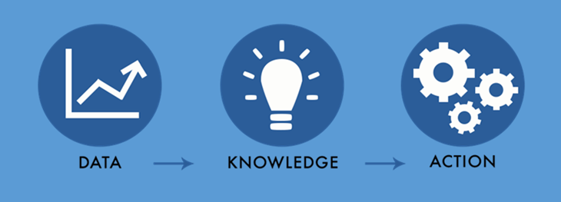
Why Do We Do All This?
By consistently reporting incidents and leverage the roles within our organization, we can use the data to better understand and drive change and quality.
Every incident which his filed requires a Corrective Action Plan (CAP) in order to make changes and minimize the risk of the incident occurring again.
Members of each division meet monthly to discuss incident trends and brainstorm ideas.
Members of leadership also meet quarterly to do a deep dive into trends and develop more risk mitigation strategies.
Notes:
So why do we do all of this?
Our hope is that by consistently reporting incidents and leveraging all of the roles we discussed earlier such as Initial Reporter, Point Person, Certified Investigator and Incident Manager that we can gather better data to drive change and quality. UCP has a Manager, Quality and Compliance who analyzes incident data regularly. This role is used to create charts, graphs and other publications of the data in order to help people think outside the box for changes that will help protect the participants.
Every incident we file requires us to have a Corrective Action Plan or CAP. By having CAPs we are committing to making changes and helping to minimize the risk of a similar incident happening in the future.
Each month there is an Incident Management meeting during which the division directors and other leaders review that month’s incidents, evaluate trends, discuss locations or participants with the greatest risk and create plans to reduce the risks.
Additionally, each quarter the CEO, Sr. Director of Operations and Manager of Quality and Compliance meet to do an additional analysis and look at year long trends.
By doing your part in reporting, you are an integral part of this process.

Slide 38
Questions?

