Slide 1

Hazard Communication
& Safe Handling of Workplace Chemicals

Slide 2

Training Objectives:
Identify components of a Hazard Communication program
Describe the different types of Hazard Communication labels
Locate pertinent information about chemicals on labels, including other forms of hazard communication, to ensure “right to understanding” provisions of Globally Harmonized System (GHS) requirements

Slide 3

PA Right to Know Act OVERVIEW
Employers are responsible for ensuring information about hazardous substances/chemicals in the workplace be made available to employees.
Mandates employees be provided with information about the chemicals through:
  Information on chemical labels, including universal pictograms
  Safety Data Sheets (SDS)
  A written Hazard Communication (HAZCOM) plan
  Training on hazard communications (HAZCOM)

Slide 4
PA Right to Know Employee Workplace Notice
Posted in UCP locations

Slide 5
Hazard Communication Training Requirements
Train employees on hazardous chemicals in their work area:
Before initial assignment
When new hazards are introduced
Nonroutine tasks
Include in training:
Methods to determine presence/release of chemicals in work areas
Hazards of chemicals
Appropriate protective measures
Where and how to obtain additional information

Slide 6
Seven Major Elements in the GHS-aligned Hazard Communication Standard
Source: OSHA
Notes:
Seven Major Elements to Hazard Communication/GHS include:
SDS
Labels
Signal words
Hazard statements
Precautionary statements
Pictograms
Training

Slide 7
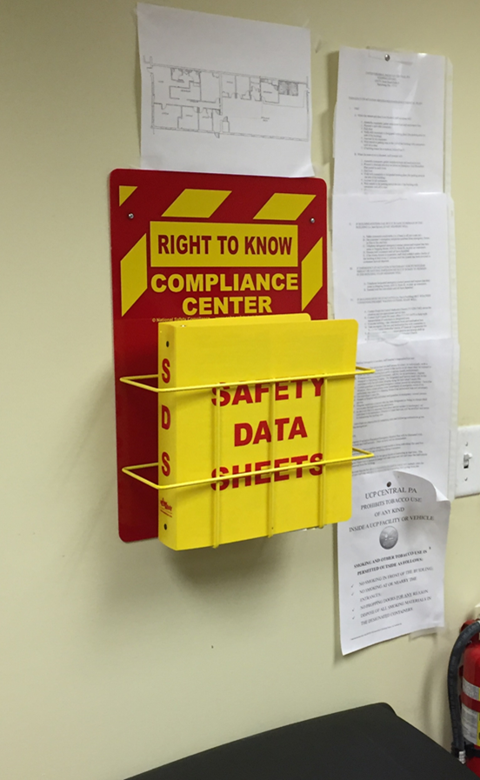
Safety Data Sheets (SDS)
& SDS Binder
Must have SDS for each chemical and staff trained on SDS format and use
New chemical SDS must be added to SDS Binder and staff trained on safe handling PRIOR to use (SDS usually available on internet)
SDS Binder must be readily accessible to employees
Most non-office locations require chemicals to remain locked when not in immediate use (unless otherwise specified)
Source: Hazard Communication Standard: Safety Data Sheets (2012), OSHA Brief DSG BR-3514, https://www.osha.gov/Publications/OSHA3514.html

Slide 8


Safety Data Sheet (SDS)
16 section format:
Section 1: Identification
Section 2: Hazard(s) identification
Section 3: Composition/information on ingredients
Section 4: First-aid measures
Section 5: Fire-fighting measures
Section 6: Accidental release measures
Section 7: Handling and storage
Section 8: Exposure control/personal protection
Notes:
Source: Hazard Communication Standard: Safety Data Sheets (2012), OSHA Brief DSG BR-3514, https://www.osha.gov/Publications/OSHA3514.html
“Sections 1 through 8 contain general information about the chemical, identification, hazards, composition, safe handling practices, and emergency control measures (e.g., fire fighting). This information should be helpful to those that need to get the information quickly.”
Section 1: Identification – identifies the chemical on the SDS and its recommended uses; provides contact information of the supplier
Section 2: Hazard(s) Identification – identifies the hazards of the chemical and appropriate warning information
Section 3: Composition/Information on Ingredients – identifies ingredient(s) contained in product, including impurities and stabilizing additives; includes information on substances, mixtures, and all chemicals where a trade secret is claimed
Section 4: First-Aid Measures – describes initial care that should be given by untrained responders to an individual who has been exposed to the chemical
Section 5: Fire-Fighting Measures – provides recommendations for fighting a fire caused by the chemical
Section 6: Accidental Release Measures – provides recommendations on appropriate response to spills, leaks, or releases, including containment and cleanup to prevent or minimize exposure to people, properties, or the environment
Section 7: Handling and Storage – provides guidance on safe handling practices and conditions for safe storage of chemicals
Section 8: Exposure Controls/Personal Protection – indicates exposure limits, engineering controls, and PPE measures that can be used to minimize worker exposure

Slide 9


Safety Data Sheet (SDS)
16 section format:
Section 9: Physical and chemical properties
Section 10: Stability and reactivity
Section 11: Toxicological information
Section 12: Ecological information
Section 13: Disposal considerations
Section 14: Transport information
Section 15: Regulatory information
Section 16: Other information
Hazard Communication Standard: Safety Data Sheets (2012), OSHA Brief DSG BR-3514, https://www.osha.gov/Publications/OSHA3514.html
Notes:
Source: Hazard Communication Standard: Safety Data Sheets (2012), OSHA Brief DSG BR-3514, https://www.osha.gov/Publications/OSHA3514.html
“Sections 9 through 11 and 16 contain other technical and scientific information, such as physical and chemical properties, stability and reactivity information, toxicological information, exposure control information, and other information including the date of preparation or last revision.”
Sections 12, 13, 14, & 15 are regulated by other agencies (i.e. EPA, DOT).
Section 9: Physical and Chemical Properties – identifies physical and chemical properties associated with the substance or mixture
Section 10: Stability and Reactivity – describes reactivity hazards of chemical and chemical stability information; broken into three parts: reactivity, chemical stability, and other
Section 11: Toxicological Information – identifies toxicological and health effects information or indicates that such data is not available
Section 12: Ecological Information – provides information to evaluate the environmental impact of the chemical(s) if it were released into the environment
Section 13: Disposable Considerations – provides guidance on proper disposal practices, recycling, or reclamation of the chemical(s) or its container, and safe handling practices
Section 14: Transport Information – provides guidance on classification information for shipping and transporting of hazardous chemical(s) by road, air, rail, or sea
Section 15: Regulatory Information – identifies safety, health, and environmental regulations specific for the product that is not indicated anywhere else on SDS
Section 16: Other Information – indicates when SDS was prepared/revised; may state where changes have been made to previous versions; other useful information

Slide 10
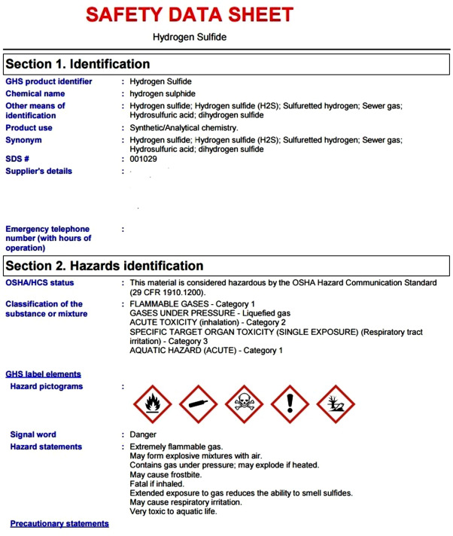
SDS Format Example

Slide 11
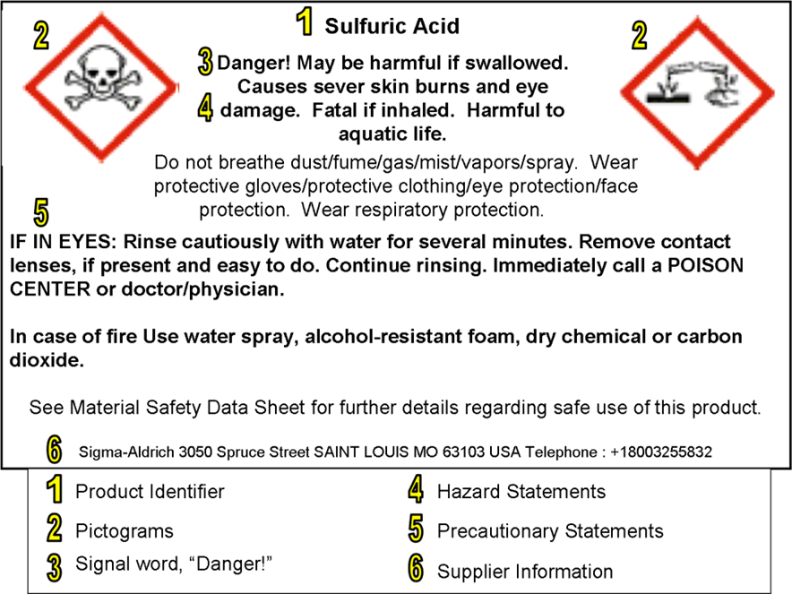
Reading Chemical Labels
Information required on the GHS label:
1. Product identifier
2. Pictograms
3. Signal (hazard) word
(danger or warning)
4. Hazard statement
5. Precautionary statement
6. Supplier information

Slide 12
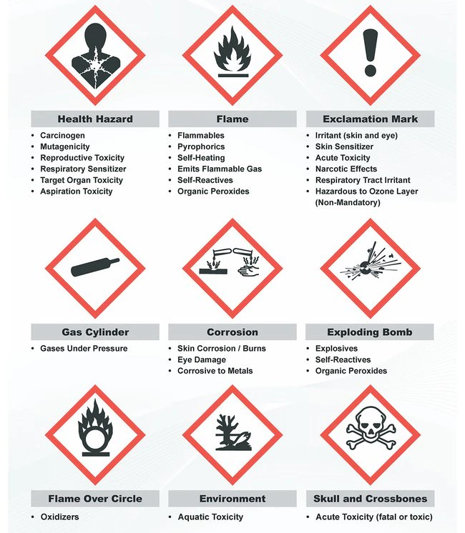
Hazard Communication Standard
GHS Pictograms
(AKA Hazard Symbols)
Hazard Communication Standard Pictogram (2012), OSHA QuickCard 3491-02, https://www.osha.gov/Publications/HazComm_QuickCard_Pictogram.html

Slide 13
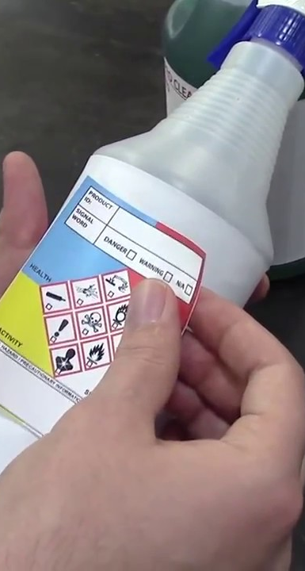
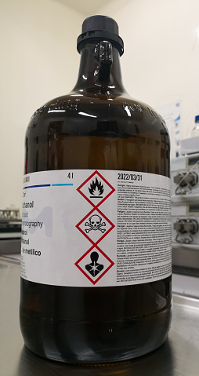
Locating Labels & Secondary Containers
All containers of hazardous materials must be labeled
Secondary containers must be labeled correctly
Do not mix different chemicals together
Label provides immediate warning, snapshot of hazards and protective information
Source: Hazard Communication Standard: Labels and Pictograms (2013), OSHA Brief DSG BR-3636, https://www.osha.gov/Publications/OSHA3636.pdf
Notes:
Source: Hazard Communication Standard: Labels and Pictograms (2013), OSHA Brief DSG BR-3636, https://www.osha.gov/Publications/OSHA3636.pdf
“…Information about chemical hazards [is to] be conveyed on labels using quick visual notations to alert the user, providing immediate recognition of the hazards. Labels must also provide instructions on how to handle the chemical so that chemical users are informed about how to protect themselves.
The label provides information to the workers on the specific hazardous chemical. While labels provide important information for anyone who handles, uses, stores, and transports hazardous chemicals, they are limited by design in the amount of information they can provide. Safety Data Sheets (SDSs), which must accompany hazardous chemicals, are the more complete resource for details regarding hazardous chemicals.”

Slide 14
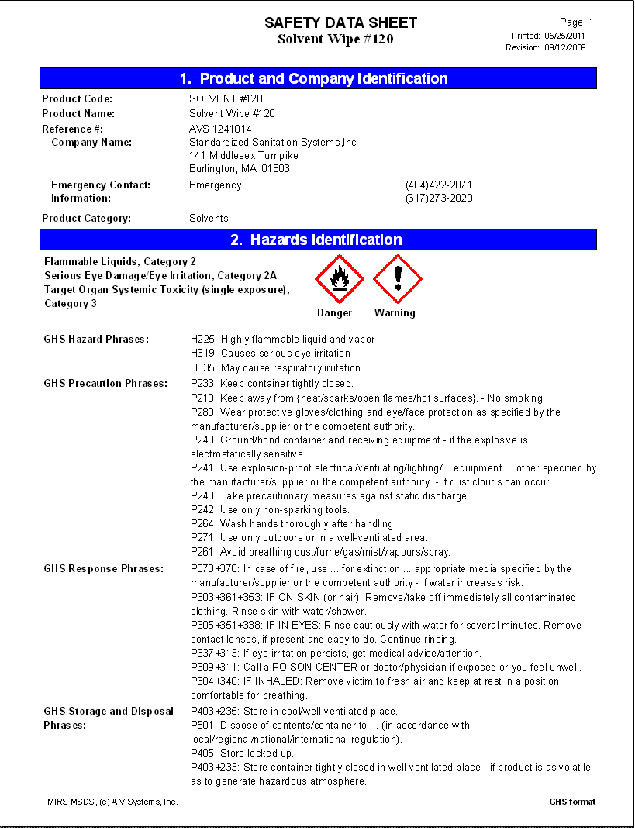


What to do if you are exposed…
Review the SDS to determine Treatment Steps/First Aid Measures
Obtain treatment according to First Aid Measures in SDS
Take SDS to the Physician
Report incident to Supervisor and file Workers Comp claim

Slide 15

Thank you for your participation!

