Slide 1
Fire Safety & Prevention Training
& Fire Extinguisher Use

Slide 2
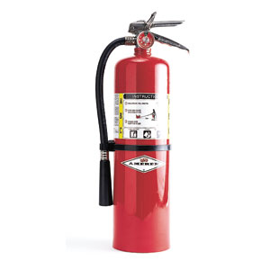
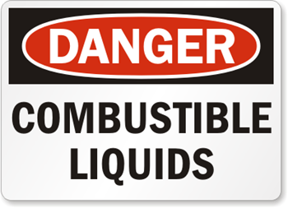
Training Objectives:
Goals of a Fire Prevention Plan
Fire Prevention Strategy
Housekeeping Issues
Flammable and Combustible Liquids
Fire Detection
Fire Suppression/Fire Extinguishers
Emergency Evacuation

Slide 3
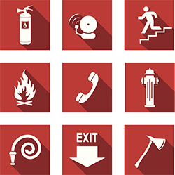
Fire Prevention Goals
Life Safety – primary goal of fire safety efforts is to protect building occupants from injury and to prevent loss of life.
Property Protection – secondary goal of fire safety is to prevent property damage.

Slide 4
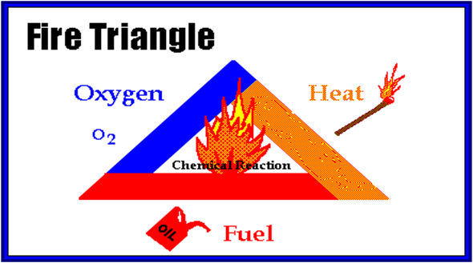
The Strategy of Preventing a Fire
A fire needs 4 things to ignite and maintain combustion:
Fuel
Heat
Oxygen
Chemical Reaction
If all four things are not present in sufficient quantities, a fire will not ignite or will not be able to sustain combustion.
The basic strategy of fire prevention is to control or isolate sources of fuel and heat in order to prevent combustion.

Slide 5
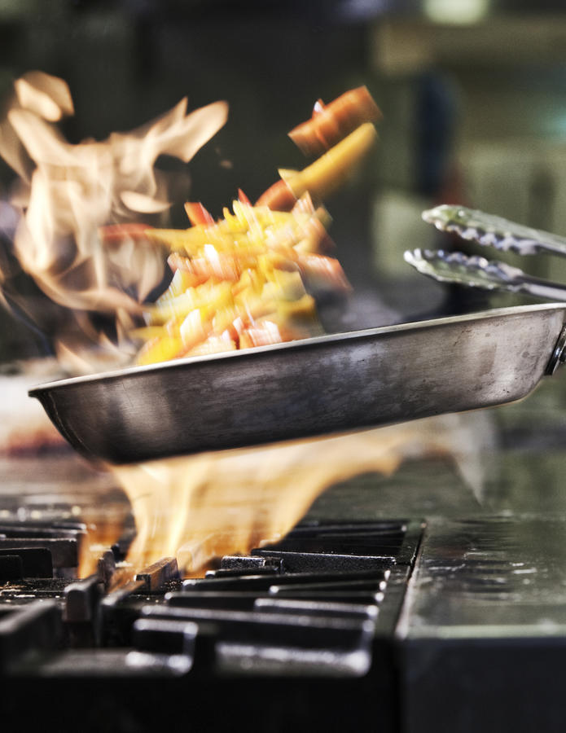
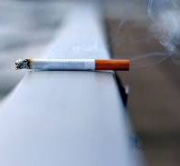
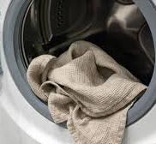
Functions of Fire Protection
Fire Prevention - eliminating or restricting the likelihood of fire. Common Hazards:
Housekeeping
Smoking
Clothes Dryers
Flammable Liquids
Electrical
Heat Producing Devices
Cooking
Fire Detection - detecting a fire when it starts
Fire Suppression - extinguishing a fire after it starts

Slide 6
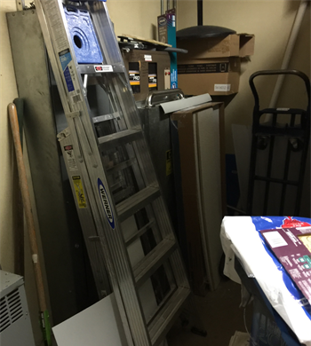
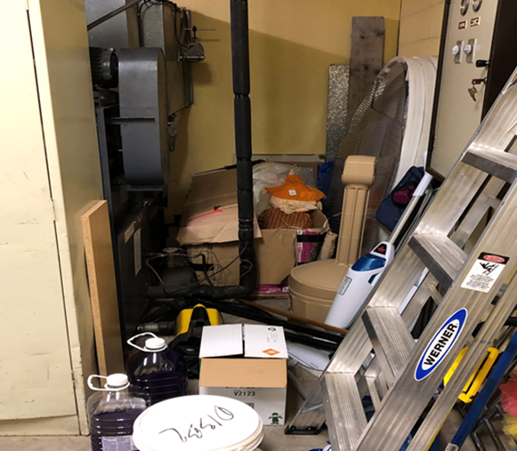
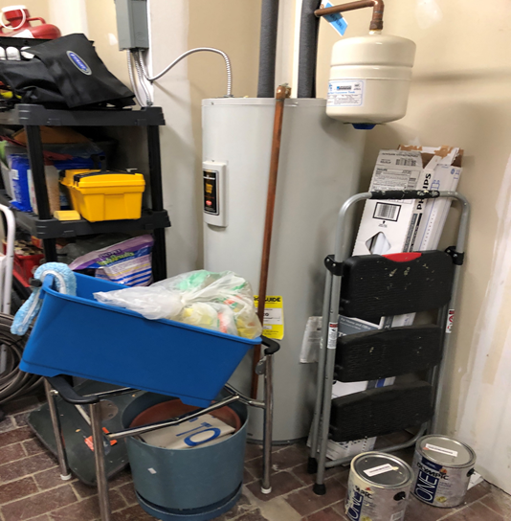
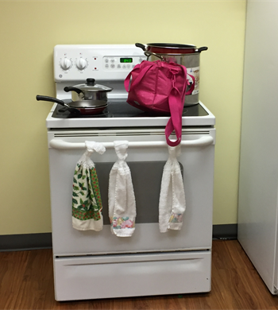
Housekeeping
Good housekeeping habits are an important part of a safe workplace.
Why?
To reduce amounts of flammable and combustible materials.
To reduce ignition hazards.
To ensure safe emergency evacuation of occupants.
To allow for quick emergency response.

Slide 7
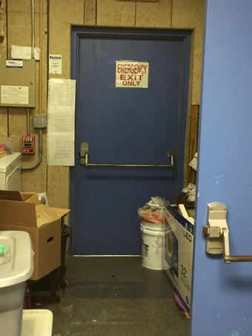
General Housekeeping Guidelines
Work areas, aisles, walkways, stairways, and equipment should be kept clear of loose materials, trash, scraps, etc.
Never block aisles, fire exits, emergency equipment, or alarm pull stations with equipment or materials.
Avoid build up of combustible trash and waste such as paper, wood, cardboard, etc.
Clean up all spills such as grease, oil, or water immediately.
Keep use and storage of flammable and combustible materials to a minimum.

Slide 8
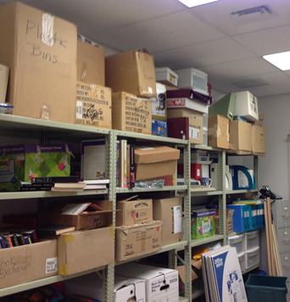
Storage Guidelines
No storage is allowed in corridors, or stairwells.
Storage must not exceed 18” below sprinkler heads or smoke detectors.
All storage must be at least 3’ from electrical panels and maintain at least 3’ clearance from heating surfaces and lighting fixtures.
Storage of combustible materials in mechanical rooms is prohibited.

Slide 9
Flammable and Combustible Liquids
Flammable and combustible liquids are fuel sources for fires and are present in almost every workplace.
It is important to understand what materials are in your work area.
Paints
Gasoline
The volatility of flammable and combustible liquids requires special storage and handling requirements.

Slide 10
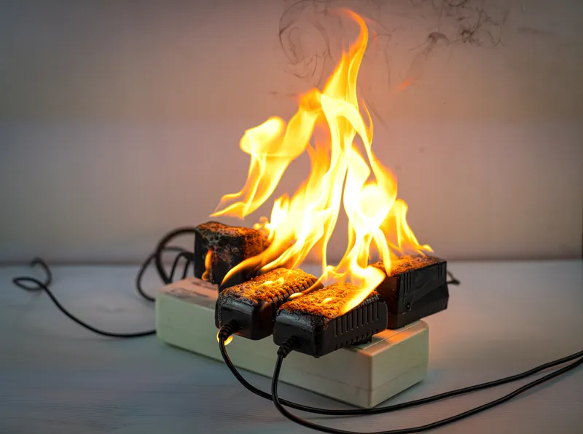
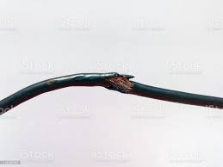
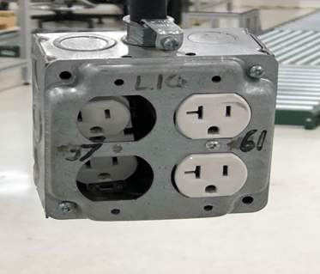
Electrical
Electrical hazards are the cause of numerous workplace fires each year.
Faulty electrical equipment produces heat and sparks that serve as ignition sources in the presence of flammable and combustible materials.
Overloading circuits
Use of unapproved electrical devices
Damaged or worn wiring

Slide 11
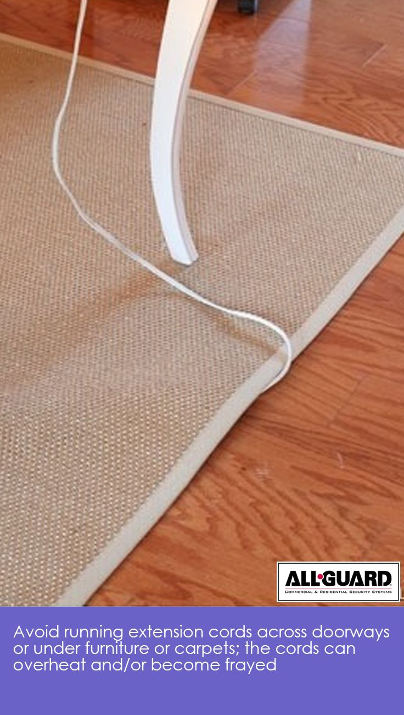
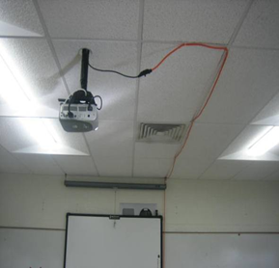
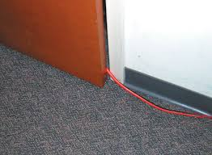
Electrical – Extension Cords
Extension cords are not approved for permanent use.
Regularly check electrical cords for defaults such as frays, brittleness, or broken wires.
Never place electrical cords in high traffic areas where they can be damaged by being stepped on or run over by equipment or put through windows, doors, or anywhere where they could be damaged easily.

Slide 12
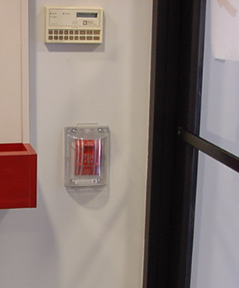
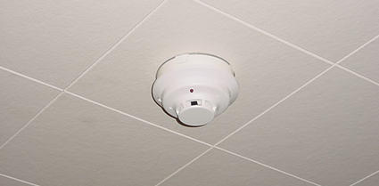
Fire Protection Equipment
Smoke Detectors – battery units
Smoke Detection System – connected to a building fire alarm system
Fire Alarm Systems – automatically or manually links the sensing of fire conditions and notification of people in and outside the building.
Manual – fire alarm pull box
Automatic – senses & activates
Automatic Sprinkler Systems
Cooking Protection – dry chemical hood

Slide 13
ABC’s of Fire Extinguishers (Classifications & Symbols)
Notes:
Most fire extinguishers will have a picture label telling you which types of fires the extinguisher is designed to fight.

Slide 14
How to Use a Fire Extinguisher
https://youtu.be/58naKHqpCWo (2 min)

Slide 15
How to Use a Fire Extinguisher Remember to P.A.S.S.

Slide 16
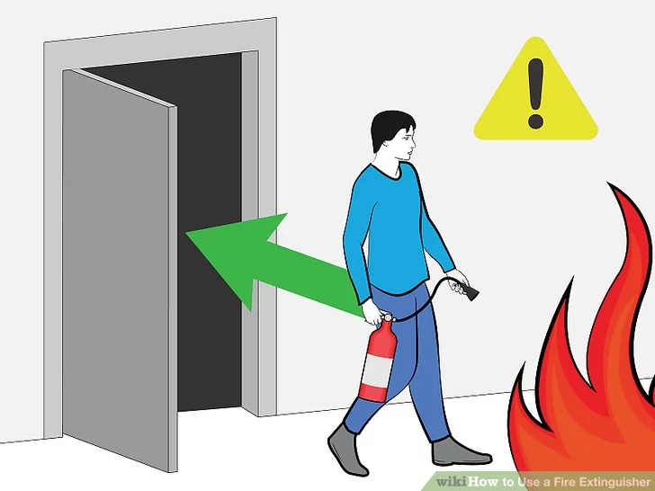
Guidelines for Fighting Fires
Fires are dangerous and you should always be certain that you will not endanger yourself or others when attempting to put out a fire!
For this reason, when a fire is discovered…
Assist any person in immediate danger to safety, if it can be accomplished without risk to yourself.
Call 911 OR a building alarm system will alert 911.
When exiting, pull fire alarm (if no building alarm system) and close the door.
If the fire is small, you may attempt to use an extinguisher to put out but only after ensuring everyone is out of danger and 911 notified.
ALWAYS POSITION YOURSELF WITH AN EXIT AT YOUR BACK!

Slide 17
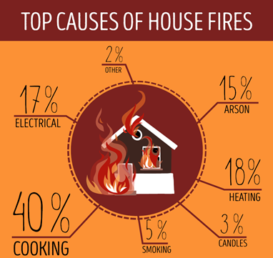
Never fight a fire if…
You don’t know what is burning
The fire appears too large to handle with one extinguisher
The fire is spreading rapidly beyond the spot where it started
You don’t have an adequate or appropriate fire extinguisher
You might inhale toxic smoke
Your instincts tell you not to

Slide 18
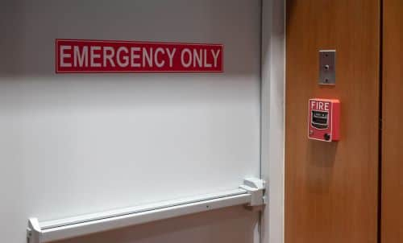
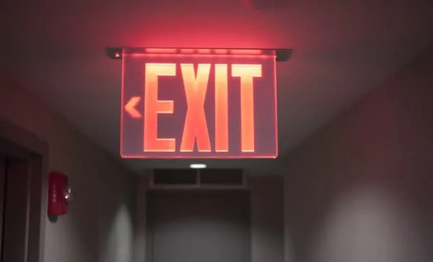
Emergency Escape Routes
EXIT ROUTES:
Continuous, unobstructed exit path from any place in worksite to safety
Exit access, exit, exit discharge (clear pathway away from building) must be:
Clearly marked
Well lit
Appropriate width
Unobstructed
Get low ‘under’ any smoke & cover mouth/nose
Shut doors behind you
Stop, Drop, Roll

Slide 19
When Fire Strikes, Get Out and Stay Out
https://youtu.be/CuNGr4qSlZ0 (17 min)

