Slide 1
Gold Standard Customer Service
Notes:
Instructor Version

Slide 2
Training Objectives:
Differentiate between exceptional and poor customer service
Identify who our customers are
Understand the Foundation of Gold Standard Service & PPWR
Identify key concepts for greeting customers, offering services, and handling requests
Demonstrate “How NOT to say No”
Demonstrate appropriate steps to Take the HEAT (angry customers)
Identify ways to cope in stressful situations
Notes:
Talking Points:
ASK - When you hear the words Customer Service – what are your initial thoughts?
ACTIVITY – write thoughts on post-it note – place on designated wall area

Slide 3
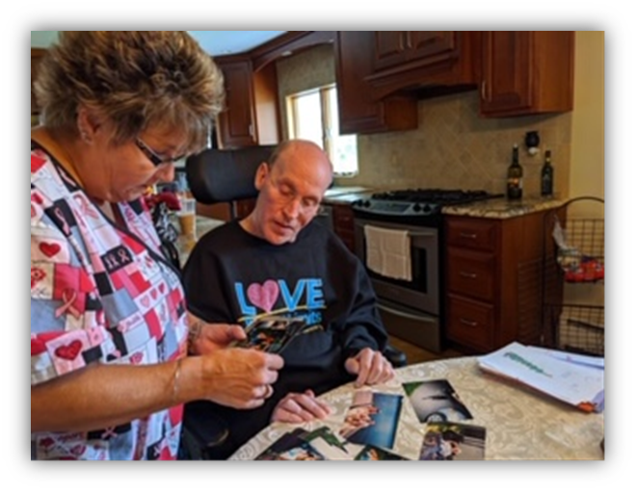
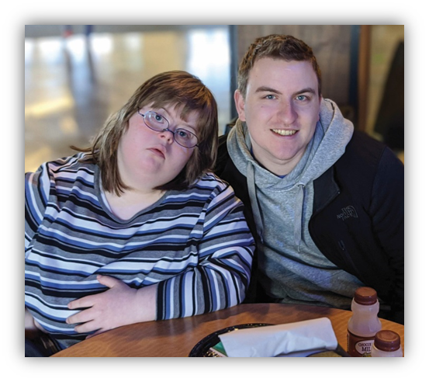
What exactly is customer service?
Customer service is anticipating and satisfying the needs of your customers in a consistent and dependable manner.
Notes:
Talking Points:
ASK – Think about your favorite restaurant. Why do you go there? A: service, prices, quality, experience
ASK – Now thinking about the worst service you’ve received. Would you go back again? Why or why not? As a paying customer, what effect did it have on you? How could this damage their business?
BEFORE NEXT SLIDE, ASK – Why does UCP need to have high standards of customer service?
Pause for answers.

Slide 4
Why does UCP need to have high standards of service?
UCP = Gold Standard service provider
It’s the right thing to do!
Survival in increasingly competitive market
Notes:
Talking Points:
No matter the business line, CUSTOMERS HAVE CHOICES - competitor products or services. We all do! The way we are treated makes big impact on our desire to repeat business and maybe refer others.
BEFORE NEXT SLIDE, ASK – Who are our customers?

Slide 5
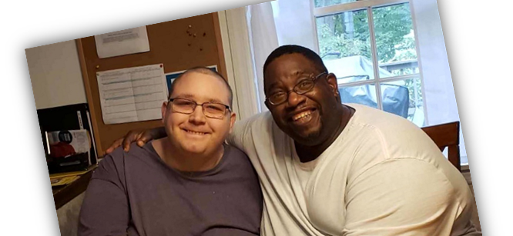
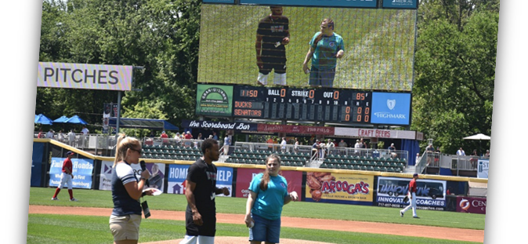
Our Customers… WHO are they??
Participants
Participant’s Families
Agency Staff/Direct Support Professionals
Service Coordinators/Case Managers
All of our customers are our business!
High standards of service differentiate us from our competitors. Without our customers, we do not have a business!
Notes:
Talking Points:
Participants is a given but we need to diligent in remembering ANYONE who supports the participants we serve are also our customers. Past participants/support are our customers. FUTURE participants/support are our customers (they will chose our services if our customer service is the Gold Standard).
BEFORE NEXT SLIDE, ASK – What are some key attributes in a professional that will make for great customer service?

Slide 6
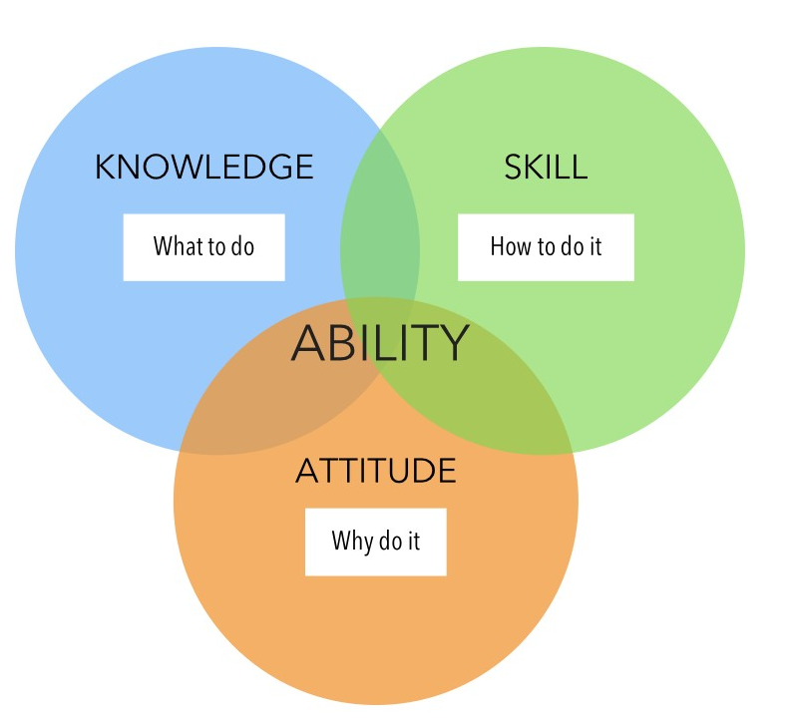
Foundations of Gold Standard Customer Service
Three Key Characteristics:
SKILLS – knowing how to complete all the task within your job function.
KNOWLEDGE – the experience of and lessons learnt from doing your job.
ATTITUDE – the energy, enthusiasm and positive approach you have towards your job and customers.
Notes:
Talking Points:
ASK - What happens to organizations that provide poor customer service? Why would customers choose us over our competitors?
A: Poor soft skills especially are a deal breaker! “Soft skills are the personal attributes that enable someone to interact effectively and harmoniously with other people” (Websters).
ASK - What are some examples of important soft skills, in addition to positive attitude and enthusiasm?
A: Empathy, Communication, Confidence, Reliability, Responsibility, Integrity, Time management, Self-management, Stress Resistance, Learning willingness, Active Listening, Decision-making, Teamwork, Good manners, Co-operation, Follows directions, Adaptability, Diversity tolerance, Organization, Problem solving, Work ethic, Follow through, etc.

Slide 7
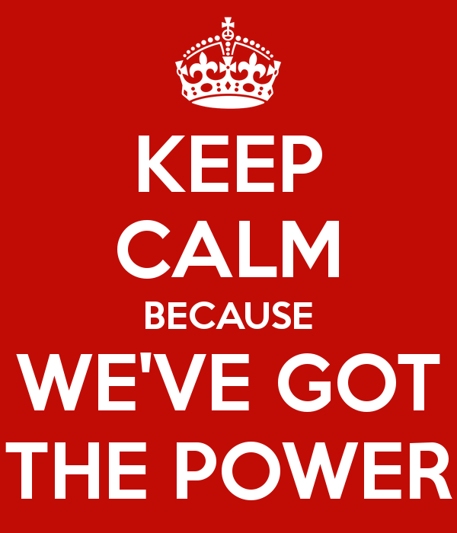
The PPWR of Gold Standard Customer Service
“We’ve got the PPWR (power)!”
Professional
Personal
Warm
Responsive
Practicing PPWR will give you the power to deliver exceptional service every time!
Notes:
Talking Points:
ASK – How do you treat guests in your home? What do you do to make them feel special?
Think of our customers as our guests.
PPWR (power) will make our customers feel like our special guests. PPWR is an easy acronym to remember! Make it your mantra!

Slide 8
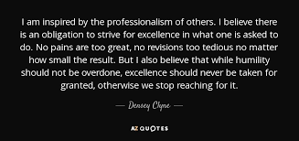
PPWR in Practice
Professional Service
Knowing our job
Following UCP’s standards, procedures & policies
How we dress & hygiene standards
Keeping a POSITIVE ATTITUDE
Taking pride in what we do
Notes:
Talking Points:
As professionals, we need to not only enforce policies but maybe more importantly, model policies – timeliness/attendance, cell phone usage (social media – NO!), not gossiping about others, complaining, etc.

Slide 9
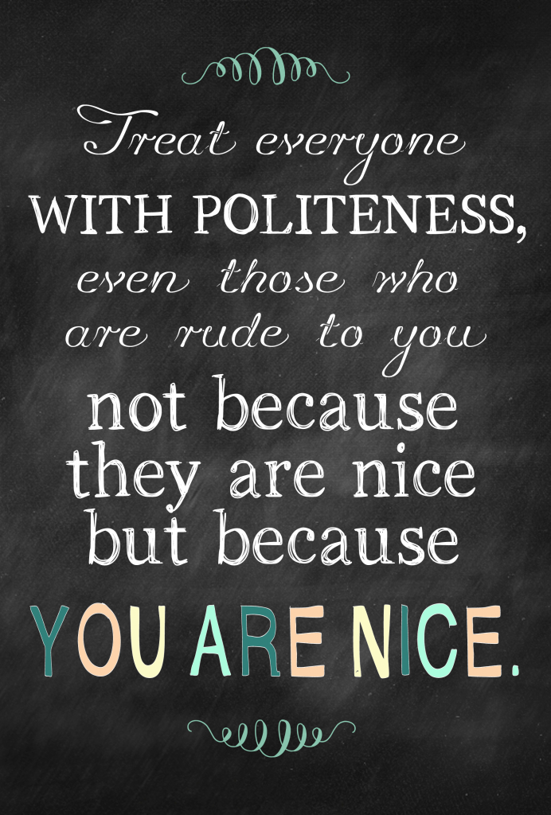
PPWR in Practice
Personal Service
Treating everyone as an individual, with respect and dignity
Providing person-centered care
Respecting and acknowledging participant’s rights and choices
Being kind and compassionate
Notes:
Talking Points:
Everyone wants their choices honored, even if others do not agree with the choices made. Personal service is about meeting people where they are and both tolerating and embracing differences!

Slide 10
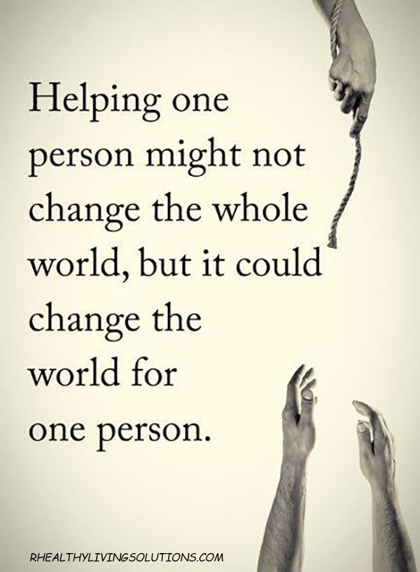
PPWR in Practice
Warm Service
Doing everything with sincerity
Being present (no cell phones, technology distractions)
Responsive Service
Responding to customers with patience and empathy
Taking the time to really listen
Following up
Notes:
Talking Notes:
I cannot STRESS enough the importance of being present!
ASK – Has anyone ever been told by someone in customer service that they would be followed up with BUT were not? How did that make you feel?

Slide 11
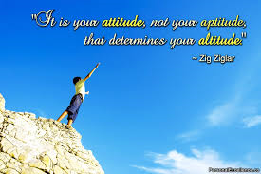
How can I practice PPWR?
In everything YOU do, YOU have the PPWR (power) to be a Difference-Maker!
If you are always Professional, Personal, Warm, and Responsive, customers will consistently receive Gold Standard Customer Service and OUR business will benefit!
Notes:
Talking Points:
ASK – What does an unhappy customer do?
A: complain to others (negative word of mouth), become unhappy, take services elsewhere, etc. It HURTS business!
ASK – What about a happy customer?
A: tell others (positive word of mouth), stay with business, potentially recruit future business. It HELPS business!
Make PPWR your mantra!

Slide 12
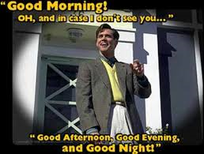
Why are GREETINGS so important?
You don’t get a second chance to make
a first impression!
We can greet customers in such a way that we can change their day because “we’ve got the PPWR.”’
Greeting Standards:
Immediately acknowledge customer with eye contact, a smile, and a warm greeting.
Use the customers’ name, if possible. If 1st encounter, introduce yourself.
Initial statement should be a non-business-related statement or question.
Promptly offer service/assistance.
Notes:
Talking Points:
We are building rapport by learning more about who our customer is and showing them warmth by opening with nonbusiness related statements or questions. ASK - What are some examples? A: I hope you travel in was easy – I am glad to see you!, What a lovely sweater on you – where did you get it?, How are you enjoying this PA weather today?, etc
ASK - What are some examples of NOT acceptable greetings? A: not smiling, shouting across the room, waving from across the room, greeting with silence, not announcing yourself if entering a home. Be mindful of using humor – not everyone has the same sense and you may unintentionally offend.
ASK - What are some unacceptable terms/names to call people? A: Dear, Love, Sweetie, Hun, Buddy, Kiddo, etc.

Slide 13
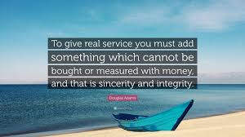
Why do we need to OFFER service, instead of waiting to be asked?
SERVICE is something you GIVE!
Offering Service Standards: 1. Look the person in the eye
2. Face your body towards the person
3. Personalize Conversation
4. When offering service, begin with “May I…?” NOT “Can I…?”
Notes:
Talking Points:
ASK - What are the 3 types of communication?
Verbal Communication - What You Say (& When You Say It)
Para-verbal Communication - How You Say It (cadence, tone)
Non-verbal Communication – What Your Body is Saying (body language)
ASK - Which is most important? WHY? A: ALL are equally important

Slide 14
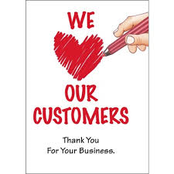
Handling Request Standards – The 5 A’s
Actively listen to the request without interruption or attempting to finish sentence.
Acknowledge & clarify request by repeating back, if necessary.
Action – take immediately or state what/when action will be taken within a specific timeframe. Explain if you will need to pass on – who, why, and timeframe for response.
Affirm Satisfaction by meeting or exceeding the need.
Appreciation – thank the customer.
Notes:
Talking Points: #1 – ASK - What is active listening? A: listening with all our senses, nodding, eye contact, body language.
ASK - What are some common mistakes made during listening? A: being distracted, assuming, focusing only on getting your points made.
#2 – Clarifying is key to ensure you understand the request and both are on the same page.
#3 – ASK - Which of the 4 steps to PPWR does #3 comply with? A: responsive service
#4 – Affirming satisfaction is ensuring that what they expected is what they got, “Joe, how is your cup of coffee?”, “Lori, I will print your paystub and mail to you immediately – is there anything else I can help you with today?” Checking for satisfaction gives you the opportunity to fix something that s/he would otherwise complain to someone else about – internal or external. TAKE OPPORTUNITIES TO EXCEED EXPECTATIONS!
#5 –Whether thanking someone for waiting or calling, for having you in their home to give service, for suggestions or feedback on how to improve service. Demonstrating appreciation and empathy can go a long way in diffusing an annoyed or angry customer.
COMPLETE ACTIVITY - I Wasn’t Aware of That Self-Assessment (5 min). ASK AFTER – Did the results surprise anyone?

Slide 15
Importance of Asking Effective Questions
Why ask questions?
Gain valuable information.
Clarify a customer’s wants and needs.
Provide customer a greater sense of involvement = boosting esteem; building trust and rapport.
Three types of questions:
Open-ended, closed-ended, and leading
Notes:
Talking Points:
ASK - How does asking questions boost esteem?
A: Sometimes you have advice or information that would be helpful for the customer to know but sharing it might make the customer feel foolish or annoyed. One way to avoid hurting a customer’s self-esteem is to share information in the form of a question.
EXAMPLE: You called the wrong number. You need to call your instructor at the Selinsgrove office.
So, how would you make that statement into a question?
ANSWER: Thanks for calling! Sounds like a good question for your instructor to best help you with. May I offer you their direct number or may I connect you?
SIDE BAR: What if someone replies that they have already left messages at that office but have not heard back?
ANSWER: Offer greater assistance! “May I have your name and phone number to send an email to the team to request a follow-up for you?”
THEN, follow-up with the team to ensure the customer was contacted! TAKE OPPORTUNITIES TO EXCEED EXPECTATIONS!

Slide 16
Importance of Using Effective Questions – Kinds of Questions
Closed-ended – discourages discussion; force YES or NO answer.
Ex: Do you want pickles on that?
Leading – worded to encourage the desired response. Can seem manipulative.
Ex: You do want pickles on that, right?
Open-ended – involves the customer; allows them to provide alternatives or additional info and to ask their own questions.
Ex: What would you like on your sandwich?
Notes:
Talking Points:
ASK - Of the three, which would most likely get you the information necessary to meet or exceed your customer’s wants or needs? A: usually open-ended
ASK - Can you think of an example in customer service when a close-ended question would work best?
POTENTIAL ANSWERS: if straightforward information is your goal, then closed-ended is useful and appropriate. If you are confirming a previous request, a leading question is useful. Someone who is limited or non-verbal might prefer closed ended questions.
COMPLETE ACTIVITY – ASK DON’T TELL (5-10 minutes)

Slide 17
Top 5 Phrases that Anger Customers
5. “You’ll have to come back later when someone can help you.”
4. “I’m not allowed to do that.”
3. “That’s not my job.”
2. “That’s our policy, sorry.”
1. “I don’t know.”
Notes:
Talking Points:
ASK - Why do statements such as these anger people? How do they make you feel when someone says them to you?
So, let’s discuss how NOT to Say NO

Slide 18
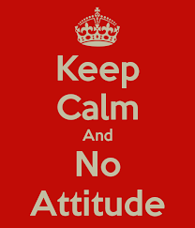
How Not to Say “No”
Try to understand why a difficult/unreasonable request is made – sometimes the underlying reason can be addressed with a solution we can do.
Apologize and explain why you are unable to fulfill a specific request– reference care plan, management is out of the office, etc.
Focus on what you CAN DO! Offer possible alternatives or solutions. Consider who you could ask to help.
Do NOT argue or become defensive – remain professional.
Be consistent.
Notes:
Talking Points:
ASK - What is an example of a potentially unreasonable request or one that you would not be able to help with in your role? How do you respond to such a request?
A: It is important NOT to point fingers (i.e. I don’t know who told you that) or state that’s not my job. “Let me find out who can maybe help you with that request.” OR “I’m not sure I can help/fix this myself, but let me reach out to the office to see what else can be done or what additional support might be available!” etc.
Now, let’s have you try it - COMPLETE ACTIVITY – How NOT to Say No (5-10 minutes)

Slide 19
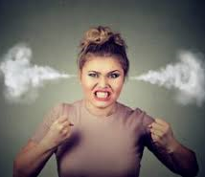
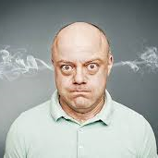
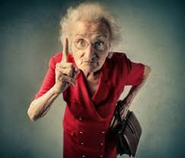
How do we handle angry customers?
Take the H.E.A.T.
Hear them out
Empathize
Apologize
Take Action
Notes:
Talking Points:
Taking the HEAT is all about NOT PERSONALIZING others attitude or actions! After all, it is easy to be kind to others when they are kind to you but in reality, does that make you a kind person if that is the only time you show kindness to others? Truly being kind is about being kind when it is hard to do!

Slide 20
Taking the H.E.A.T.
Hear them out
Let them talk, and simply, patiently LISTEN.
Not easy to do but it WILL help the customer feel better.
Notes:
Talking Points:
Do NOT personalize others energy, attitude, or behavior. You can only control your own energy, attitude, and behavior and are only responsible for YOU!
Do NOT tell them to CALM DOWN or RELAX – both will escalate the person.

Slide 21
Taking the H.E.A.T.
Empathize
Put yourself in their shoes.
Calmly name their emotions: “I understand that you are frustrated and I can see why.”
Helps to diffuse anger.
Notes:
Talking Points:
SHOW VIDEO
Listening and responding with empathy is NOT necessarily agreeing with the person or pitying. It is simply saying “I hear you and I understand.”

Slide 22
Taking the H.E.A.T.
Apologize
“I’m sorry” can go a long way.
Customer does NOT want to hear YOU aren’t responsible. Maybe YOU didn’t ‘do it’ but your company did and you ARE part of that team.
Notes:
Talking Points:
DO NOT BLAME!
You will NEVER lose face when you apologize for someone’s poor customer service experience.

Slide 23
Taking the H.E.A.T.
Take Action
After you have Heard them out, Empathized & Apologized…
Take ACTION, not reaction.
Notes:
Talking Points:
SHOW VIDEO. Remember to remain calm and professional - focus on the solution! Focusing on “here’s what I can do for you…”
DISCUSSION: Using HEAT (hear them out, empathize, apologize, take action), discuss ways to handle the following scenarios:
SCENARIO #1 (participant yelling at DSP in the client’s home): You need to move faster! It takes you too long to do one damn thing!
SCENARIO #2 (participant yelling at DSP in a grocery store): You moved my wallet out of my purse! You are always f*** up! I can never find my stuff because of you!

Slide 24
Remember, OUR Customers ARE…
Not dependent on us – we are dependent on them.
Not interruptions to our work – they are the purpose of it.
Doing us a favor when they call – we are NOT doing them a favor.
People who have wants and needs – it is OUR JOB to meet them.
Deserving of the most courteous & attentive treatment (PPWR).
The reason why our business exists.

Slide 25
Coping 101 Customer Service can be Stressful
Relieving Your Stress
Pause in conversation, if necessary.
Deep breathing – inhale 4 sec. through nose, hold, fully exhale through mouth. Repeat.
Talk to a supervisor – everyone feels better after being heard (then let it go!)
Go for a short walk. Take a short break.
Stress ball.
Practice empathy.
Notes:
Talking Points:
ASK – What are some ways to cope during or after stressful situations?
Pause for answers.
ASK - What does “practice empathy” mean to you?
A: maybe the golden rule, or putting ourselves in someone else's shoes
COMPLETE ACTIVITY – Deep Breathing exercise

Slide 26
Customer Service Training Recap:
“We’ve got the PPWR!”
Our skills, knowledge, ATTITUDE are the foundations for Gold Standard Customer Service
Always greet customers, offer service, and graciously handle all requests by remembering ‘How NOT to Say No’
Diffuse angry customers by taking the H.E.A.T.
Notes:
Talking Points:
ASK -
What does PPWR stand for? (pg. 7) A: Professional Service, Personal Service, Warm Service, Responsive Service
How should be greet a customer? (pg. 12) A: Use Greeting Standards:
Immediately acknowledge customer with eye contact, a smile, and a warm greeting.
Use the customers’ name, if possible. If 1st encounter, introduce yourself.
Initial statement should be a non-business-related statement or question.
Promptly offer service/assistance.
Why is offering service important? (pg. 13) A: Service is something you give, something you offer.
How should we handle requests? (pg. 14) HINT: think the 5 A’s!
Actively Listen
Acknowledge & Clarify
Action
Affirm Satisfaction
Appreciation – say thank you to the customer!
How do we ‘not say no’ to requests? (pg. 18)
Try to understand why a difficult/unreasonable request is made – sometimes the underlying reason can be addressed with a solution we can do.
Apologize and explain why you are unable to fulfill a specific request– reference care plan, management is out of the office, etc.
Focus on what you CAN DO! Offer possible alternatives or solutions. Consider who you could ask to help.
Do NOT argue or become defensive – remain professional.
Be consistent.
What does H.E.A.T. stand for? (pg. 19)
Hear them out
Empathize
Apologize
Take Action
ACTIVITY – write down 1 thing you have learned today that you will implement when providing customer service. Take it with you to remind yourself!

Slide 27
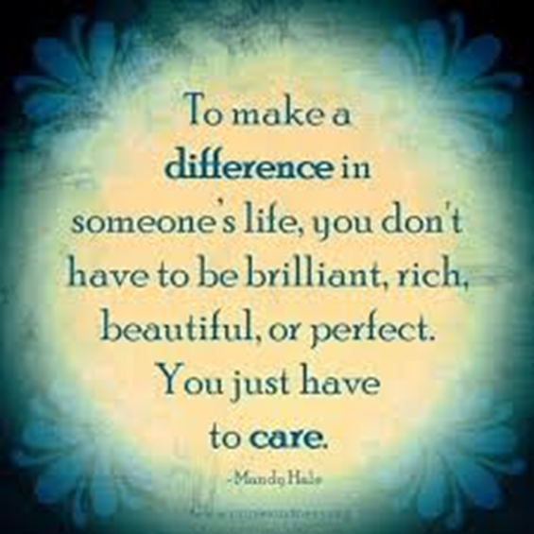
Thank YOU for being a Difference-Maker!
https://youtu.be/t4AJFyK63Hg
Notes:
Talking Points:
To make a difference in someone’s life, you don’t have to be brilliant, rich, beautiful, or perfect. You just have to care. Thank YOU ALL for caring and for being difference makers!
SHOW VIDEO
Thank you for your time and participation!

