Slide 1
Introduction to Assistive Technology at UCP of Central PA
Assistive Technology Department
UCP of Central PA
Serving the following PA counties: Adams, Cumberland, Dauphin, Franklin, Fulton, Huntingdon, Juniata, Lancaster, Lebanon, Mifflin, Perry, and York
Notes:
Our programs operate in conjunction with TechOWL and are paid for by the residents of Pennsylvania.

Slide 2
What is Assistive Technology?
Assistive technology (AT) is any item, piece of equipment, software program, or product system that is used to increase, maintain, or improve the functional capabilities of persons with disabilities – TechOWL

Slide 3
Types of AT
Low Tech | Medium Tech | High Tech
No electronics or programming Usually cheapest very limited functions Typically easiest to make and use | Preprogrammed Limited or no customization | Highly customizable Multifunctional Typically more expensive

Slide 4
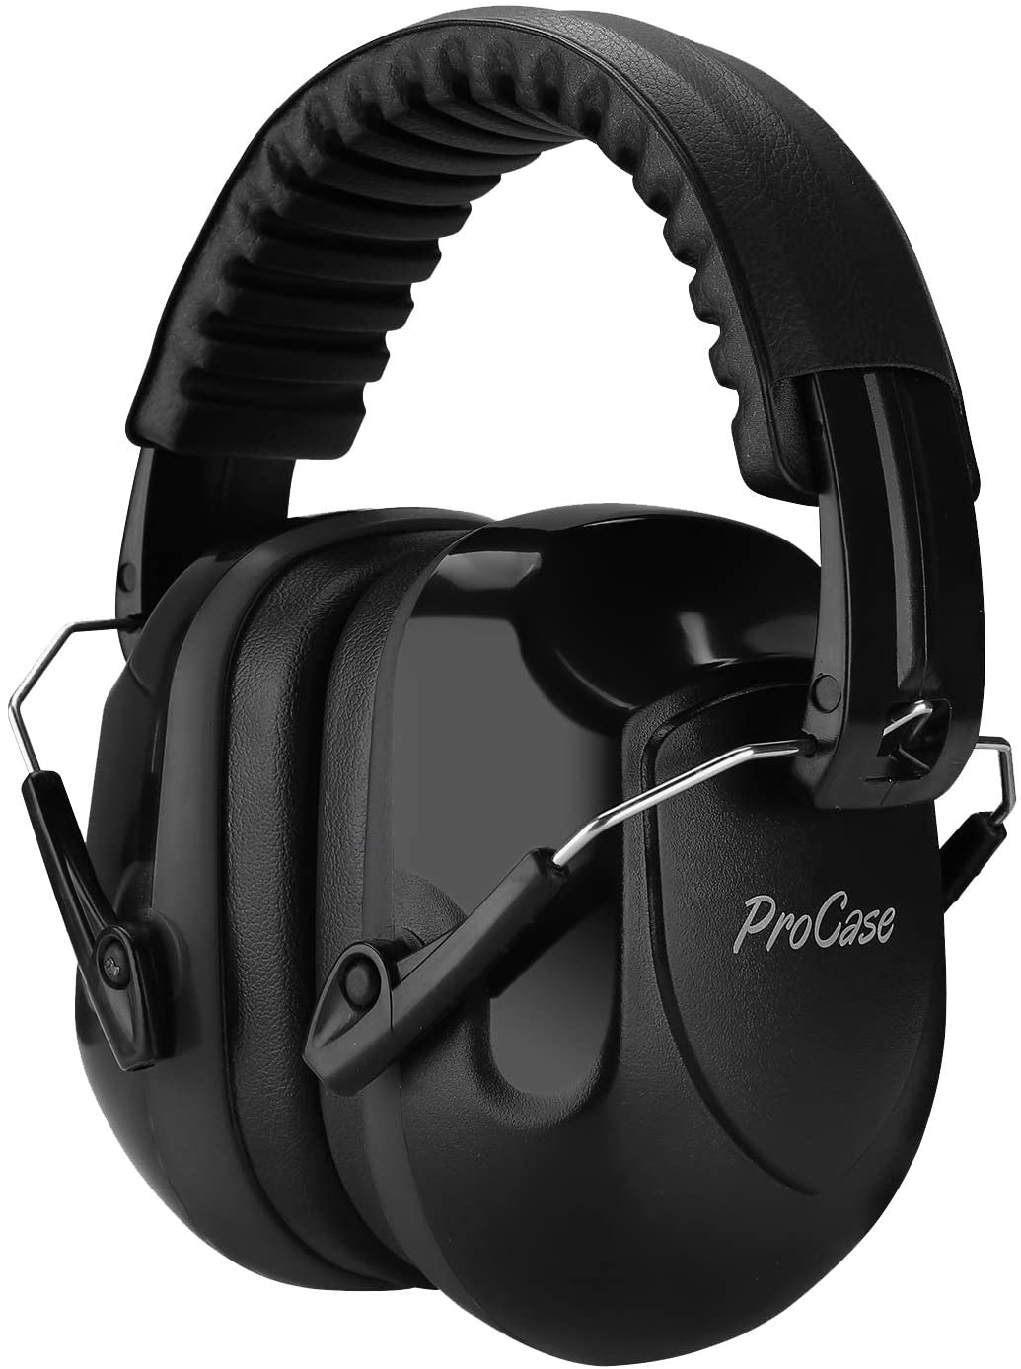
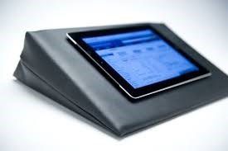
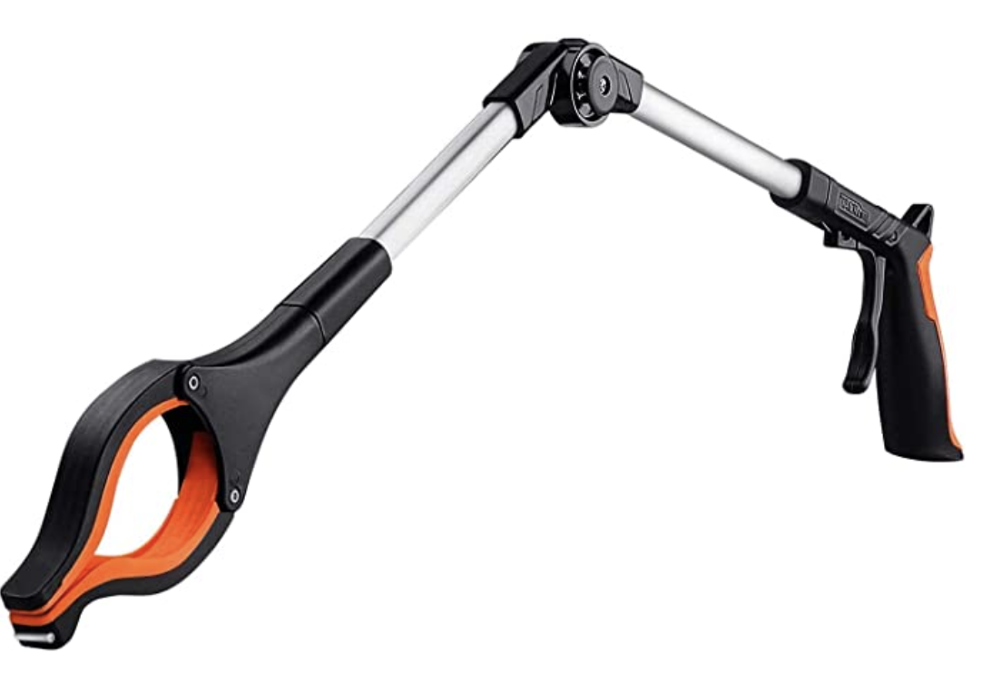
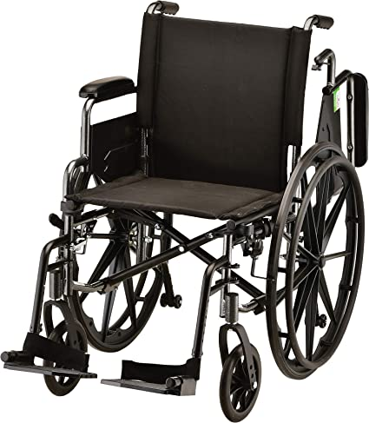
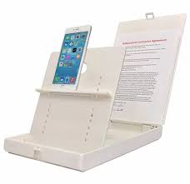
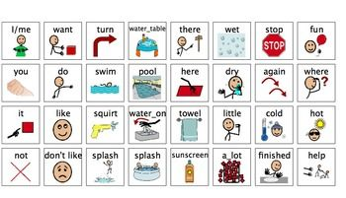
Low Tech – No electronics, limited
Noise reduction headphones
Wedge pillow
Easy Grip Mugs/utensils
Reachers
Wheelchairs
Mounts and holders
Pictures
Notes:
These low tech items require no battery or energy source.

Slide 5
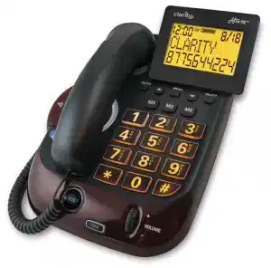
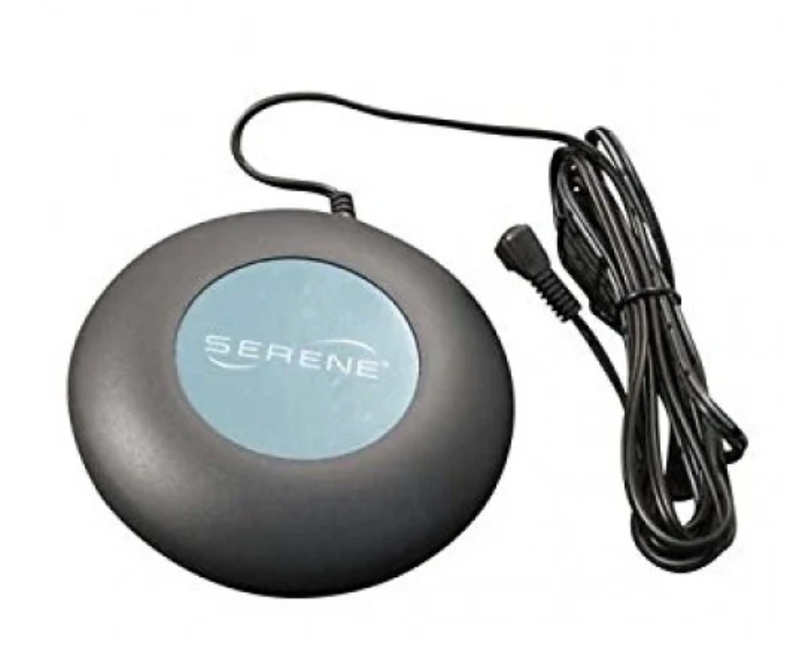
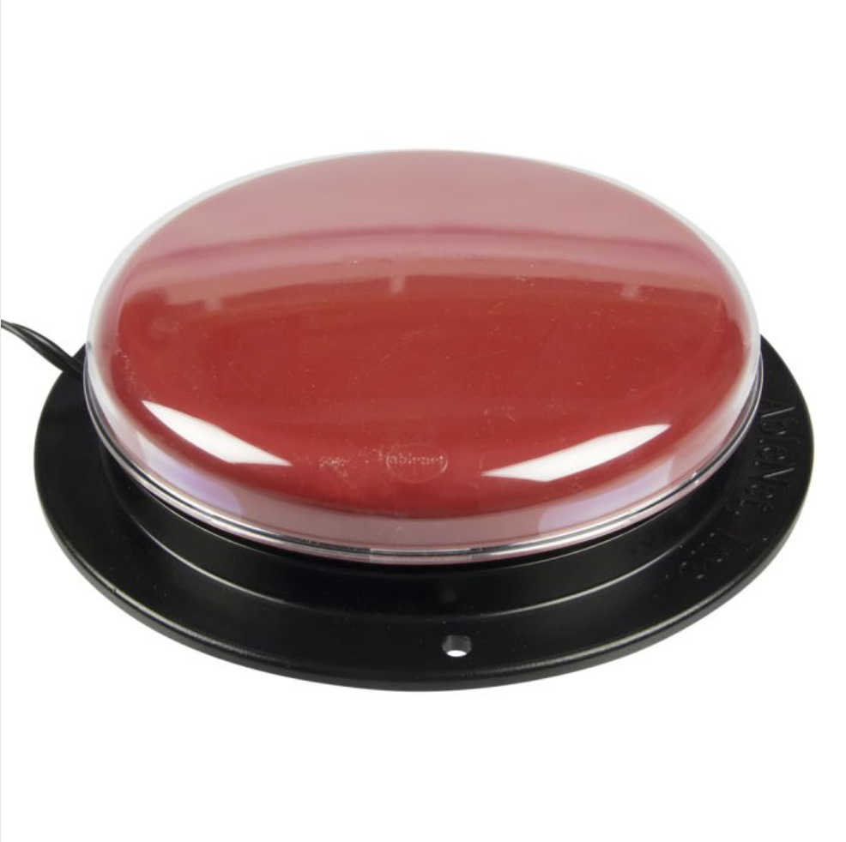
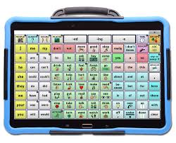
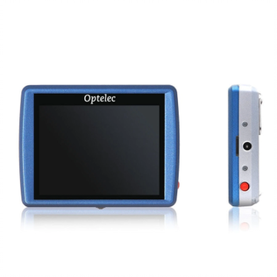
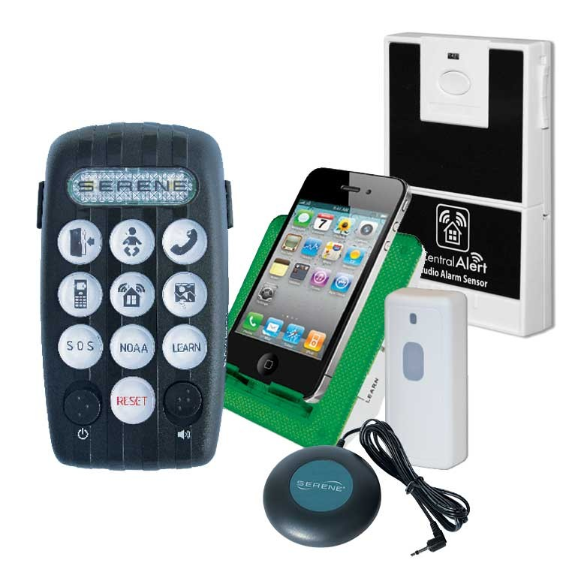
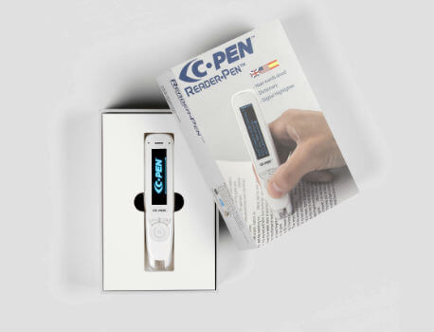
Medium Tech- Pre-programmed, limited
Specialized home phones
Bed shakers
Switches
Dedicated speech devices
Magnifiers
Alert systems
Reading devices
Notes:
These items serve a limited function and are not customizable except for that function. Even though items such as the pen reader are very complex in its design and software, it is considered medium tech due to its limited scope of function.

Slide 6
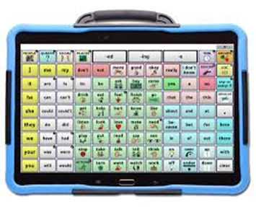
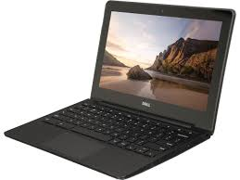
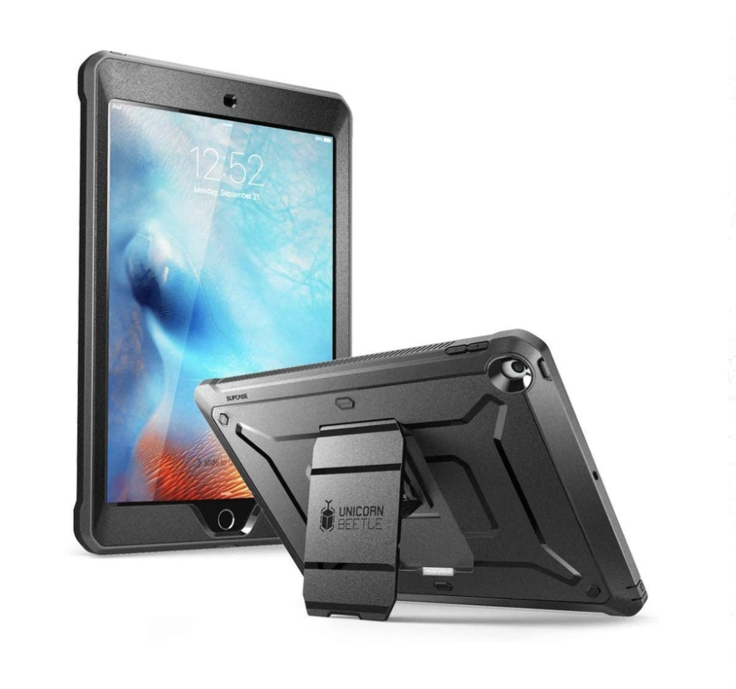
High Tech - multifunctional
Speech devices
Chromebook laptop computers
iPad
Notes:
These items are high customizable through apps and accessibility settings. They can serve a wide variety of uses. You may have noticed that speech devices are on both the medium and high tech lists. If an item is considered a dedicated speech device then it is medium tech as speech is its only function. If speech is one of many functions, it would be considered high tech. Most commonly this would be a tablet or smart phone with a speech app.

Slide 7
Nobody’s disability is unique,
You don’t need to start from scratch,
.
But everyone experiences their disability uniquely.
But you may need to adapt.
Notes:
Picture or text labels on each drawer/cabinet to give Deonte a visual reminder. Works for dressers too to help Deonte put away or choose clothing.

Slide 8
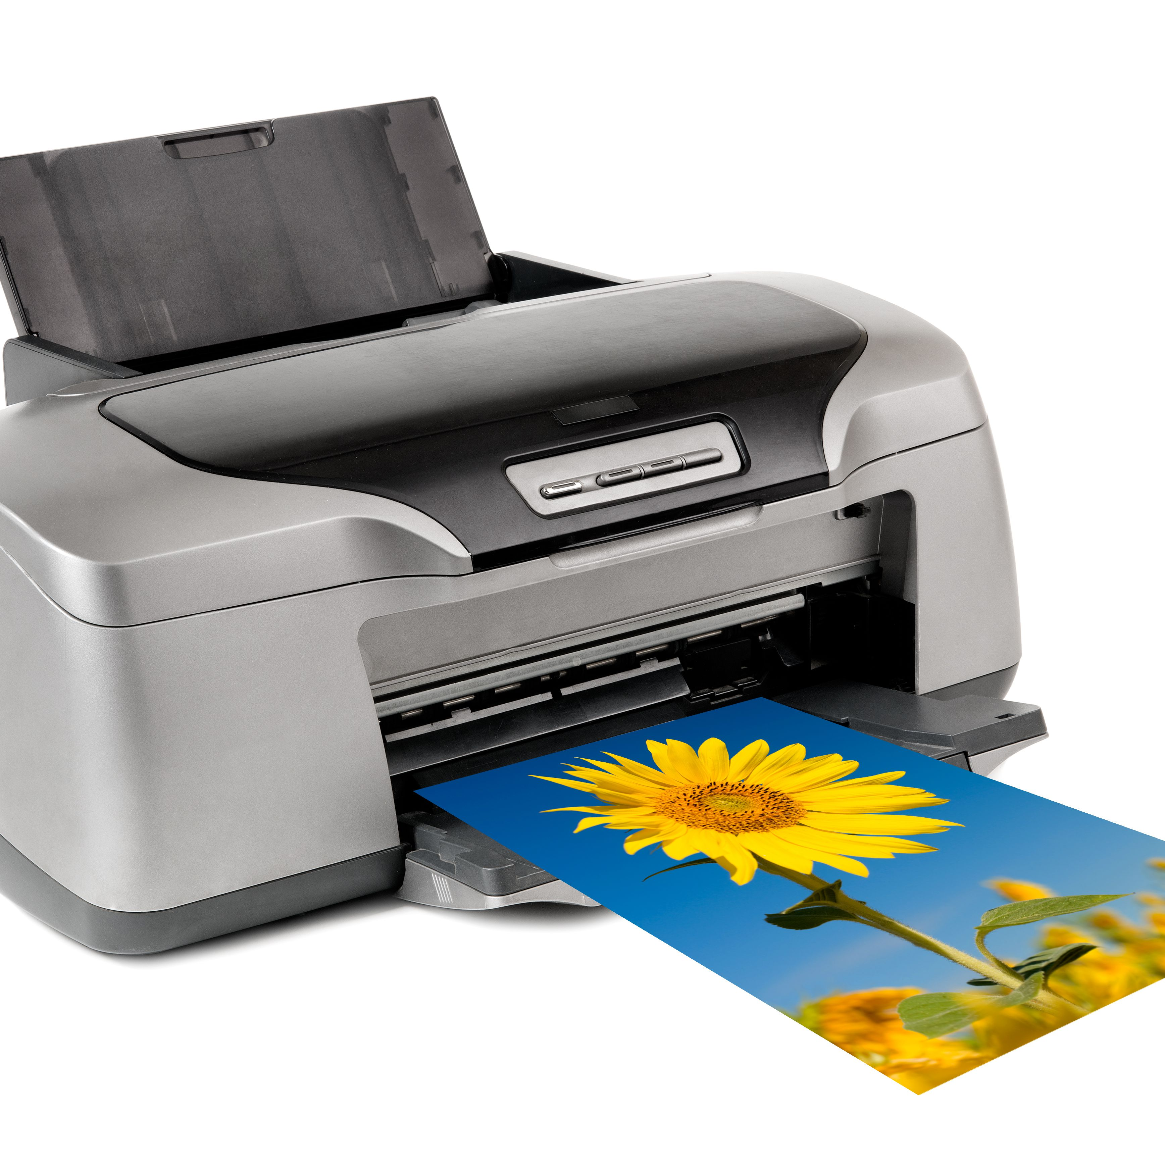
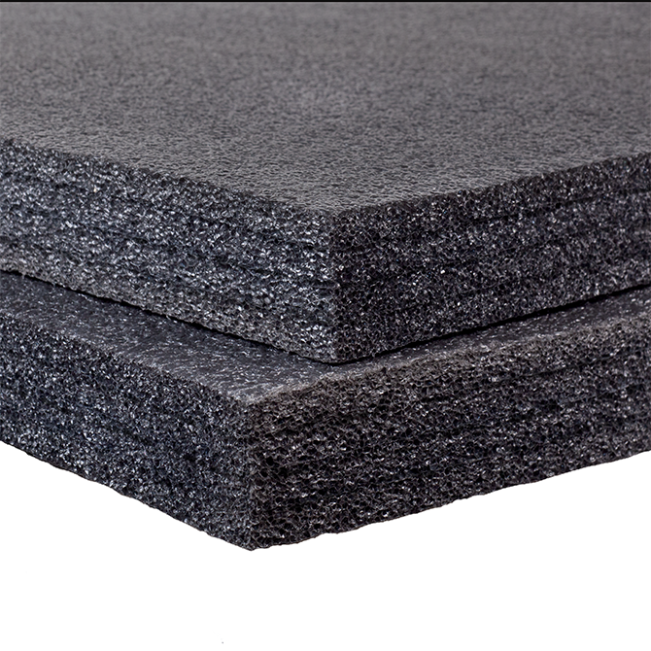
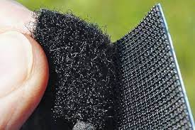
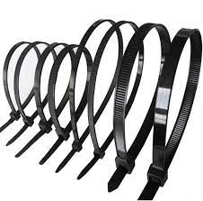
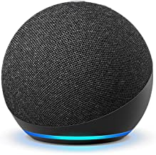
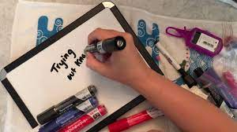
Common Items for AT Making:
Notes:
Printer
Velcro, adhesive or self-attaching
Zip ties
Foam
Smart devices such at the Amazon Echo, tablets, smart phones, etc.
White boards/signs/posters, etc.
Your own creativity.

Slide 9
Situation:
Deonte has autism and is without speech causing heightened anxiety. One of Deonte’s goals is to help with getting ready for dinner which is proving to be a challenging task for him. Each night seems the same. Deonte enters the kitchen and gets frustrated because he can’t remember which items are in which cabinets and it is causing him great stress and anxiety.
What tech could you use to help Deonte be successful?
Notes:
Picture or text labels on each drawer/cabinet to give Deonte a visual reminder. Works for dressers too to help Deonte put away or choose clothing.

Slide 10
Situation:
James has a spinal cord injury and is unable to hold papers in his hands or bend is head down to read papers laying flat on a table. What kind of device could you use or make to hold up papers for James.
What tech could you use to help James?
Notes:
Art easels. Cardboard boxes with slits cut into them. Binder and tape or binder clip.

Slide 11
Situation:
Vera is six years old and is starting first grade. Her disability inhibits grasping standard pencils well which makes her handwriting illegible. She is afraid using jumbo pencils or anything too different will be embarrassing for her.
What tech could you use to be successful?
Notes:
Simple pencil grips often help a lot. No grip? Wrap a rubber band around the part of the pencil the fingers grasp.

Slide 12
Situation:
You work in a home with more than one participant. One of the participants is prone to leaving the home without asking or telling anyone. According to the participant’s ISP, leaving alone is not safe for this participant.
What tech could you use to know if someone is leaving?
What if you were helping another participant elsewhere?
Notes:
Simple pencil grips often help a lot. No grip? Wrap a rubber band around the part of the pencil the fingers grasp.

Slide 13
Our Programs in Conjunction with TechOWL
Free Assistive Technology Lending Library
Nine week loans
On site or shipped from central library
Low, medium, and high-tech equipment
Anyone can borrow
Changing Hands
Donation-based
Free permanent re-use
Anyone can use
Free Special Phone Program
Pennsylvania Residents with disabilities and low income
Disabilities such as limited speech, mobility, vision, and hearing.
Notes:
Also note ICanConnect, ILT, and AgrAbility but in-depth detail is not relevant to most new hires.

Slide 14
Learn More About Us
About Us
https://www.facebook.com/ATUCPCentralPA/
https://www.ucpcentralpa.org/services/assistive-technology/
Email us at ATUCP@ucpcentralpa.org
More Lending Library and Free Special Phone information
https://techowlpa.org/
Notes:
Feel free to contact us in the AT department if you have any questions or would like to utilize our services.

Slide 15
Changing Hands in action…
https://www.facebook.com/ucpcentralpa/videos/486923888533288/
(3-minute video)
Notes:
Also note ICanConnect, ILT, and AgrAbility but in-depth detail is not relevant to most new hires.

