Slide 1
Maintaining Professional Boundaries

Slide 2
Professional Boundaries Training Objectives
Define and identify professional boundaries
Understand the importance of establishing professional boundaries
Describe common situations where boundaries can be blurred
Review UCP’s Conflict of Interest and Gift Acceptance Policies

Slide 3
WHAT are Professional Boundaries?
Guidelines for maintaining a positive and helpful relationship with participants, families, any customer or co-worker.
The space between the professional’s power and the participant’s vulnerability.
Notes:
NADSP - Develop a respectful relationship with the people I support that is based on mutual trust and maintains professional boundaries.

Slide 4
WHY are Professional Boundaries Important?
To ensure relationships are compassionate yet professional.
To prevent unnecessary conflicts.
To protect both participants and yourself.
Protect privacy and confidentiality.
Provide the best possible care or service!
Notes:
Professional boundaries apply to families, co-workers, and all others too.

Slide 5
The Caregiver-Participant Relationship
The caregiver has a powerful role in the relationship. This power comes from:
Control over the services provided
Access to private knowledge
It is important not to let the balance of power slide to the caregiver’s side of the relationship.
Maintaining professional boundaries helps the caregiver maintain a helpful or “therapeutic” relationship.
Ask yourself: “Are my actions more about my needs than about the needs of my client?”
If so, you may be crossing a professional boundary.
Notes:
Instructor:
ADD: How does this benefit the participant? Direct conflict of interest.
EX: borrowed mop

Slide 6
Powerful Role of the Caregiver “Zone of Helpfulness”
The Caregiver-Participant Relationship
Notes:
Instructor:
This graphic depicts the idea of maintaining a therapeutic or helpful relationship with your client, neither over-involved nor under-involved. Staying within the zone helps you to stay “in bounds.”
Under involved – distant, cold, detached, preoccupied
Over involved – enmeshed, intrusive, dependent

Slide 7
Crossing Boundaries
Sharing of personal information
Not seeing behavior as symptomatic
Unprofessional behavior or demeanor
Accepting gifts/favors
Conflict of interests
Over-involvement
Touch
Intimate relationships
Secrets
Notes:
Instructor:
To learn more about how to stay in the zone of helpfulness, let’s review the Maintaining Professional Boundaries chart. The chart gives examples of boundary crossings and offers tips for staying in bounds in specific situations.
Reference under involved vs. over involved chart of categories.

Slide 8
Social Media Professionalism
Social media can create a conflict of interest when an employee connects with participants, their families, or their peers.
Ex. 1: Employee is friends on social media w/a participant they support. The employee calls off work to go on vacation and posts pictures. The participant sees these posts and asks for this employee to be re-assigned.
Ex. 2: Employee is friends with the participant’s family. After the participant has a medical episode at the program, the employee posts on social media about having a ‘terrible day’. Without naming names, they detail the incident. The family files a lawsuit against UCP.

Slide 9
Social Media Recommendations
Set expectations early
Avoid blurring personal and professional lines
Don’t share participant or family information on social media
Do not use social media to contact your supervisor for conversations in an official capacity
Don’t use social media as a “representative” of the agency
Stay off social media (& phones) during work time!

Slide 10
Getting Back In-Bounds
Have you ever crossed any professional boundaries? Or considered doing so? What should a you do if you find yourself stepping over the line?
Talk to a trusted colleague
Talk to your supervisor or manager
Consider asking about another location/site for re-assignment
Explain that you are unable to behave in certain ways due to professional guidelines (i.e. accept gifts, keep secrets)
Draw a line between your work life and your private life
Apologize and learn from your mistake
Other ideas?

Slide 11
Activity Break
Group Breakout Session:
Review the scenario and discuss:
What observations can you make about the situation?
How could the caregiver’s actions affect the participant?
How could the situation affect the caregiver?
5 minutes to discuss & 2 minutes to report
Notes:
Using what you’ve learned about professional boundaries so far, we’re going to explore some examples of boundary crossings using the scenarios that follow in the guide.
Please choose one person to take notes about your discussion and report back to the larger group at the end of your discussion. When you look at the example, please discuss:
What observations can you make about this situation?
How could the caregiver’s actions affect the client?
How could the situation affect the caregiver?
5-7 minutes for discussion

Slide 12
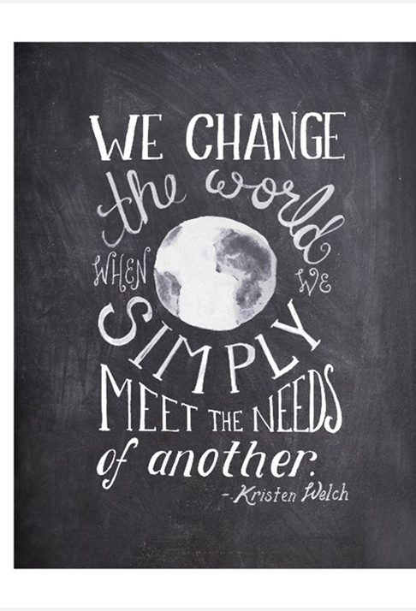
Maintaining Professional Boundaries Wrap-Up
Maintain a helpful but professional relationship with participants by staying in the zone of helpfulness

