Slide 1
Documentation Practices

Slide 2
Why is documentation important?

Slide 3
#1 Protects Individuals Serviced
It is important to have documentation completed for any service to ensure that the individuals are being accurately assessed for their skills and abilities.
Documentation provides an account of progress/regression and allows for changes to be made when necessary.
Documentation allows for accurate reflection of what happened on any given date/time and verifies all parties involved.
Documentation is important to memorialize relevant situations that may be necessary to assess for treatment options.

Slide 4
#2 Protects the Organization
To substantiate claims for services to avoid incidents of fraud and abuse and to back up claims submitted. Failure will result in payments and lose of revenue.
Verifies the individuals name, outcomes, service provided, who provided the service.
Provides a methodology for gathering necessary information to ensure claims submitted for payment are completed within the guidelines established.
Documentation is important as it describes and explains the daily events of the individual while in the care of the provider.
Audit protection - ensures UCP is completing the services in accordance with all state, federal laws and within the established set parameters.

Slide 5
#3 Protects the Program
Documentation ensures the service is effective in meeting the outcomes established
Proof is in the “pudding”
Ensures the integrity of the program
Documentation is used to evaluate the services for CQI (continuous quality improvement)
“If its not in writing it didn’t happen”
Verifies the events of any particular day.

Slide 6
Documentation OBJECTIVE: to use words that are descriptive and detailed.
Importance of daily and timely documentation of the individual’s day and events.
In / Out logs (CPS Services)
Community Outing events/logs
Medication Administration Records (MAR) - all 15 steps are adhered to each administration occurrence
Service Notes

Slide 7
Documentation OBJECTIVE: to use words that are descriptive and detailed.
Teaching plans
Van Logs
Incident Reporting
Medical Appointments/signs & symptoms of illnesses
Body charts for injuries/seizures

Slide 8
Examples of words to use to describe supports:
Engage
Encourage
Explain
Explore
Provide Feedback
Teach
Educate
Review
Role play
Identify
Practice
Guide
Revise
Support
Evaluate
Assist
Reinforce
Model
Comfort
Apply
Give Examples
Challenge
Show
Guide
Develop
Question
Prompt
Adapt
Coach
Implement

Slide 9
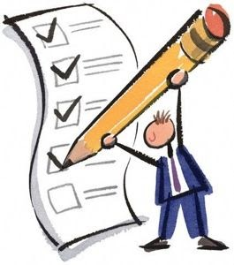
Now, let’s practice documentation…

